Slide 1

Alzheimer’s Disease

Slide 2
Dementia
"dementia" is not itself a disease but a broad term specifying a range of symptoms found in multiple diseases like AD, Parkinson's disease, fronto-termporal dementia, and several other disorders.

Slide 3
What is dementia? As the National Institute on Aging (2017) defines it,
AD is a form of dementia. "Dementia is the loss of cognitive functioning—thinking, remembering, and reasoning—and behavioral abilities to such an extent that it interferes with a person's daily life and activities.
These functions include memory, language skills, visual perception, problem solving, self-management, and the ability to focus and pay attention.
Some people with dementia cannot control their emotions, and their personalities may change"

Slide 4
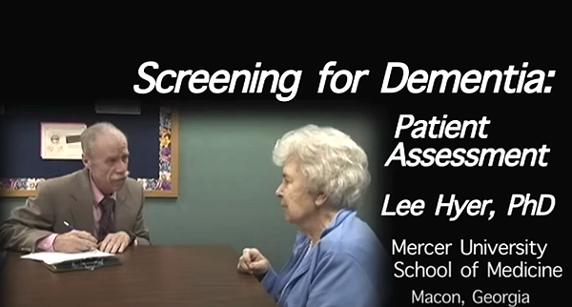
Screening for Dementia
Here is the link to a YouTube video
  https://www.youtube.com/watch?v=_hRBPrfDQVI
This is an excerpt on "Patient Assessment" from the movie, Screening for Dementia. Produced by the University of Georgia's Dr. Leonard W. Poon, video by Alan Stecker of ASV Productions, and filmed at Mercer University's School of Medicine.

Slide 5
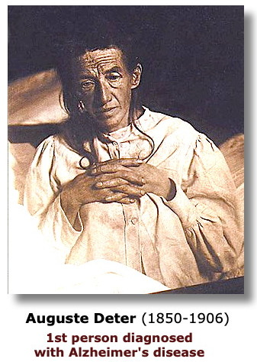
Discovery of Alzheimer’s Disease
The disorder was first identified and diagnosed by the German psychiatrist and neuropathologist, Dr. Alois Alzheimer (1864-1915) in 1906. A patient in the Frankfurt psychiatric asylum, Frau Auguste Deter, who showed significant behavioral symptoms including memory loss. When she died in 1906, Alzheimer analyzed her brain tissue after autopsy and discovered the characteristic presence of amyloid plaques and neurofibrillary tangles of tau (discussed below).

Slide 6
Alzheimer specifically
AD is a progressive disorder which initially involves minor forgetfulness. Over the course of about 8 to 10 years following diagnosis, AD patients experience increasing symptoms including severe memory loss, confusion, depression, hallucinations, delusions, restlessness, sleeplessness, and loss of appetite. Eventually, the disease will lead to death.

Slide 7
Early vs. Late Onset AD
AD which develops among people over the age of 65 is described as "late onset" AD [LOAD]. This occurs in more than 90% of cases of AD.
However, about 5% of AD occurs among people aged 30 to 65 and this is called "early onset" AD [EOAD].
This form of the disease [EOAD] appears to be strongly related to the presence of one of three specific genetic variants on chromosomes 1, 14, and 21 and other genetic risks.

Slide 8
Prevalence and Incidence of AD. What is the rate of Alzheimer’s disease in the United States?
Mendez (2019) reports that among those who are 45 to 64 years old, early-onset AD [EOAD] is diagnosed each year at a rate of about 6.3 per 100,000 with an overall prevalence of 24.2 per 100,000.
Thus, EOAD is actually a fairly rare (though fatal) disorder. Note that people with EOAD tend to die more quickly than in late-onset AD (LOAD) which is why the prevalence rate remains steady.

Slide 9
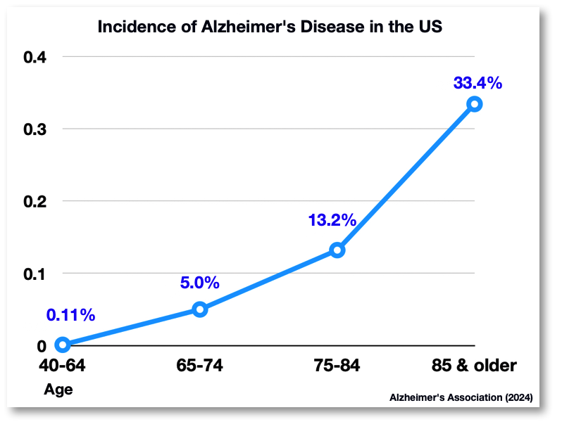
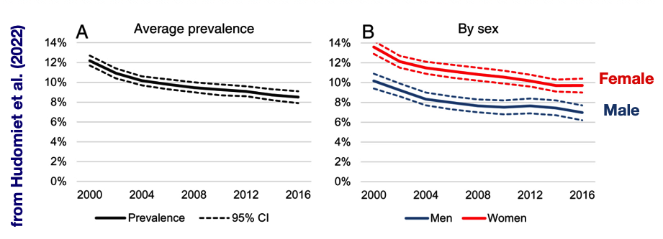
The overall prevalence rate among those who are over the age of 65 in the United States is approximately 9.5%.
The rate of AD rises each decade after age 65. So, while the estimate of those with EOAD was between 0.11% (in 2024) and 0.24% (in 2019), recent data show that late-onset Alzheimer's disease (LOAD) is present in 5% of those aged 65-75, 13.2% of those 75-84 years old, and 33.4% in those over the age of 85.
Women are more likely to develop AD than men as seen in section B of the chart below.

Slide 10
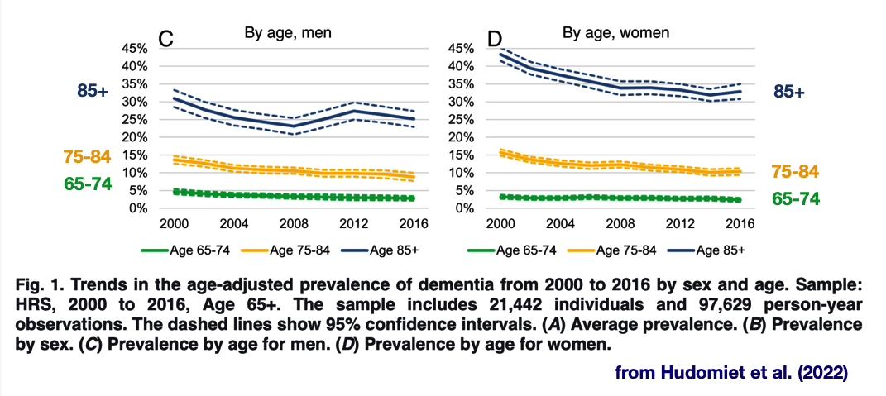
Changing Trends in Prevalence (1)

Slide 11
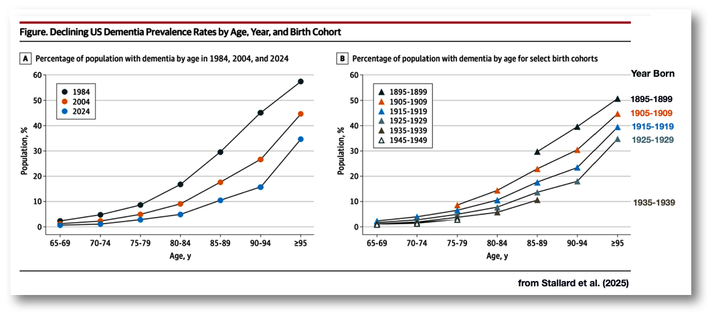
Changing Trends in Prevalence (2)

Slide 12

Twin studies indicate that "the risk of Alzheimer’s disease is 60–80% dependent on heritable factors" (Sheltens et al., 2021, p. 1580.)
  APOE gene. The most widely documented risk for the onset of AD in older people is one of 3 variants found in humans of the APOE gene
1. (Apolipoprotein E) which is "involved in making a protein that helps carry cholesterol and other types of fat in the bloodstream.
2. The APOE ε4 allele (variant) is the major known risk-factor gene for late-onset Alzheimer's disease.”
3. The APOE ε3 allele (variant) appears to have no relation to AD development while the APOE ε2 allele is actually protective against the development of AD. These gene variants are found on chromosome 19.

Slide 13
Genetics is not the only risk factor
Building on earlier studies, more recent genome-wide association studies involving over 400,000 individuals with AD and age-matched controls (Jansen et al. 2019) has increased the number of genetic risks to over 40 variants.
These findings also point to what may be a crucial roll for cholesterol and inflammatory processes in the development of AD.
Down's Syndrome: Note that individuals with Down's syndrome ("trisomy 21" = 3 chromosomes 21) often develop AD

Slide 14
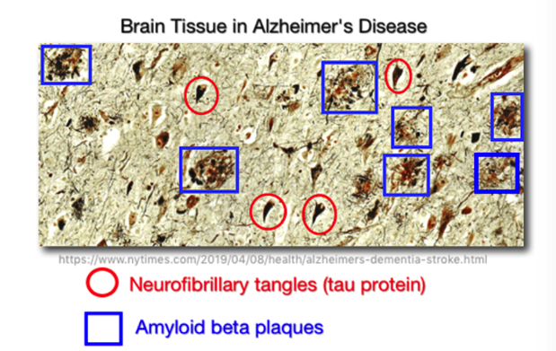
Cellular Pathology in AD
Amyloid plaques: amyloid precursor protein in the brain is incorrectly broken down into amyloid beta protein 42 (usually called A-beta by researchers). This substance accumulates with other amyloid beta proteins and damages the membranes of axons and dendrites as these clumps develop in the space between neurons.
Neurofibrillary tangles: the tau protein within the neuron usually supports the cell's structure, particularly the axon of neurons. However, abnormal forms of the tau protein collect inside the neuron and cause tangles to form within the neural cell.
Many AD researchers believe that the tau protein tangles are not the cause of, but a result of other processes involved in the development of the disease.

Slide 15
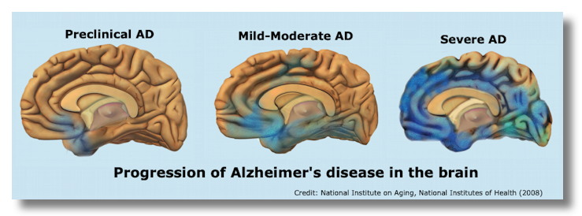
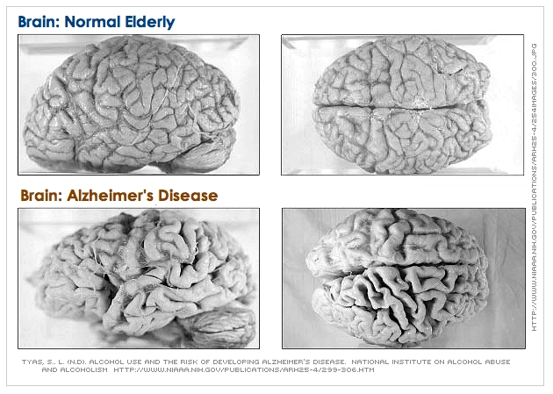
As you see in the figure on the top, the progression of AD in the brain begins usually in the temporal lobe (involving the hippocampus) and the inferior area of the frontal lobe.
As the disease progresses the deterioration begins to spread widely throughout the brain.
After many years (perhaps 10-20), there is a gross deterioration of the brain. See the comparison between a normal elderly brain and one of someone with AD

Slide 16
Co-pathologies
A major problem for researchers is the discovery that many people with a diagnosis of Alzheimer's disease also have a mixture of other degenerative abnormalities in the brain--what is called the "co-pathologies problem" (Couthard & Love, 2018; Robinson et al. 2018).
The mixture of problems such as blood vessel wall pathology, lowered blood flow to brain tissue, and the presence of other pathological proteins (alpha-synuclein & TDP-43 [i.e., TAR DNA-binding protein 43 which contributes to frontotemporal dementia & ALS/Lou Gehrig's disease]) all make it difficult to understand the sequencing of what factors cause what damage as AD develops.

