Slide 1
Learning Exercise (1)
Take out a piece of paper and a pen or pencil.
Look at the word below and (1) define it and (2) use it in a sentence.
lachrymose

Slide 2
Learning Exercise (2)
With a show of hands, how many people were able to define lachrymose? How many were able to use it in a sentence?
So, what does that word mean?
“lachrymose” =
weeping; tearful; showing sorrow

Slide 3
Learning Exercise (3)
Now on the same piece of paper you just used, I want you to read these two sentences. After you do so, list on that page which of these sentences makes sense:
(A) Maria went to her best friend’s birthday party and had a wonderful time. She left the party feeling very lachrymose.
(B) When Maria heard her best friend had died, she became quite lachrymose

Slide 4
Learning (1)
Learning = any relatively enduring change in behavior due to experience
At first you may not have known what lachrymose meant and could neither define it nor use it in a sentence. I then defined the word for you and asked you to read that definition. If, after reading the meaning of lachrymose, you recognized that sentence B was correct, your behavior changed. You learned something.
When we studied memory, we saw the process of encoding was one of the ways we learn many things. Are there other ways of learning?

Slide 5
Learning (2)
Learning = any relatively enduring change in behavior due to experience
1. Learning through signaling (= classical conditioning)
2. Learning through consequences of behavior (= operant conditioning)
3. Learning by watching (= observational learning)
4. Cognitive/social learning during development by apprentice (ZPD) experiences (Vygotsky)

Slide 6
Conditioning
Conditioning = learning associations between events that occur in any animal’s* environment
What associations have you learned?
Fears of elevators, heights, animals?
Your parents’ facial expressions?
* Many psychologists who study learning talk about ”organisms” learning while I will use the word ”animal” (= humans, dogs, pigeons, etc.)

Slide 7
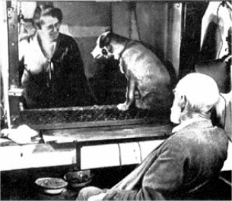
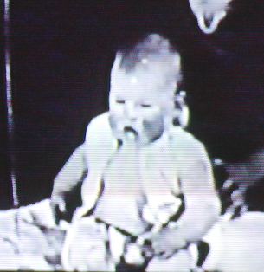
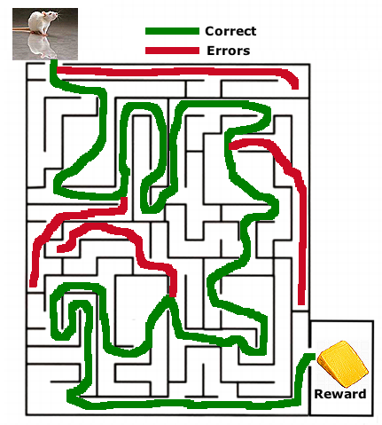
Learning I: Classical Conditioning
Pavlov Watson Thorndike
Pavlov’s Dog
Little Albert
http://axon.bhs.mq.edu.au/PSY104/pavlov.jpg

Slide 8

Signals • Sound
Listen to these sounds
Sound #1
Sound #2
Sound #3
What do people do when they hear these sounds? Why?

Slide 9
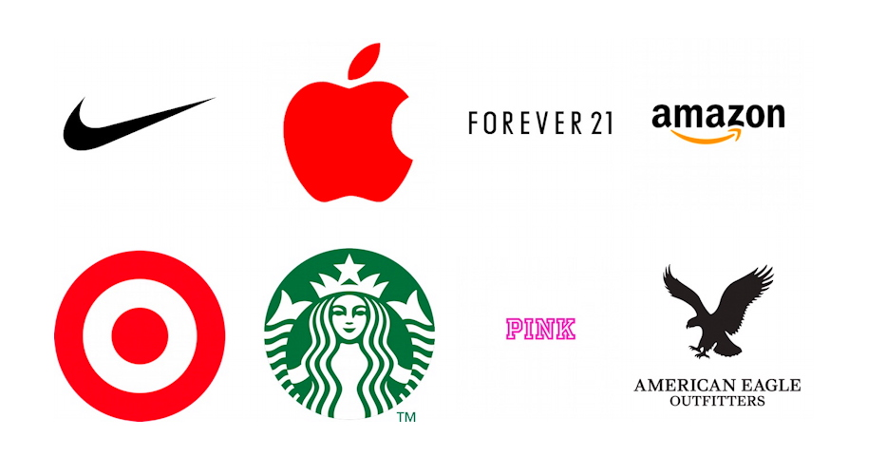
Signals • Sights
When you see each of the images below, what comes to mind or how do they make you feel?

Slide 10
Previously neutral or meaningless sights and sounds can become signals that control or affect our behavior
Why? Because of classical conditioning

Slide 11
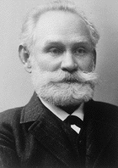
Ivan Petrovich Pavlov
1849-1936 (b. near Moscow)
Animal research using live animals
Early research on animal digestion in which taste of food shown to trigger release of gastric juices
“Psychic reflexes” become focus of work
ttp://www.nobel.se/medicine/laureates/1904/pavlov.gif

Slide 12
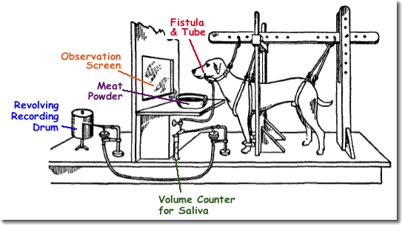
Pavlov’s Research on Conditioning
Animals had small incision in jaw to create a channel (fistula) through which saliva would flow and be collected & measured
Pavlov researched what would happen when he turned on a metronome or a sound (tone) just before he put meat powder in the dog’s bowl
The Office: Conditioning (YouTube)

Slide 13
Conditioning I
An unconditioned stimulus (US or UCS) is a stimulus that produces an unconditioned response (UR or UCR). An unconditioned response is an unlearned reaction to the unconditioned stimulus. Thus, “unconditioned” means pretty much the same as “natural”
Before training
Unconditioned stimulus (UCS [meat powder]) elicits an unconditioned response (UCR [salivation]). This is what Pavlov originally called a “psychic reflex”
Neutral stimulus (e.g., tone) does not trigger salivation
UCS
UCR
No response
After training
Pair a neutral stimulus such as a tone with the UCS a number of times. The neutral stimulus goes before the UCS in the training
+

Slide 14
Conditioning II
The neutral stimulus now elicits salivation. It’s become a conditioned stimulus (CS) and the salivation is now a conditioned response (CR)
Signaling: Tone signals expectation that food will appear
After training
CS
CR
A conditioned stimulus (CS) is a previously neutral stimulus that has, through conditioning, acquired the ability to evoke a conditioned response (CR). The CR is a learned reaction to a CS that occurs because of previous conditioning. Thus, “conditioned” pretty much means the same as “learned.” When you experience the CS, you can better predict what will happen.

Slide 15
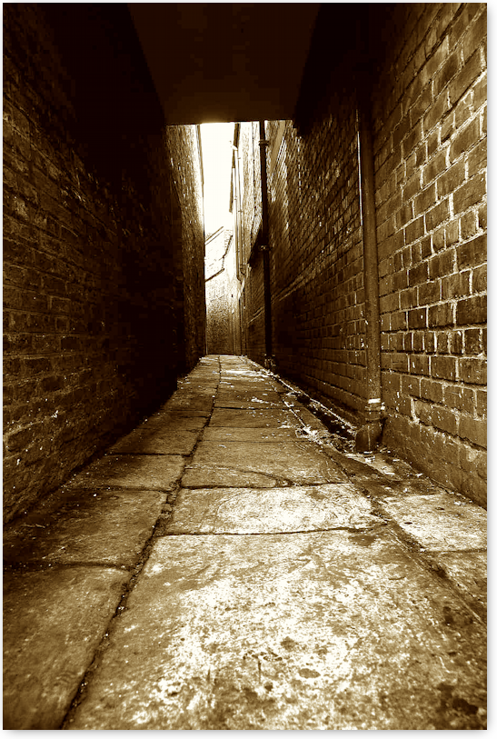
Examples of Conditioning
In a horror movie, there is the sound of a squeaking door. What’s up?
Your mother says nothing but closes her lips and frowns. What do you do?
Suppose you are walking along a street and look down the alleyway on the right. You see someone urging you to come closer to see something. What do you do?
How about other phobias?

Slide 16
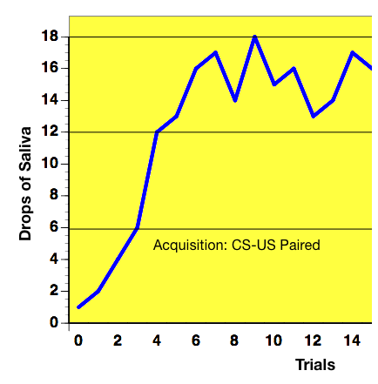
Conditioning I: Basic Processes
Acquisition: to acquire a new conditioned response
The pairings must be done closely in time = stimulus contiguity
The neutral stimulus needs to be novel or at least an intensive stimulus which is distinctive

Slide 17
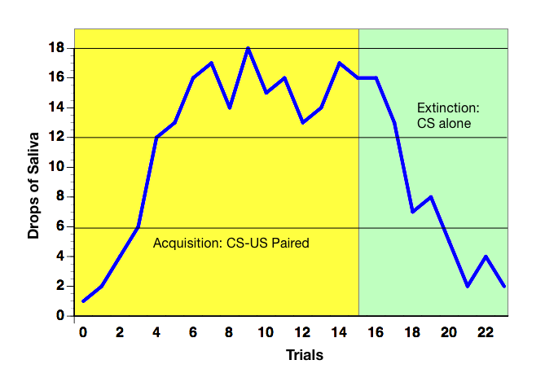
Conditioning II: Basic Processes
Extinction
After repeated presentations of CS, the CR gradually dies. This might be called the “Chicken Little” effect
What happens? The signal no longer predicts what will happen

Slide 18
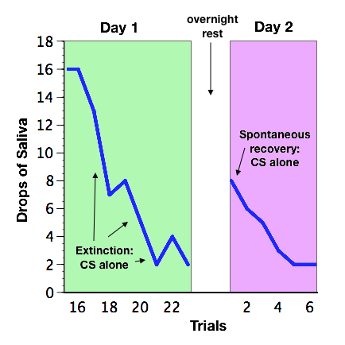
Conditioning III: Basic Processes
Spontaneous Recovery
If animal rests after extinction of CR, it tends reappears again

Slide 19
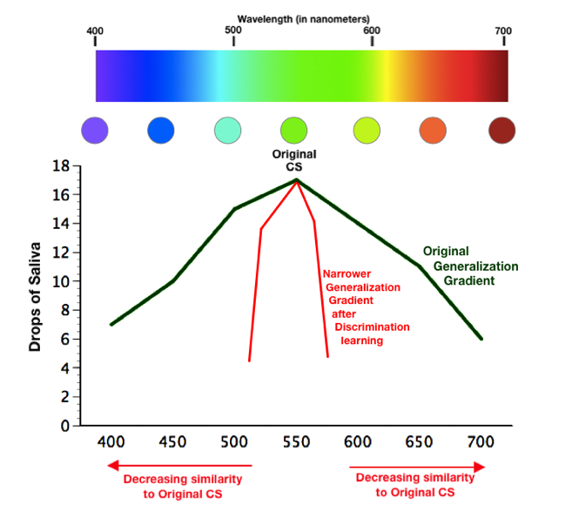
Conditioning IV: Basic Processes
Stimulus Generalization
Animal will often respond to stimuli which are similar to CS
Discrimination
Animals can learn to respond only to certain stimuli and not to others that are like it

Slide 20
Conditioning V: Basic Processes
Higher-Order Conditioning
A second CS can be paired with a first CS and serve to cause a CR (red light -> tone -> food => salivation)
A third CS cannot be paired to a second CS

Slide 21
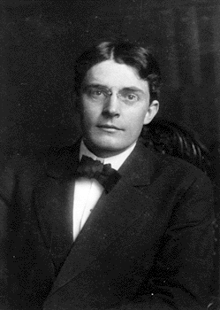
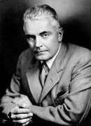
John Broadus Watson
1878-1958
Taught 1909-1921 at Johns Hopkins University
Phipps Psychiatric Clinic (late 1910s)
Fear, rage, & love are basic emotions from which all other emotions arise by conditioning
Conditioning of Little Albert (see next slide)
1921 Fired from Hopkins due to affair with student, Rosalie Rayner, whom he married
Worked at J. Walter Thompson advertising agency & applied psychology to marketing issues
http://www.uta.edu/psychology/faculty/ickes/social_lab/ancestry/watson.jpg
http://www.jhu.edu/~gazette/2001/jan2201/images/22page4.gif

Slide 22
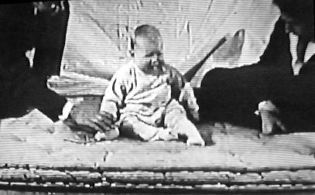
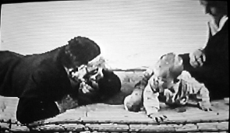
What ever happened to Little Albert? (Watson & Rayner, 1920)
Albert B. @ 9 months only afraid of loud noises; not of animals
@ 11 months: white rat + sound of loud bar being struck (2x)
1 wk. later: repeated 5x: Albert shows fear response to rat
5 days later: fear response to rabbit, dog, seal fur coat, Santa Claus mask (stimulus generalization)
About two weeks later, Albert left hospital. Never seen again
Watson believed this was proof that fears in later life were caused by processes of conditioning
Unethical experiment
Raynor
Watson
YouTube Video

Slide 23
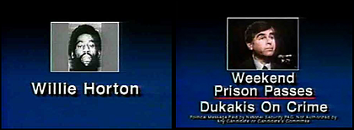
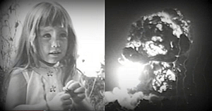
More on Classical Conditioning in Everyday Life: Affecting Attitudes
• Business
Promoting Sales
Promoting Self
Politics
Positive Associations
Negative Associations
Willie Horton Ad (1988) • GW Bush (R) against M Dukakis (D)
“Daisy” Ad (1964) • L B Johnson (D) against Barry Goldwater (R)

Slide 24
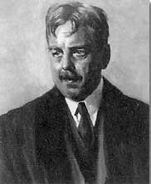
Edward L. Thorndike
1874-1949
Professor at Teachers’ College NYC
Early work on animal learning
Cats use trial & error to escape puzzles boxes
Animals learn when they are rewarded
= Law of Effect: success strengthens the bond between a stimulus & a response (Instrumental Conditioning
Human learning processes
Rejected notion that general learning exercises the mind
Transfer of training is limited = suggests need for more focused learning

