Slide 1
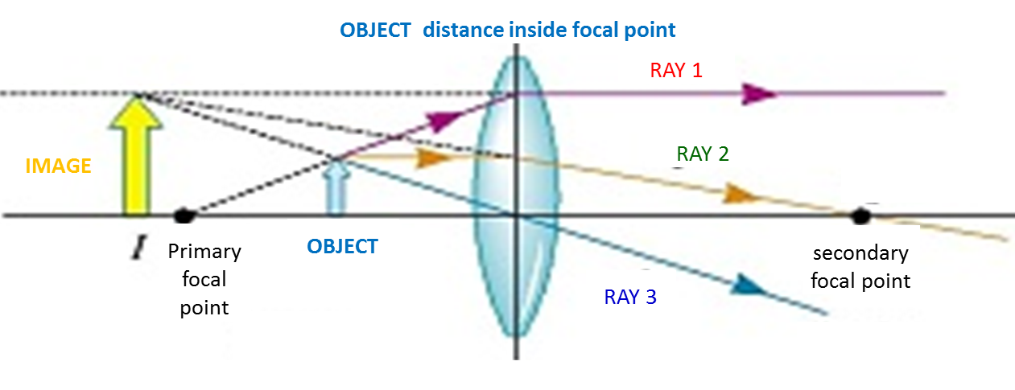
Converging (convex) lens
OBJECT distance outside focal point
Focal
length, f
RAY 2
OBJECT
Secondary focal point
RAY 3
Principal axis
Primary focal point
IMAGE
RAY 1
Object distance, d_{o}
Image distance, d_{i}
Assume each box is 10mm left-to-right and 10mm top-to-bottom
Fill in the table for Activity 4 by actually collecting data, then answer the questions for Activity 4.

Slide 2
Diverging (Concave) lens – image forms on the same side of the lens as the object also PRE-LAB #9
Focal
length, f
_{(negative)}
RAY 2
OBJECT
RAY 1
Principal axis
IMAGE
Primary
focal point
Secondary focal point
Image
distance, d_{i}
RAY 1
RAY 2
Object distance, d_{o}
RAY 3

Slide 3
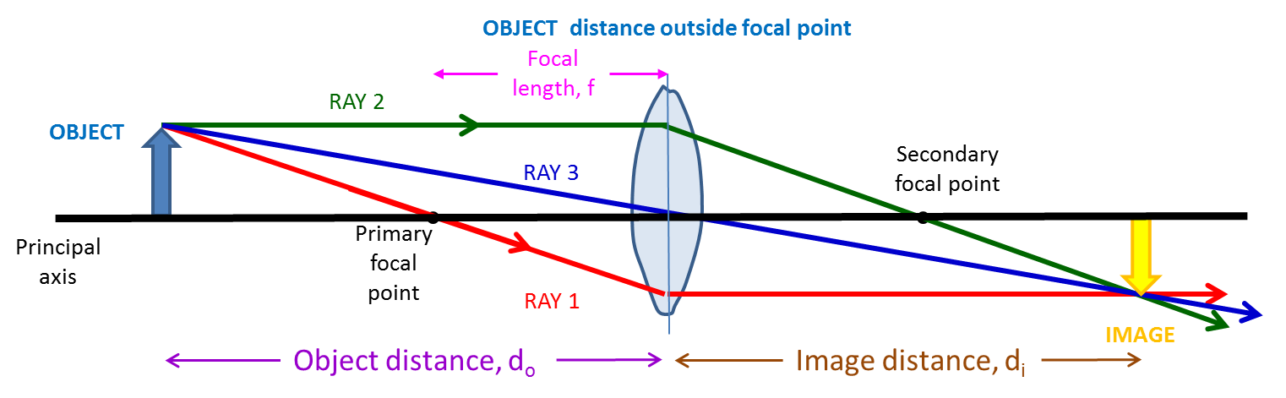
Activity 5 and 6
Convex Lens ONLY
Activity 5 and 6
d_{o}, d_{i}, f for the convex lens are positive
d_{o} < 0 for the concave lens
d_{i} is positive for the concave lens
Focal length, f will be negative for the concave lens
Activity 6 – Two lenses
d_{o} = -100mm for all trials (concave lens)
h_{o} = height of convex image (negative)
d_{i} is positive for concave lens
h_{i} = height of final image (negative)
Focal length of concave lens, f will be negative
Convex and Concave Lens together
Object distance for Concave Lens, d_{o}
Virtual OBJECT for Concave lens
RAY 1
In Activity 6 the
screen is moved to here after the concave lens is inserted
RAY 3
Principal axis
Primary focal point
FINAL IMAGE
RAY 1
Image distance for
concave lens, d_{i}
RAY 3
Assume each box is 10mm left-to-right and 10mm top-to-bottom

Slide 4
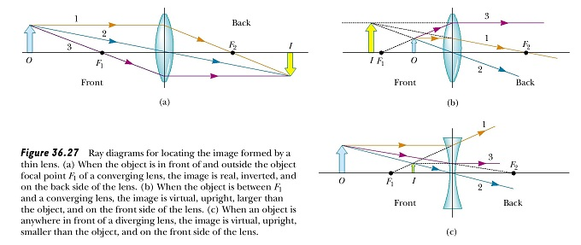
Converging Lens – focal length, f > 0
object distance, d_{o} (positive means left side of lens, negative means right side ) | Image distance, d_{i} (positive means opposite side than object, negative means same side as object) | Type of image | orientation | Magnification , M = - d_{i} / d_{o}= h_{i} / h_{o} (M is positive for upright image, negative for inverted image, height is positive if upright, negative if inverted)
> 2f | < 2f, positive | real | inverted | negative, |M | < 1
2f | 2f, positive | real | inverted | M = -1
2f > d_{o} > f | > 2f, positive | real | inverted | negative, |M | > 1
f | none | - | - | -
< f | d_{i} < 0, negative | virtual | upright | positive, M > 1
2
1
right
3
image
2
1
object
image
object
3
left
left
right
1 1 1
--- = ---- + ---
f d_{o} d_{i}

Slide 5
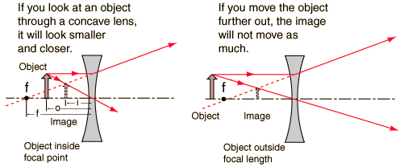
Diverging, concave lens – focal length, f < 0
object distance, d_{o} (positive means left side of lens, negative means right side ) | Image distance, d_{i} (sign is the negative of the object distance sign) | Type of image | orientation | Magnification , M = - d_{i} / d_{o}= h_{i} / h_{o} (M is positive for upright image, negative for inverted image, height is positive if upright, negative if inverted)
If d_{o} > 0 then | d_{i} < 0 | virtual | upright | positive, |M | < 1
If d_{o} < 0 then | d_{i} > 0 | Virtual | Upright | positive
2
2
3
3

Slide 6
PRE-LAB #6 - Diverging (Concave) lens –object inside focal length
Focal
length, f
_{(negative)}
RAY 2
OBJECT
RAY 1
Principal axis
IMAGE
Primary
focal point
Secondary focal point
Image
distance d_{i}
RAY 1
RAY 2
Object distance, d_{o}
RAY 3

Slide 7
Pre-Lab #7,8 – Converging Lens with Object on Right
RAY 2
Secondary focal point
RAY 3
Principal axis
IMAGE
Primary focal point
OBJECT
RAY 1
Focal
length, f
Image distance, d_{i}
Object distance, d_{o}

Slide 10
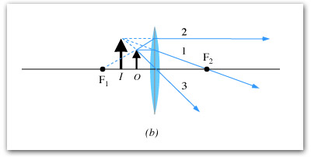
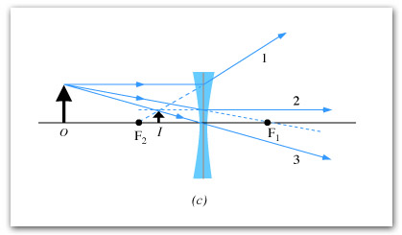

Slide 11
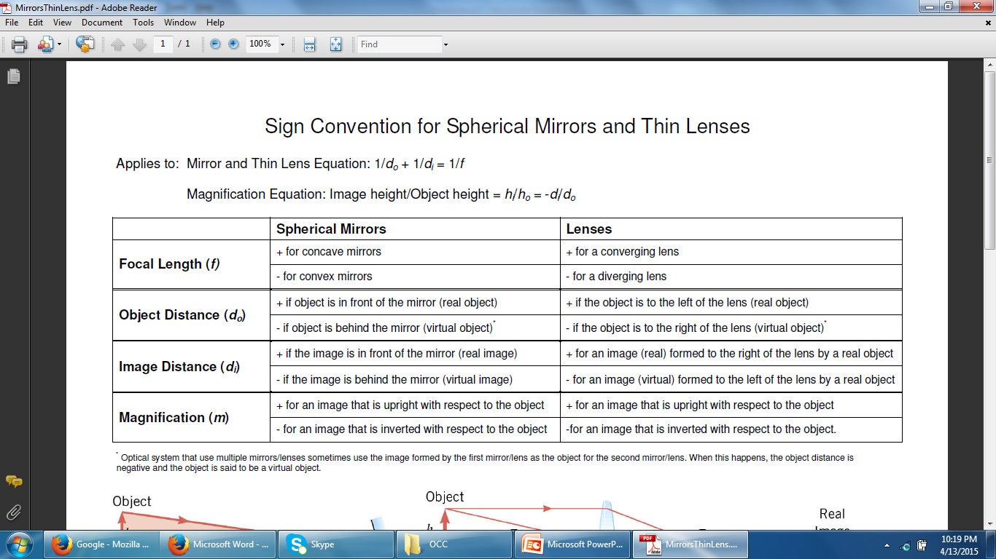

Slide 13
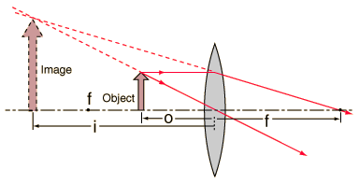
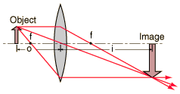

Slide 14
Converging (convex) lens
RAY 2
OBJECT
Secondary focal point
RAY 3
Principal axis
Primary focal point
RAY 1
IMAGE
OBJECT distance inside focal point
RAY 1
IMAGE
RAY 2
Primary focal point
OBJECT
secondary focal point
RAY 3

