Slide 1
Initial Capstone Presentation
Elisa Hoffmann

Slide 2
Table of contents
01
02
03
04
05
06
Project Summary
Project Outline
Objectives & Report Outline
Status Report
To be done
Goal
What has been done and what needs to be done
Plan of attack and timeline

Slide 3
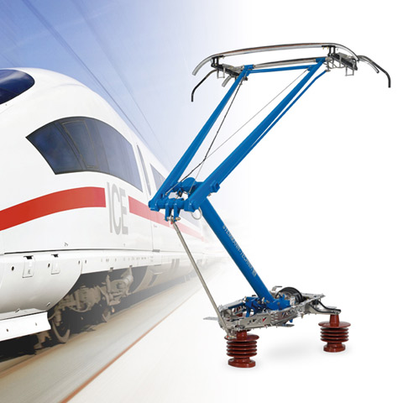
Project Summary
This project aims to explore the design of the pantograph, part of the pantograph-catenary system (PCS), or overhead contact system (OCS) used for high-speed passenger rail using CAD and 3D Printing.
Notes:
https://www.wabteccorp.com/sites/default/files/2020-07/Wabtec-Transit-Rail-Power-Collection-Pantographs-480x480.jpg

Slide 4
Project Outline
Background
Understanding and explaining the importance of well-engineered pantograph design
Design
Exploring and creating a working pantograph design using CAD software
Product
Successfully 3D printing a pantograph model

Slide 5
Objectives & Report Outline
Objectives
01
02
03
- Design and 3D print a pantograph model
- Complement the Honors Thesis (and vice versa)
- Encourage more widespread knowledge of the PCS, its design, and its advantages
History and Uses
Physics Behind the Design
CAD Modeling
Giving a reason for the project
What is the process behind the CAD?
What goes into it?
Final Product

Slide 6
Status Report/To Be Done Summary
Background
Honors Thesis Research has provided ample information and references
Design
DOT Internship has provided skills needed to work with CAD software
Actual CAD design still needs to be done
Product
Production using 3D printers in Keenan Center to be done after design completed

Slide 7
To Be Done– Plan of Attack & Timeline
Task | Description | Date | J | A | S | O | N | D | Status
Research | What is the history behind PCSs? | July 1-Aug 15 |  |  |  |  |  |  | Completed
Writing/ Research | Starting design research | Aug 15- Sep 15 |  |  |  |  |  |  | In Progress
Design | Working with CAD to design | Sep 15 - Oct 15 |  |  |  |  |  |  | In Progress
Printing | Design to print | Oct 15 - Nov 15 |  |  |  |  |  |  | Unstarted
Final Tune Up | Preparing final writing and presentation | Nov 15-Dec 9 |  |  |  |  |  |  | Unstarted

Slide 8
Goal
- Learn about CAD modeling to 3D printing
- Produce a pantograph model
- If possible– design and print variations of
the model based on research

Slide 9
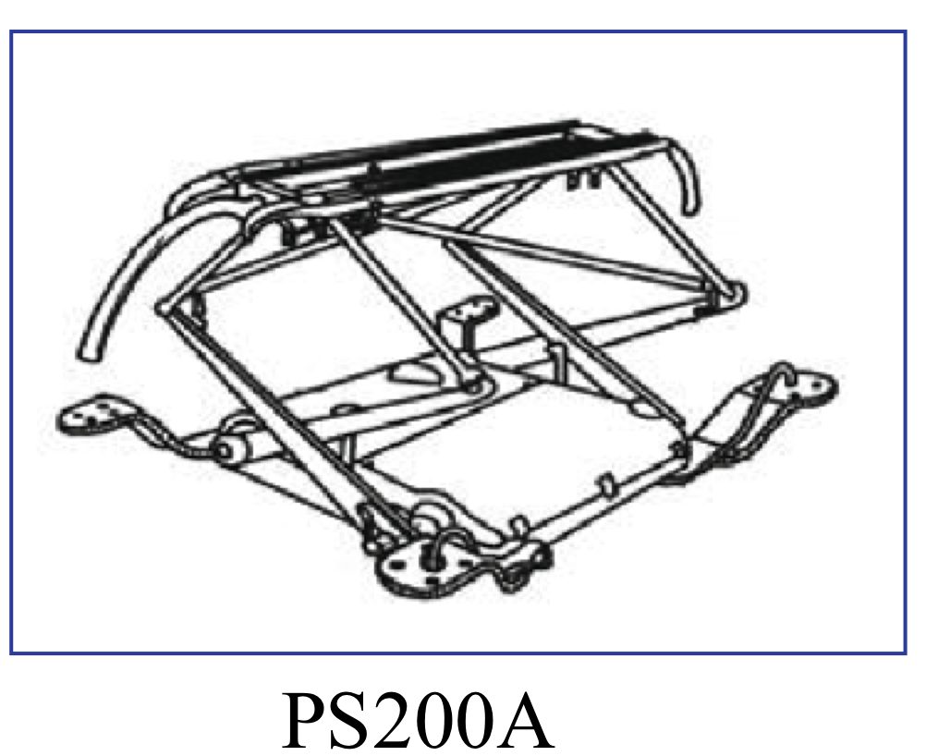
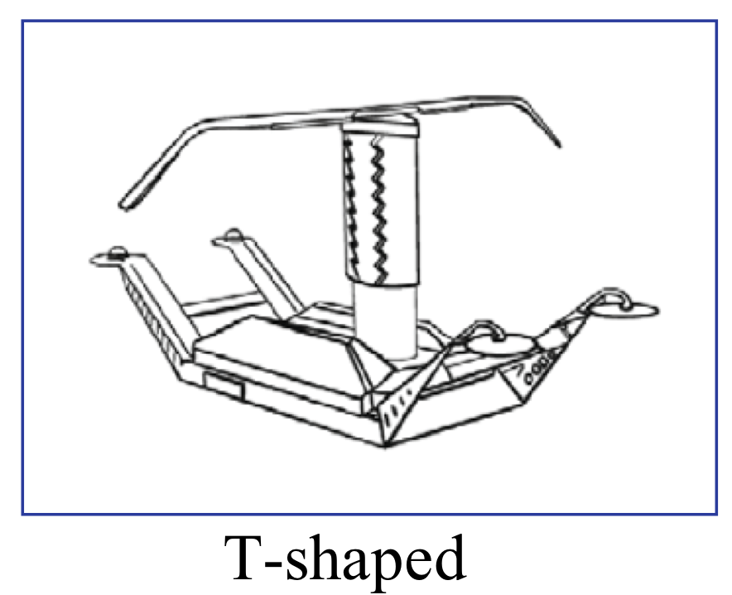
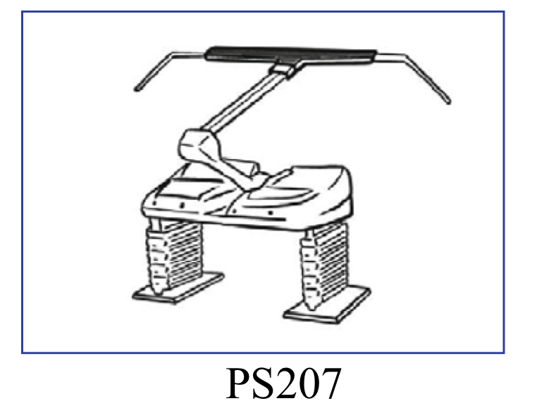
Sample Pantographs
Notes:
G. Wu et al., Railway Engineering Science 30(4), 437 (2022).

Slide 10
Thank You
Questions?

