Slide 1
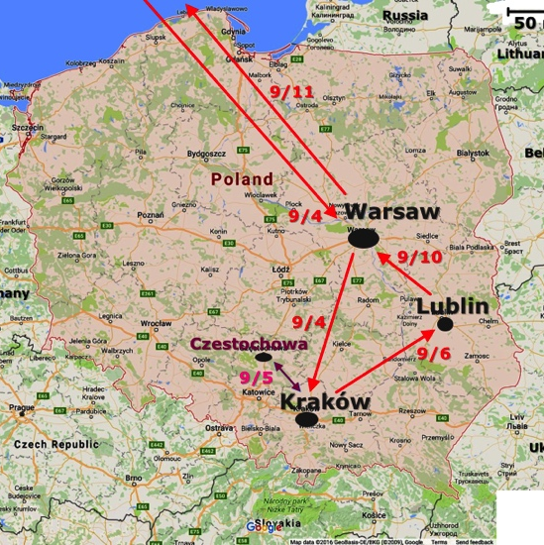
Poland 2016
September 4-11
9th International Conference on the Dialogical Self
Lublin

Slide 2
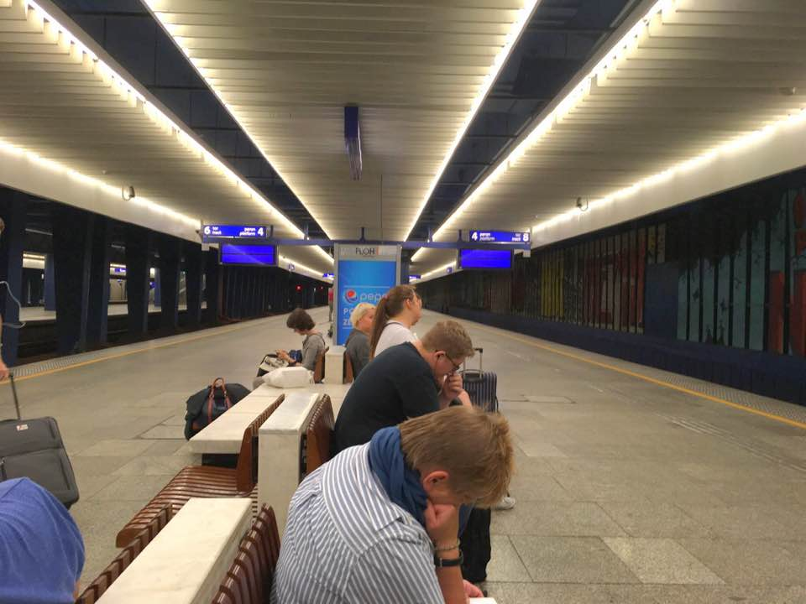
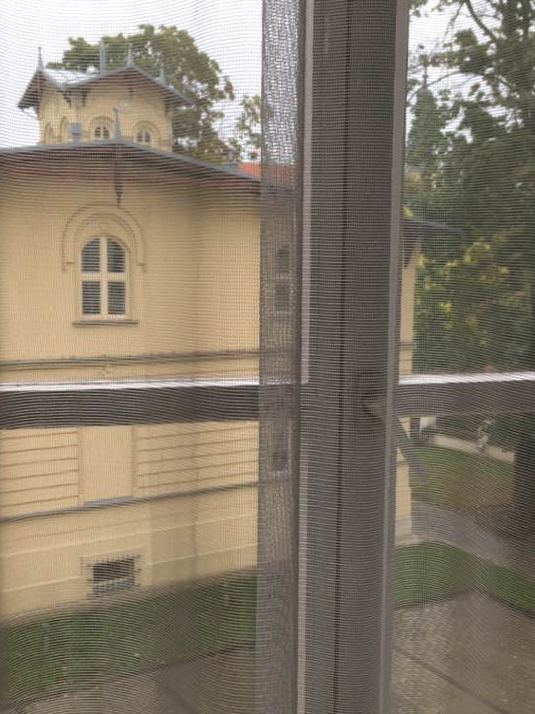
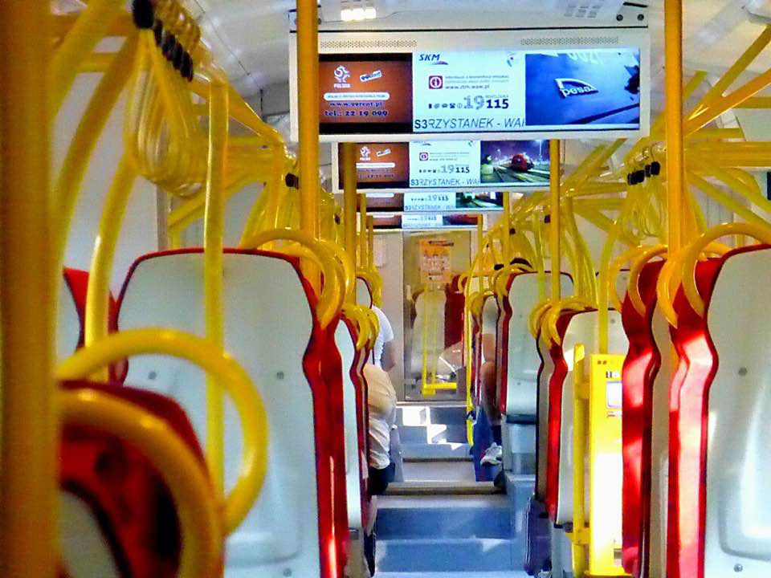

Slide 3
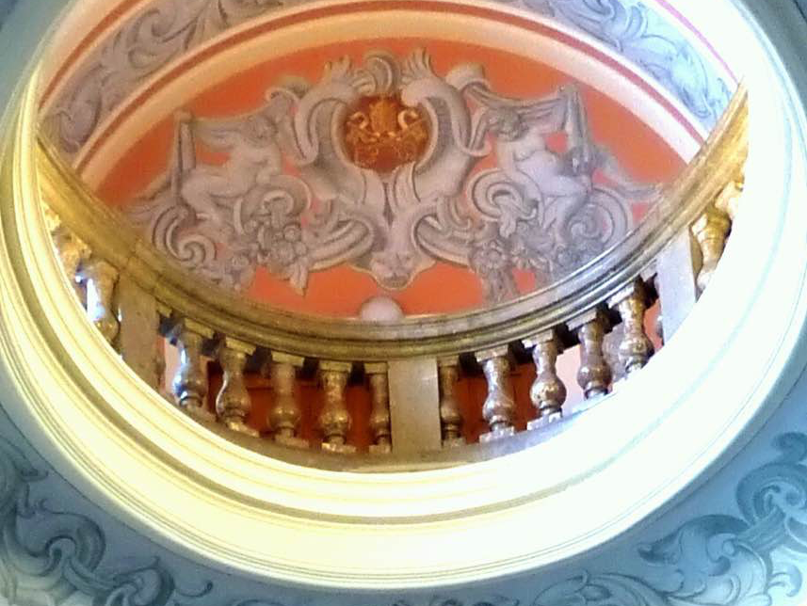
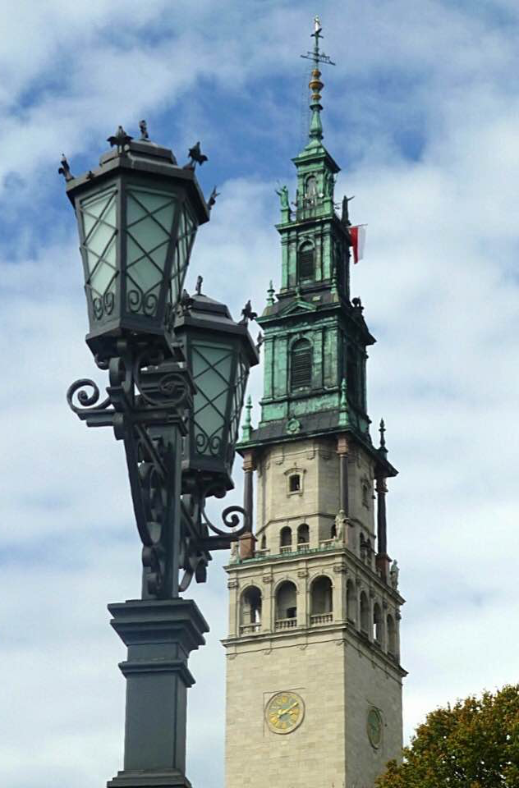
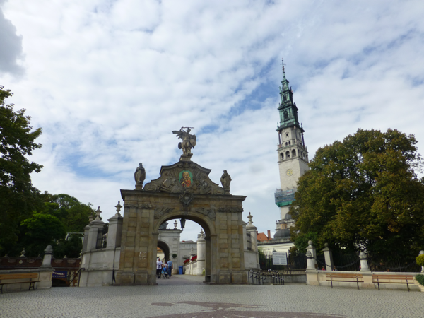
Ceiling of entry to Basilica
Gate to Jasna Gora
Tower of the Monastery of Jasna Gora

Slide 4
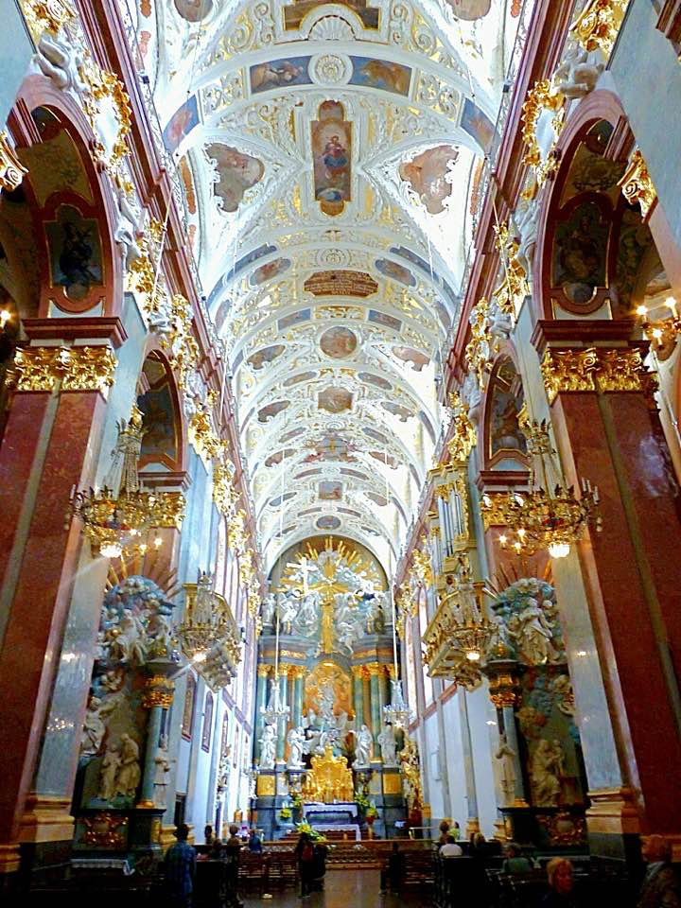
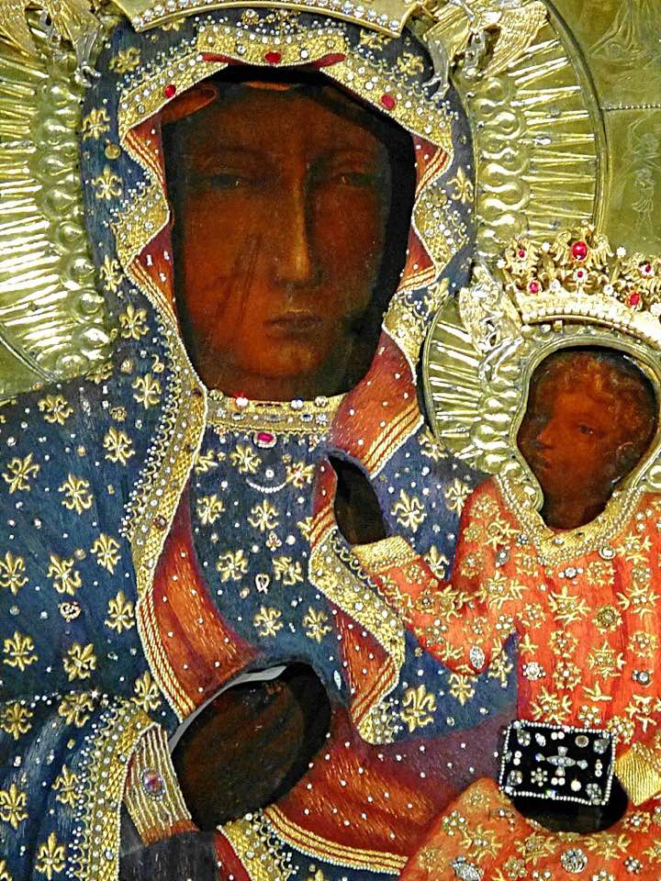
The Basilica at the Monastery of Jasna Góra in Częstochowa.
Our Lady of Czestochowa

Slide 5
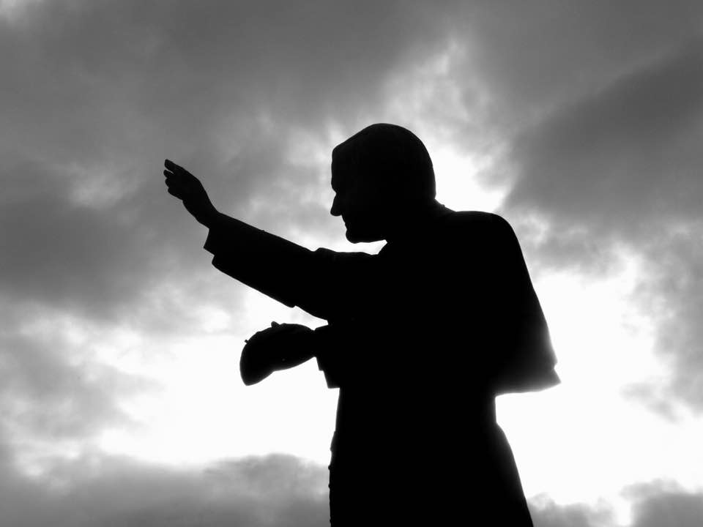
Statue of John Paul II at Jasna Gora, Czestochowa

Slide 6
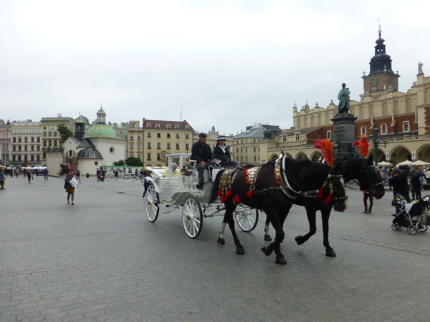
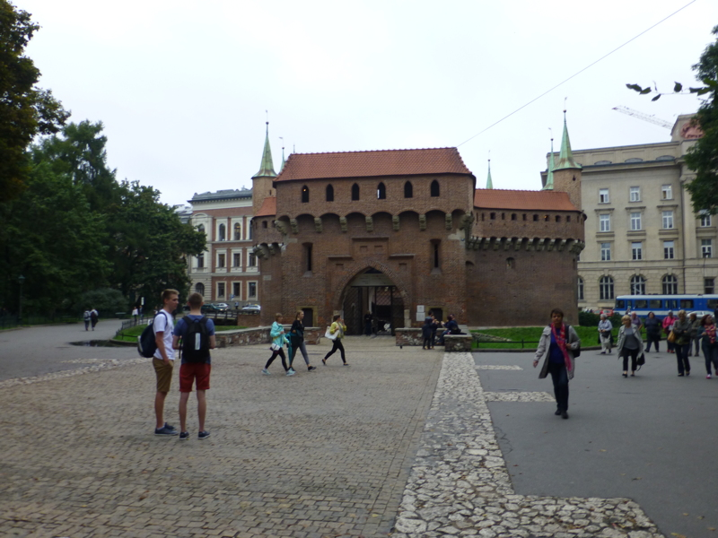
The Rynek (Town Square) of Old Krakow, the largest in Europe
The Barbican – The original gate at the north end of Krakow.

Slide 7
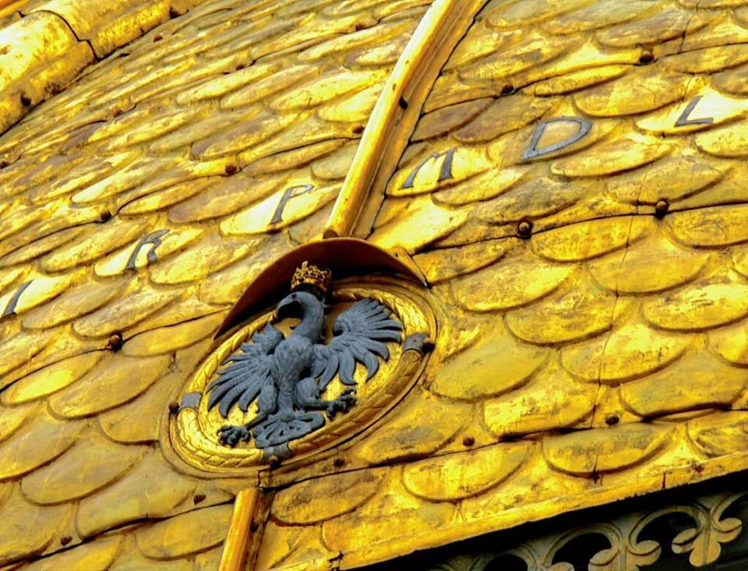
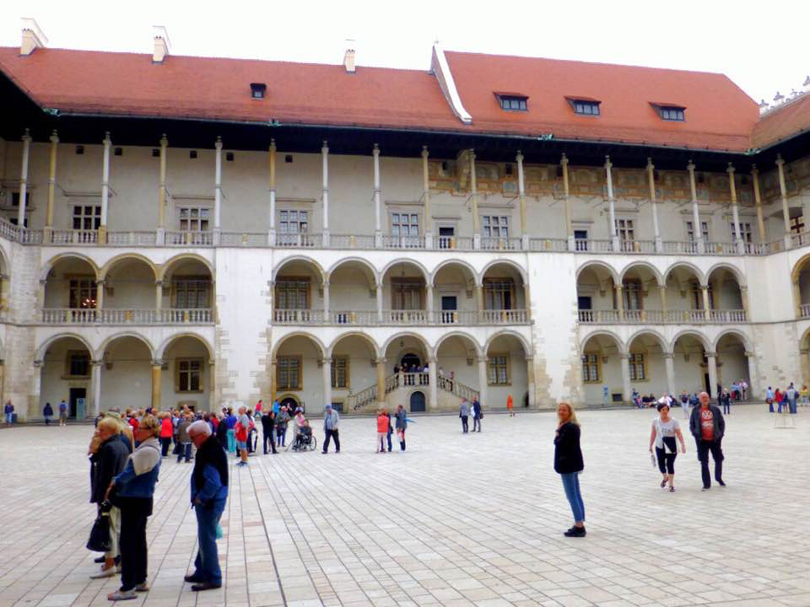
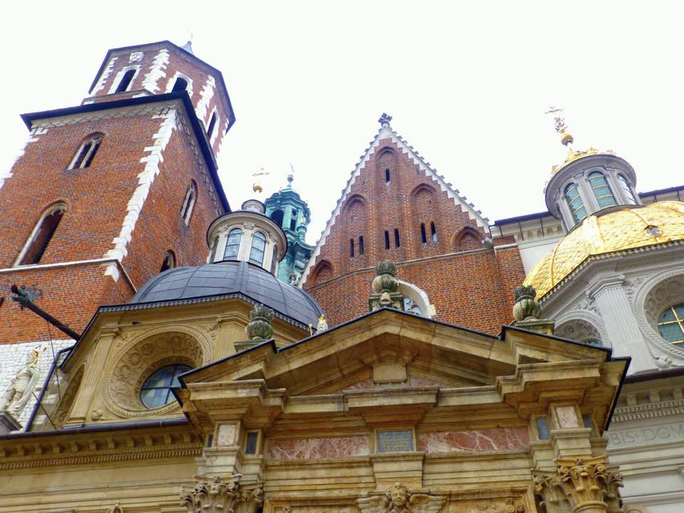
Wawel Castle & Cathedral (Krakow)

Slide 8
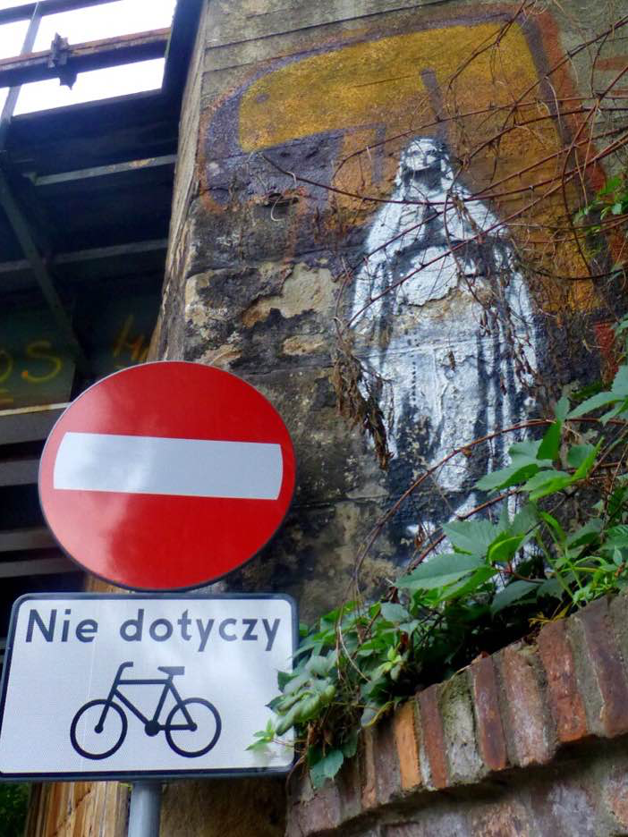
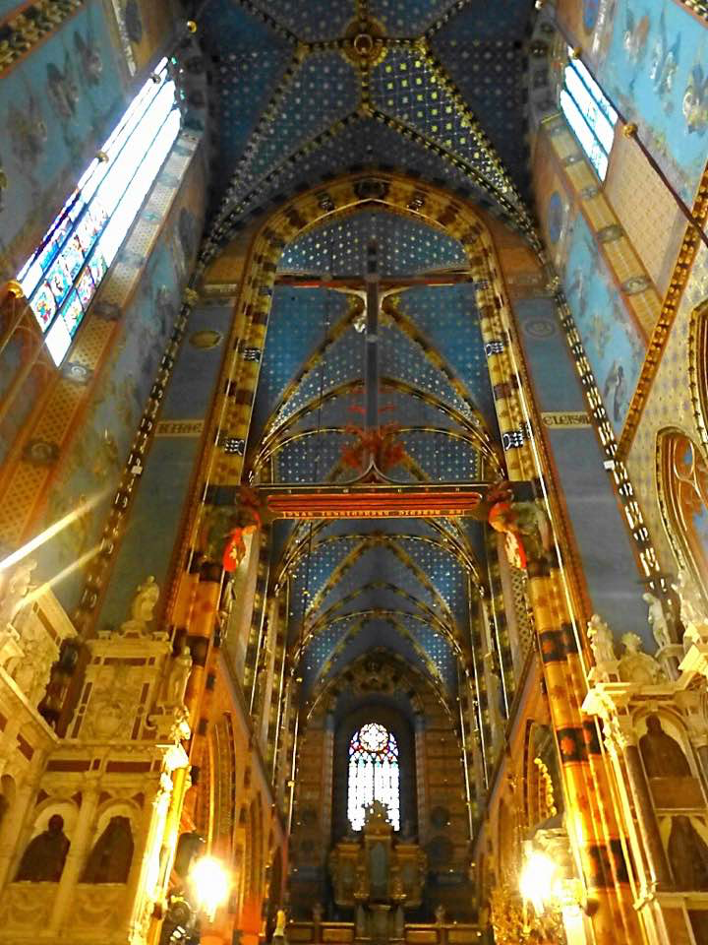
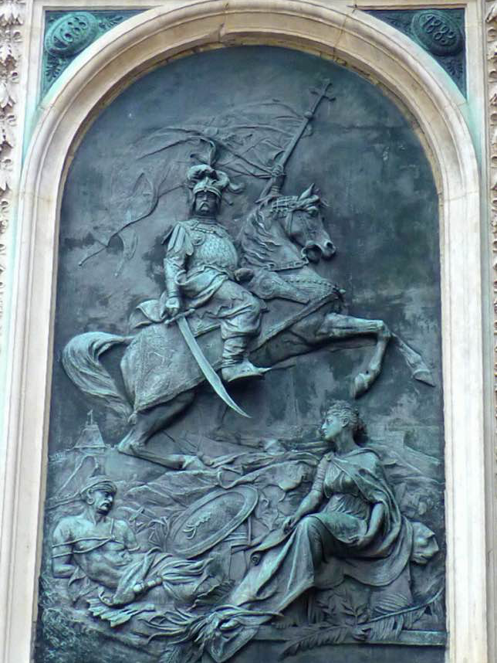
Image of Mary on side of railroad bridge over ul. Kopernika (Copernicus St.) in Krakow
Looking toward the back of the Basilica of St. Mary (Krakow), considerably lightened photo
This bas-relief of King John III Sobieski's victory over the Turks (who lies bound below) is found on the front left exterior wall of the Basilica of St. Mary (Krakow)

Slide 9
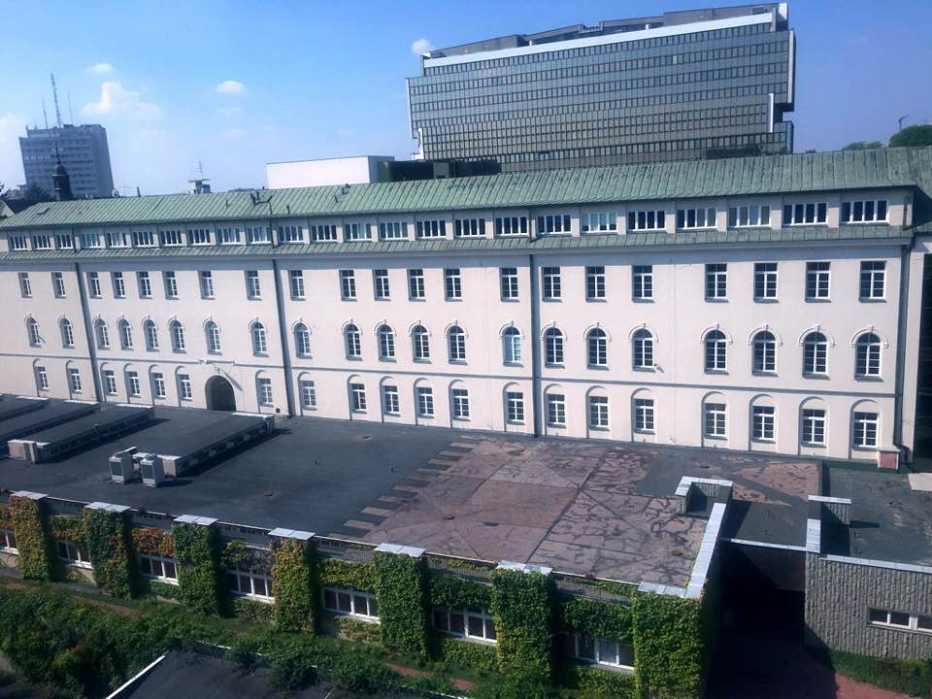
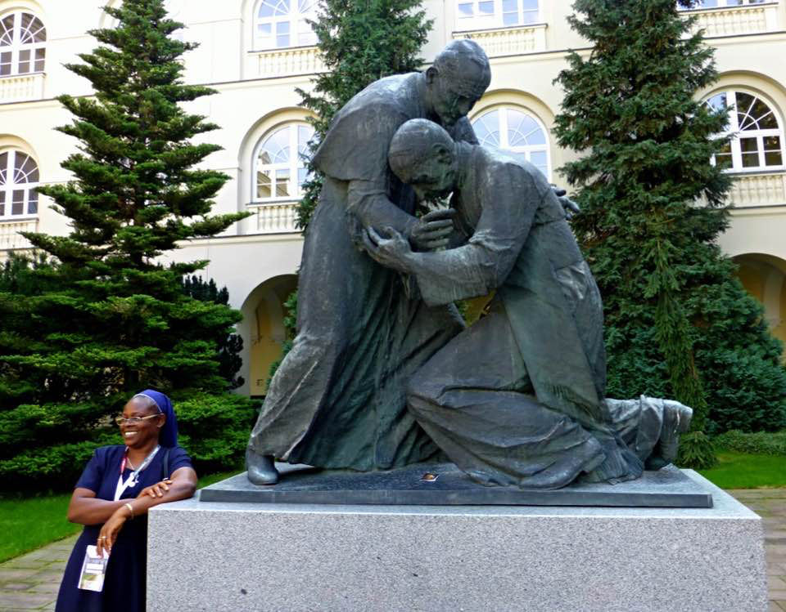
Catholic University of Lublin
Courtyard of the original building at the Catholic University of Lublin, beneath the windows of the classroom in which Karol Wotyła taught in the 1950s and 1960s

Slide 10
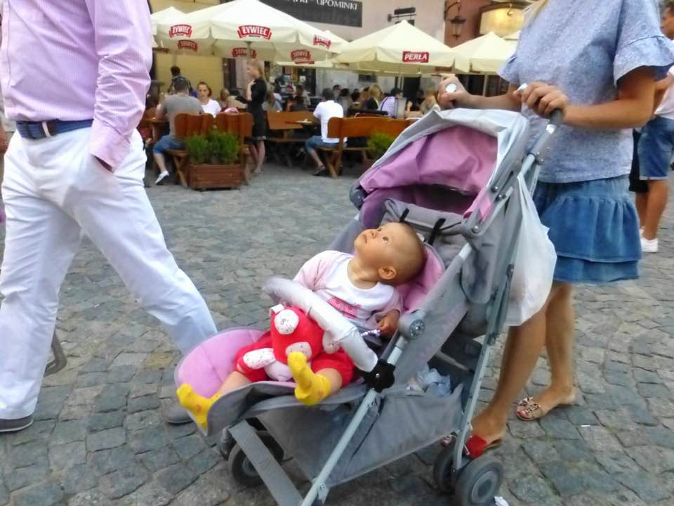
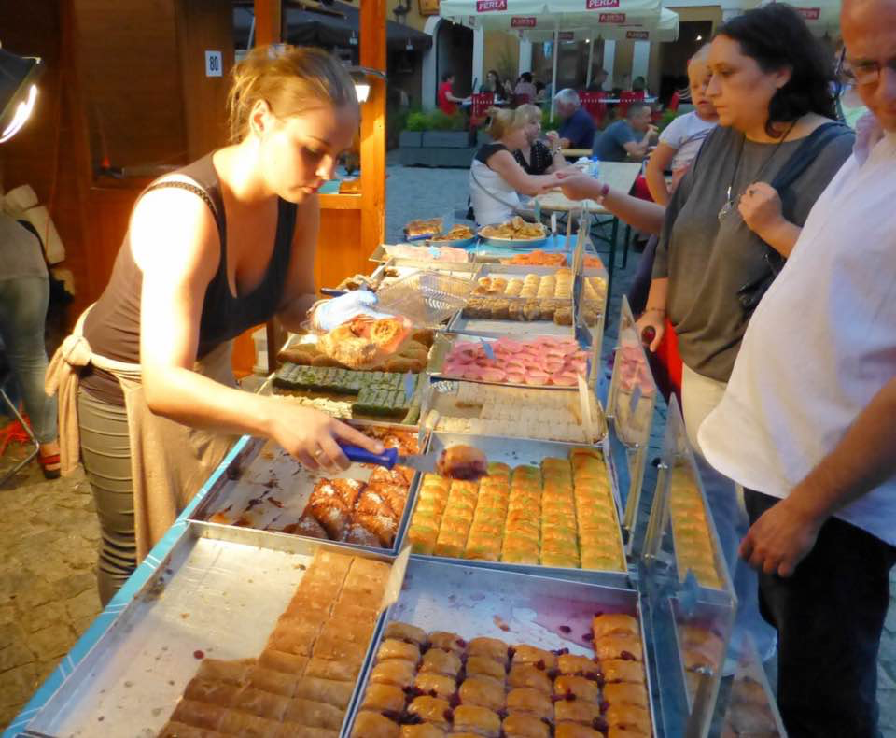
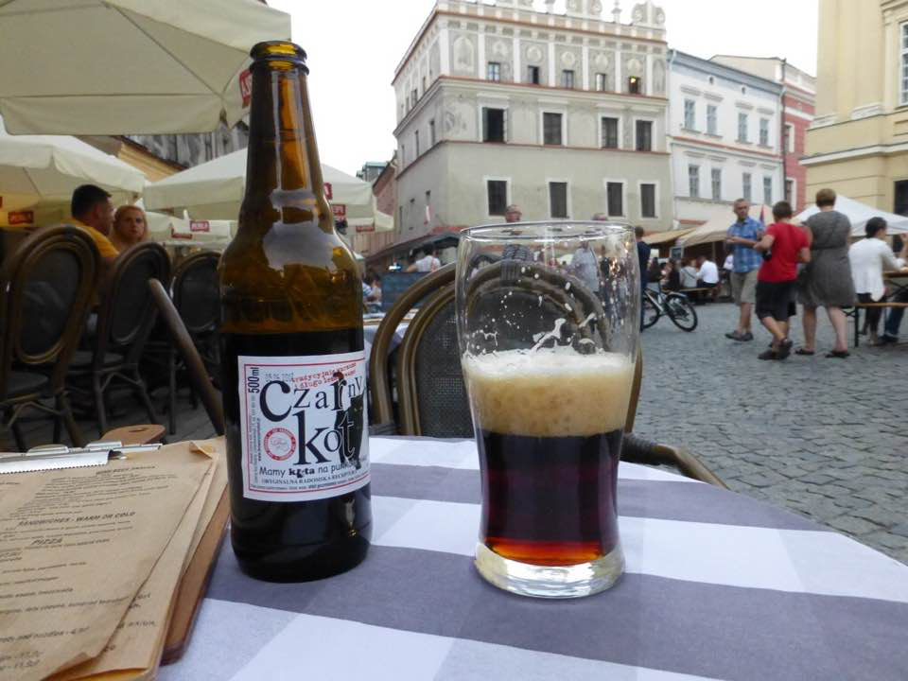
In the Rynek (Town Square) of the Old City in Lublin

Slide 11
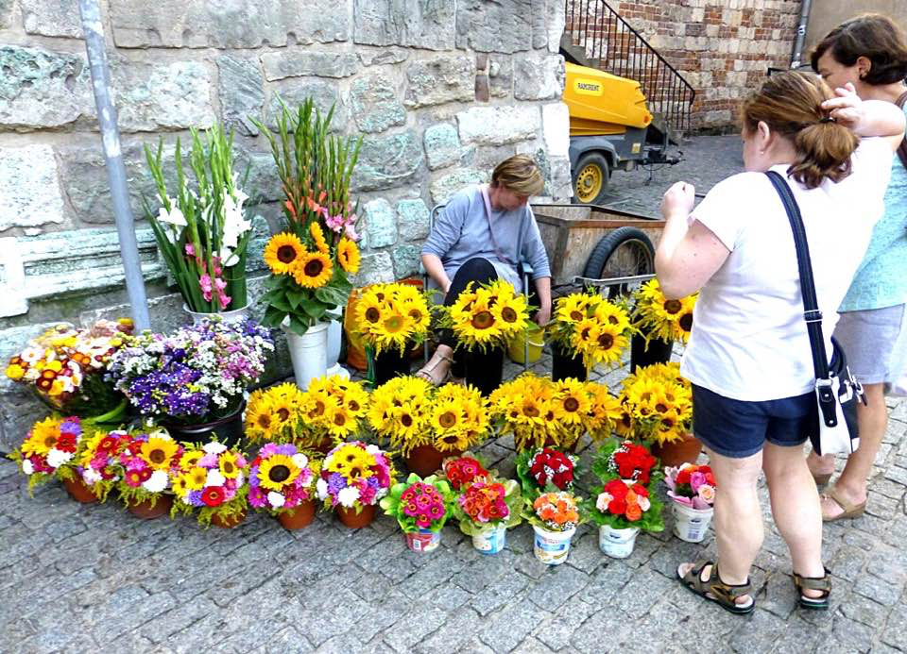
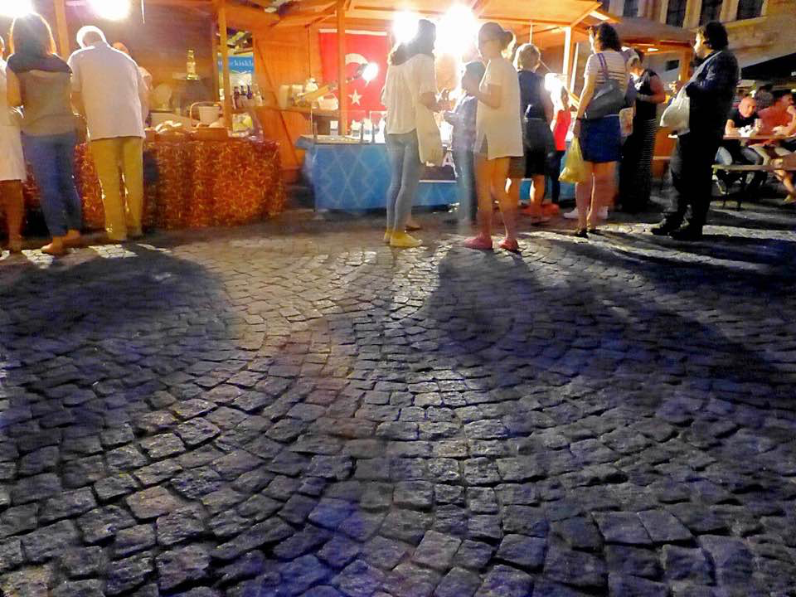
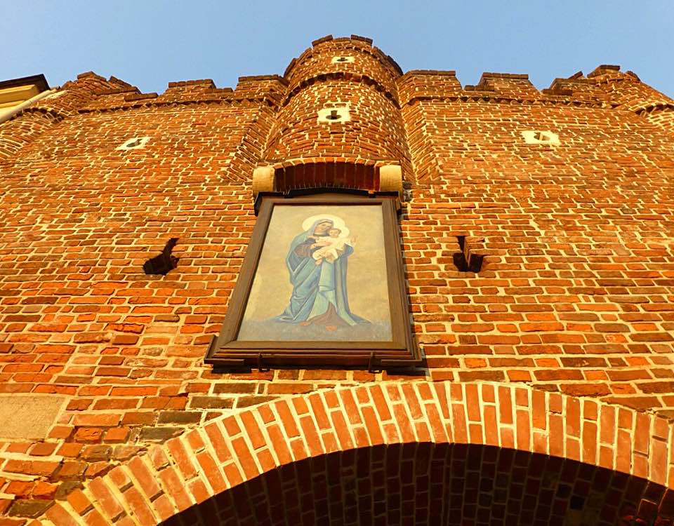
More pictures from the Old City of Lublin

Slide 12
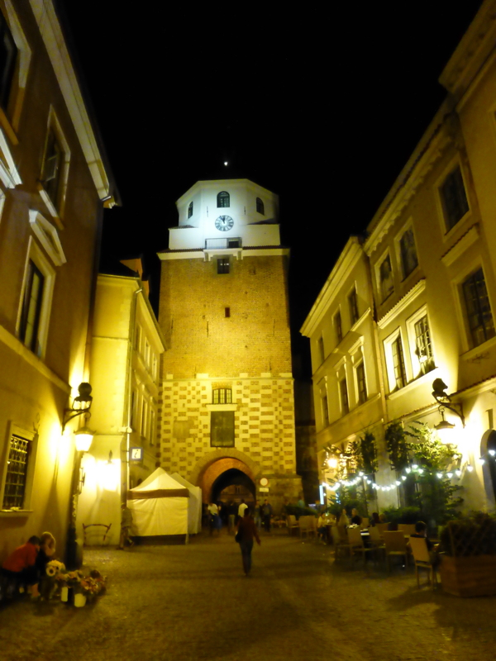
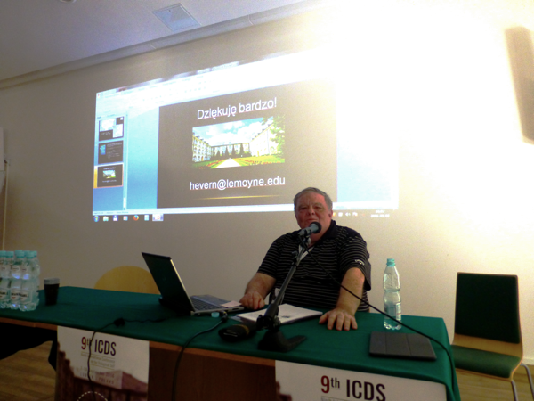
Above: Me at the end of my talk
Left: Leaving the Old City in Lublin

