Slide 1
Radioactivity of Building Materials
Helaina Hale

Slide 2
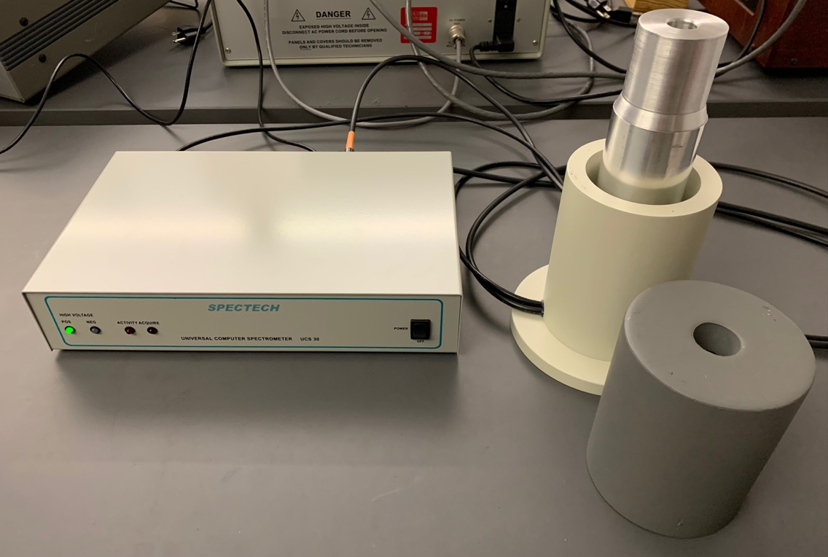
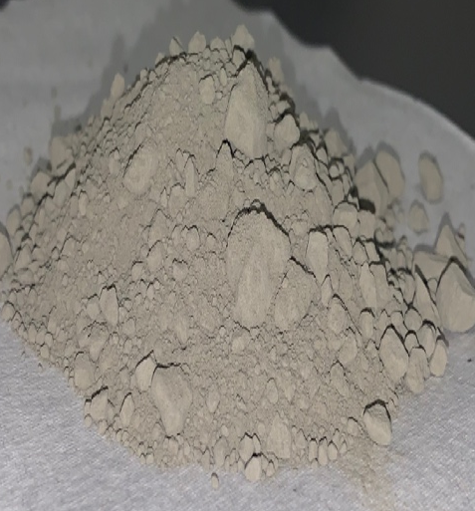
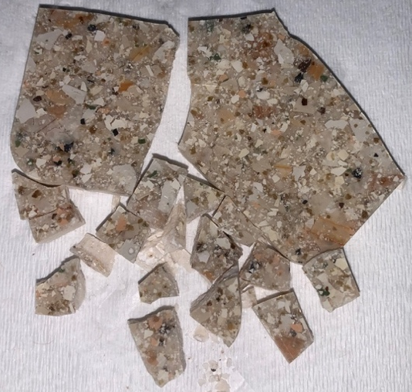
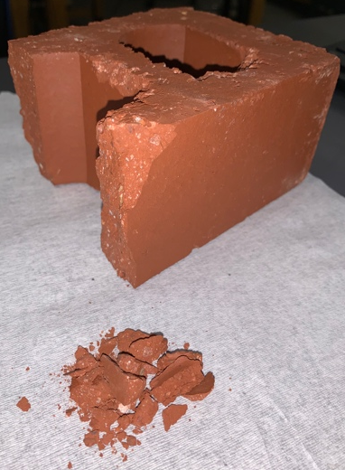
Recap of Experiment
Studying radioactivity of building materials using gamma-ray spectroscopy
  Determine what nuclides are present in each sample
  Source Activity for nuclides identified
  Estimation of dose rate from given elements

Slide 3
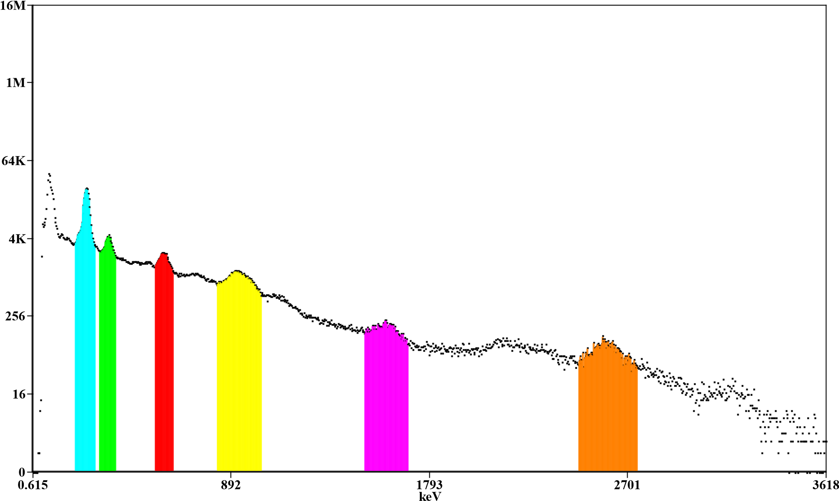
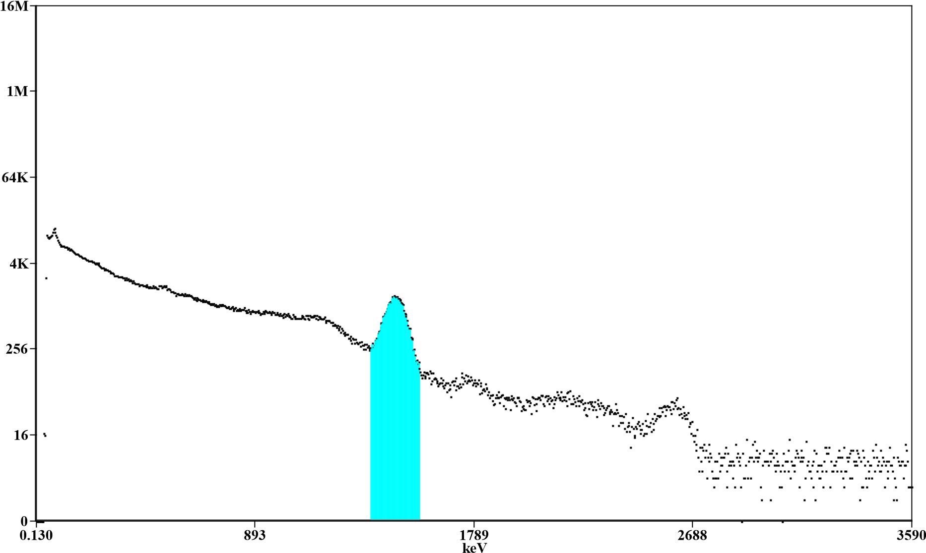
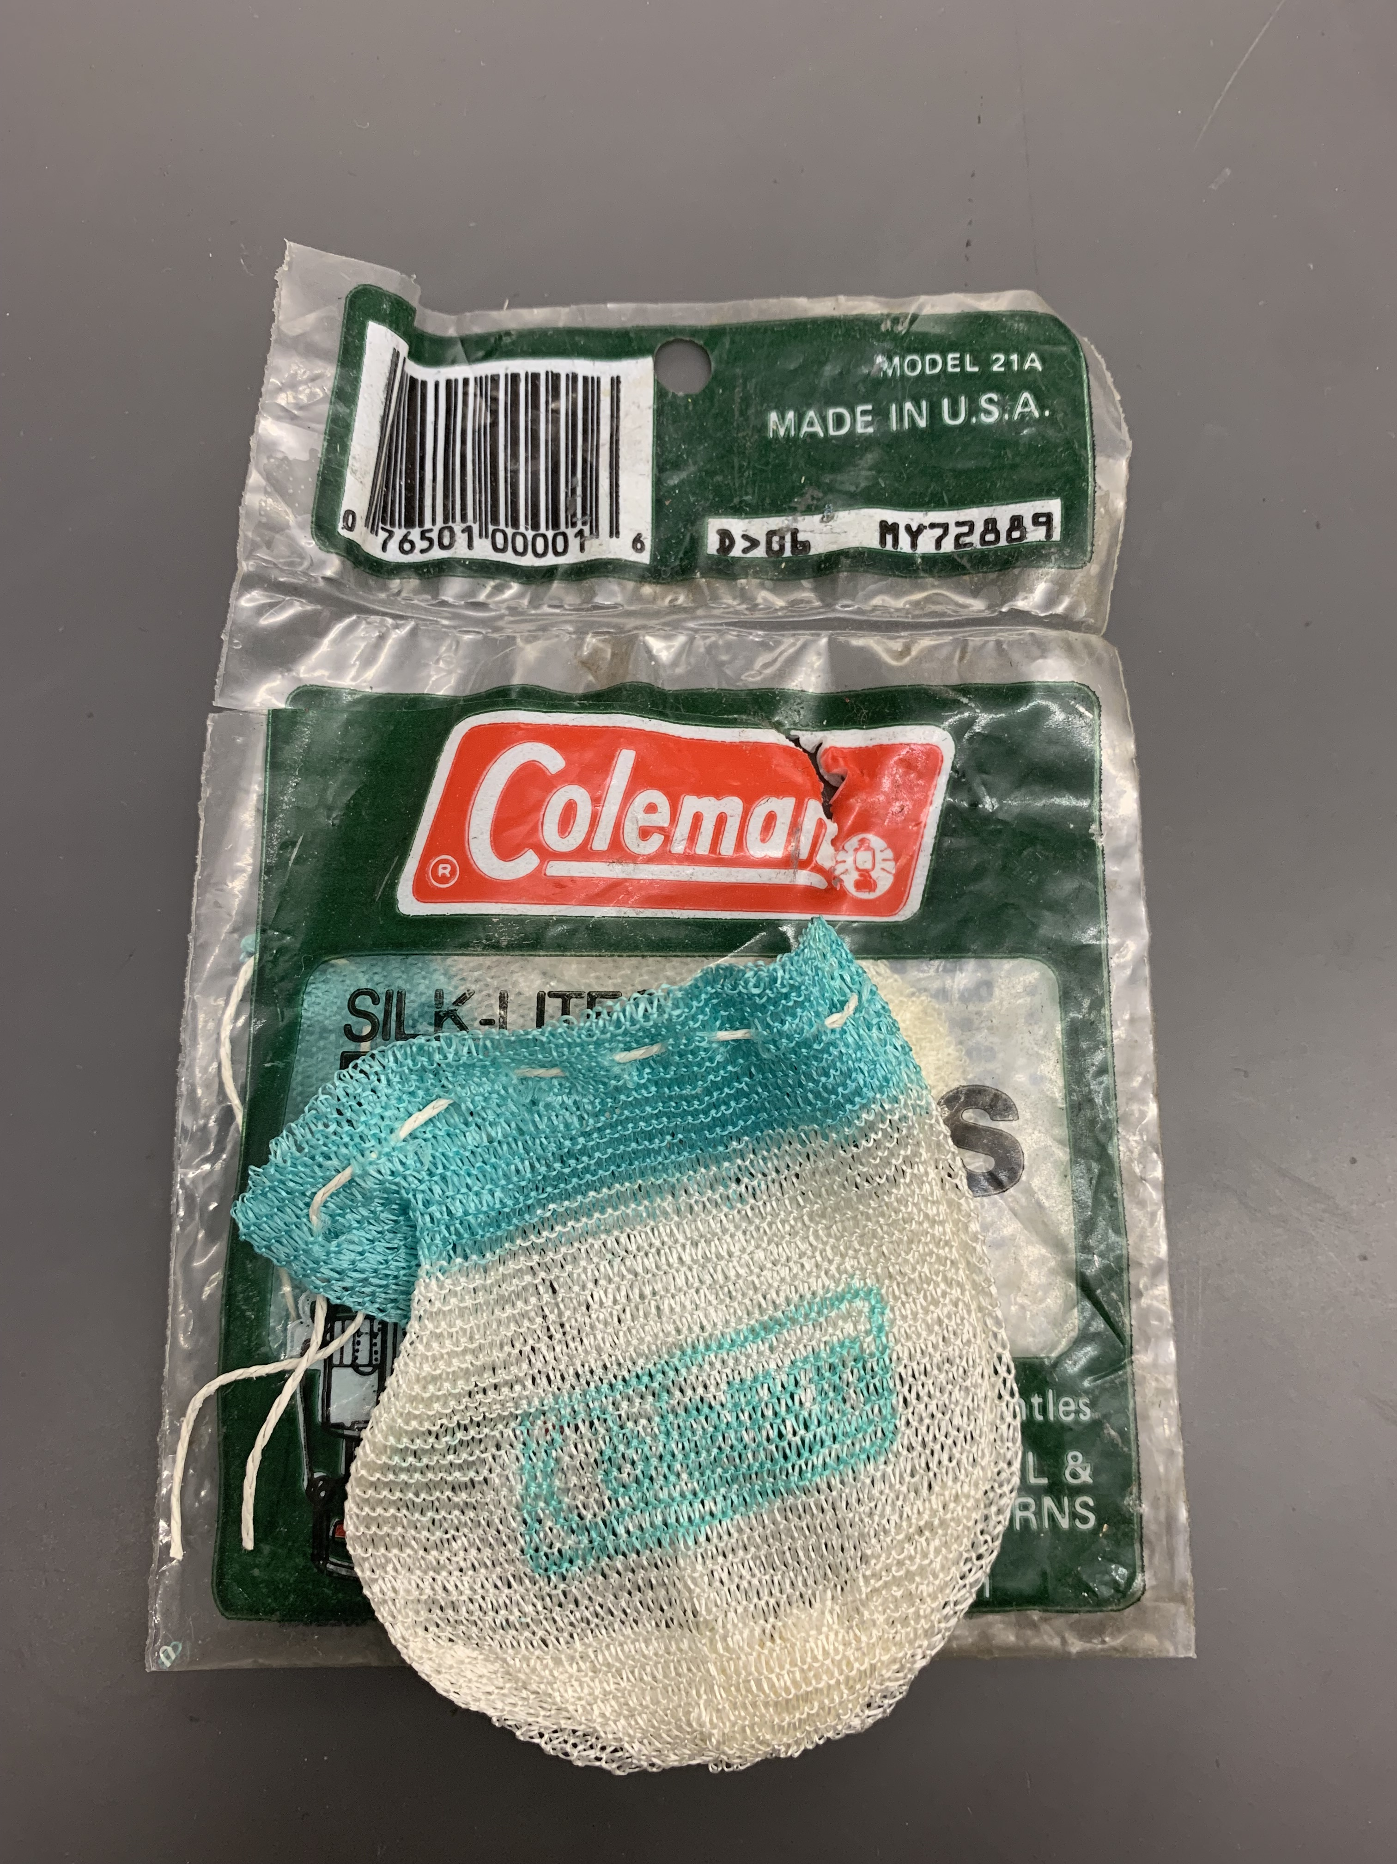
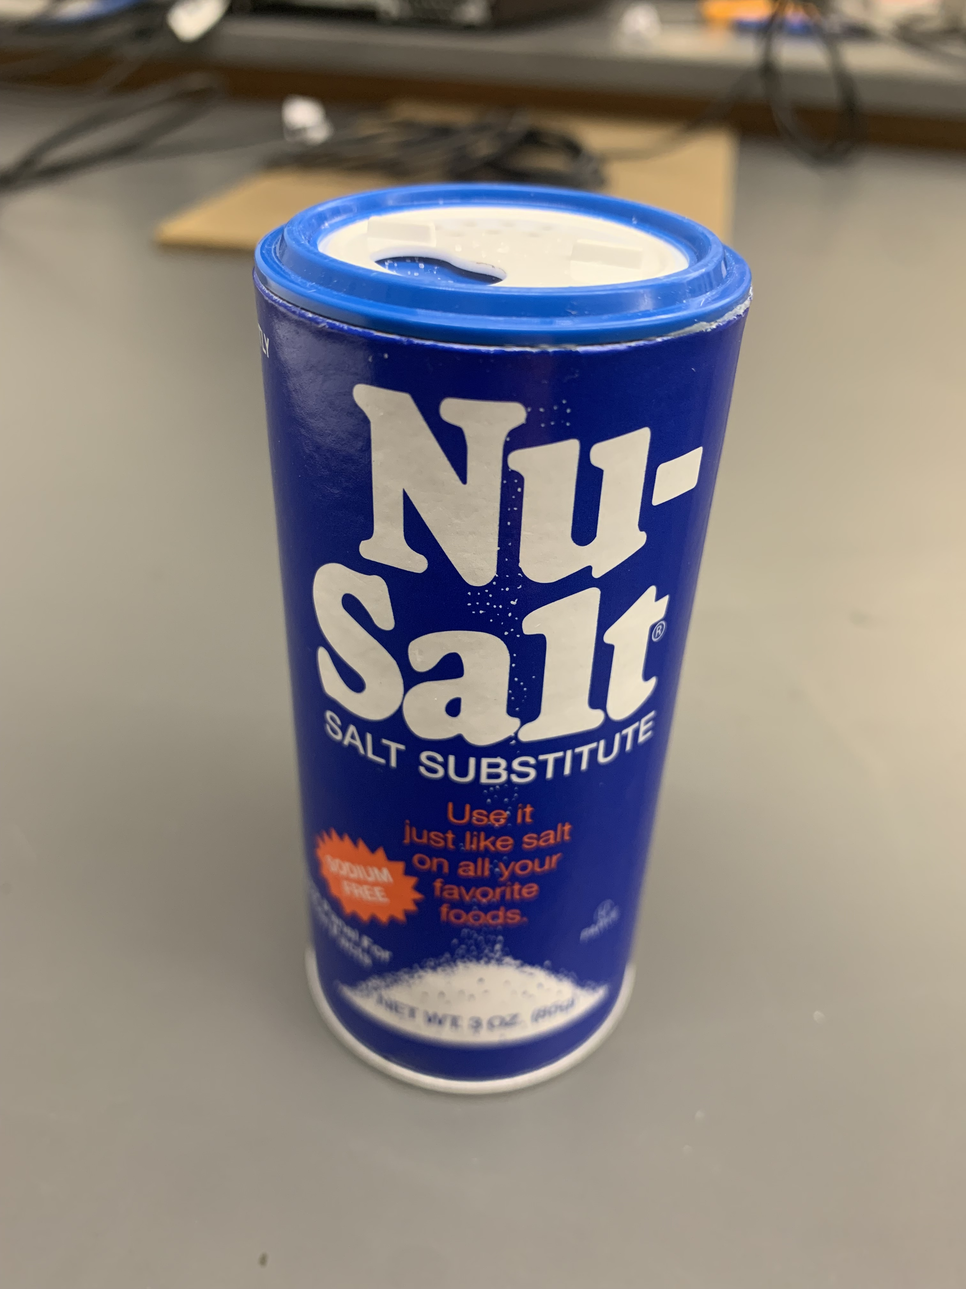
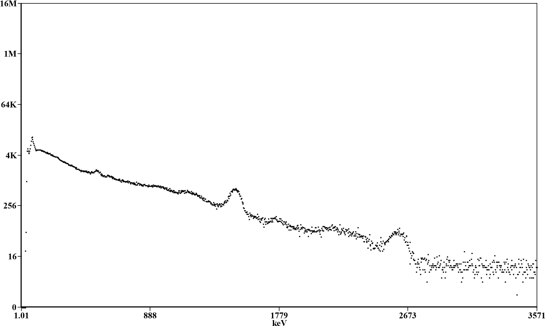
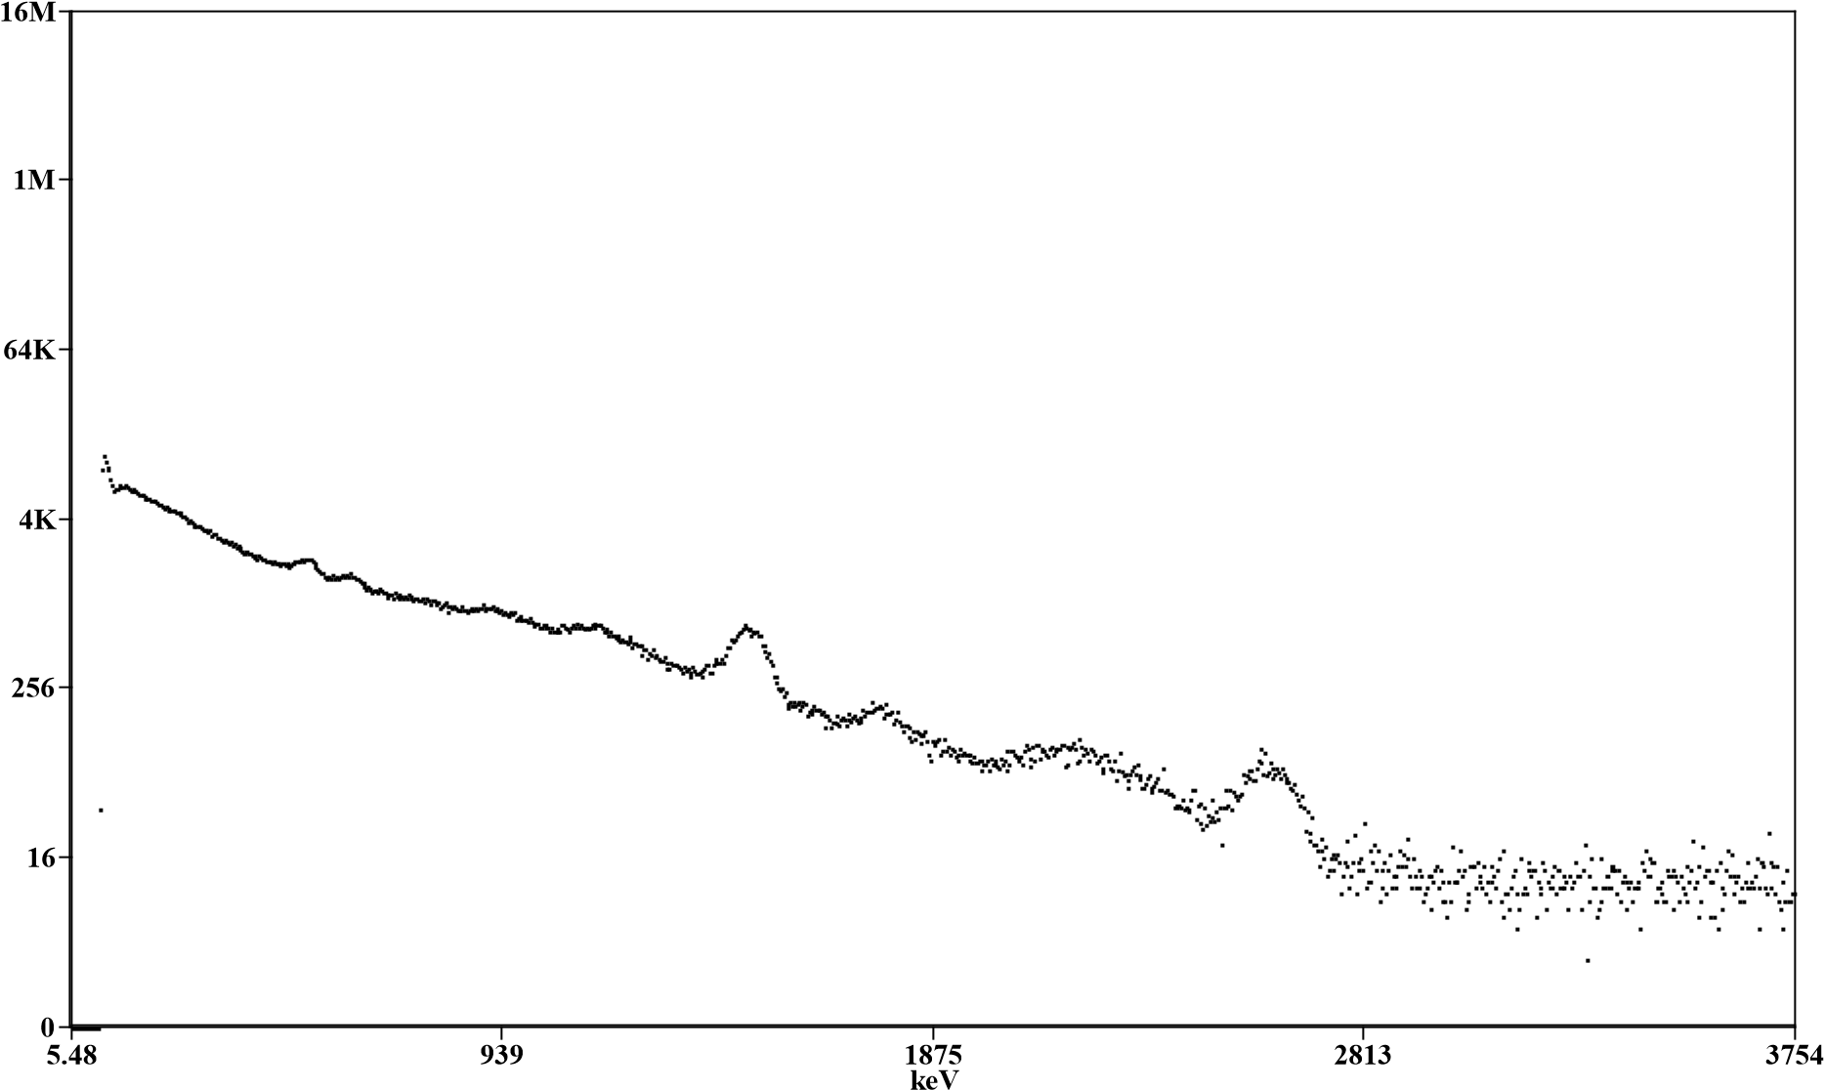
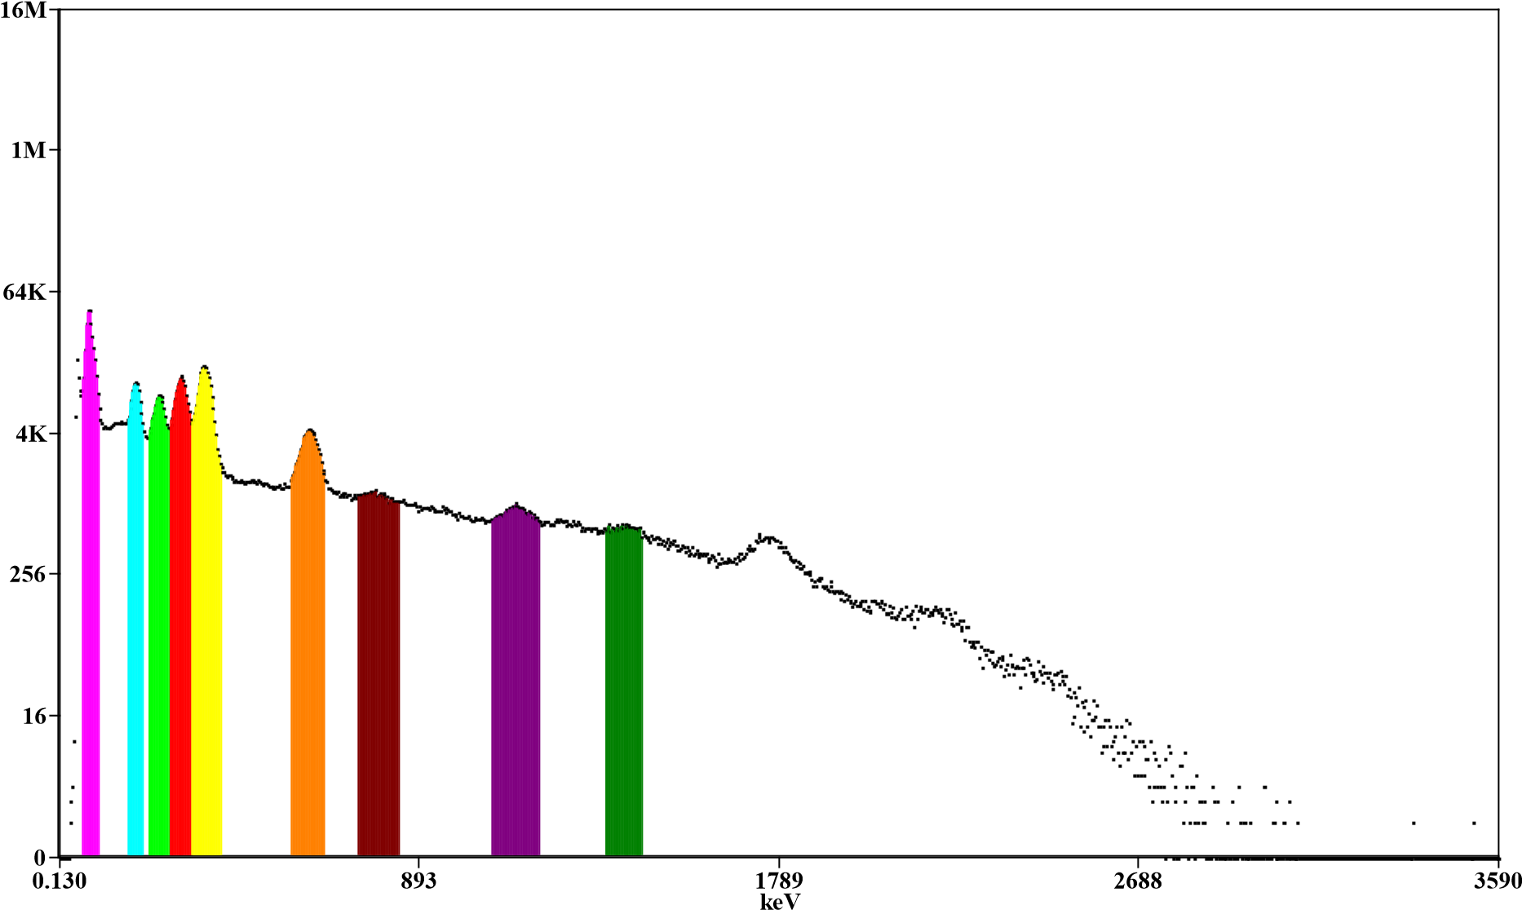
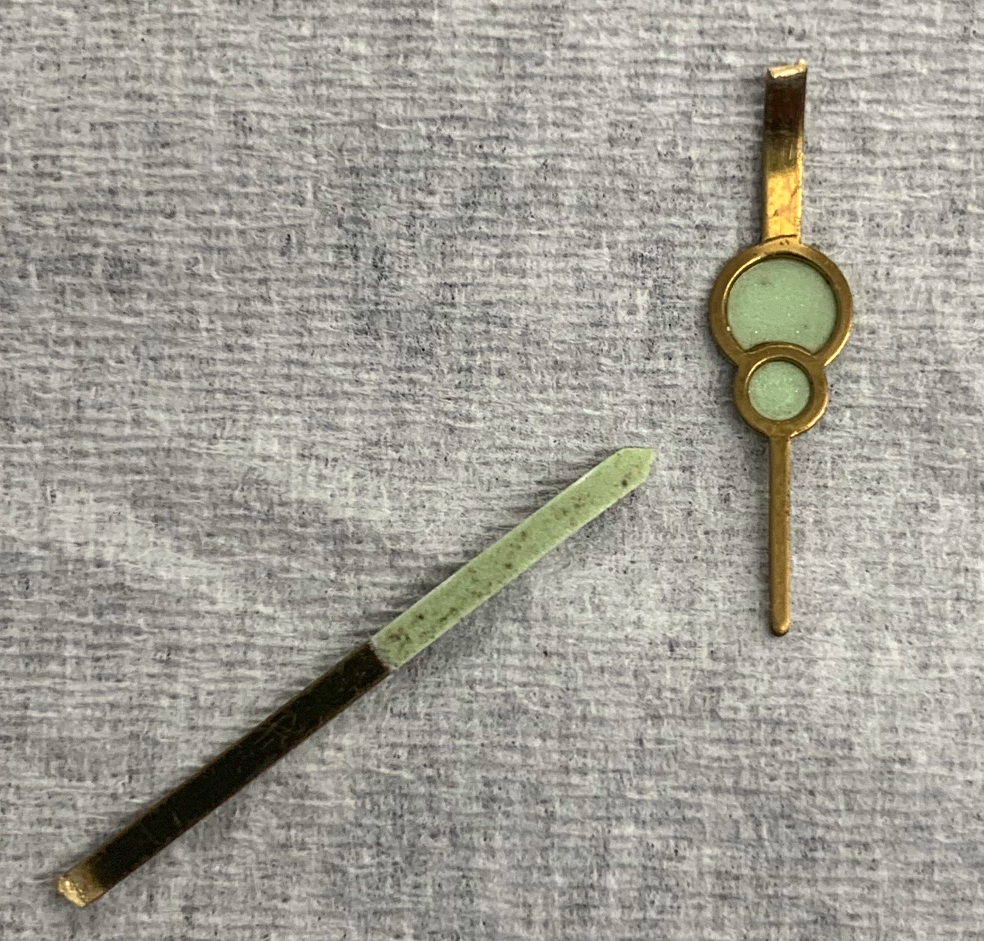
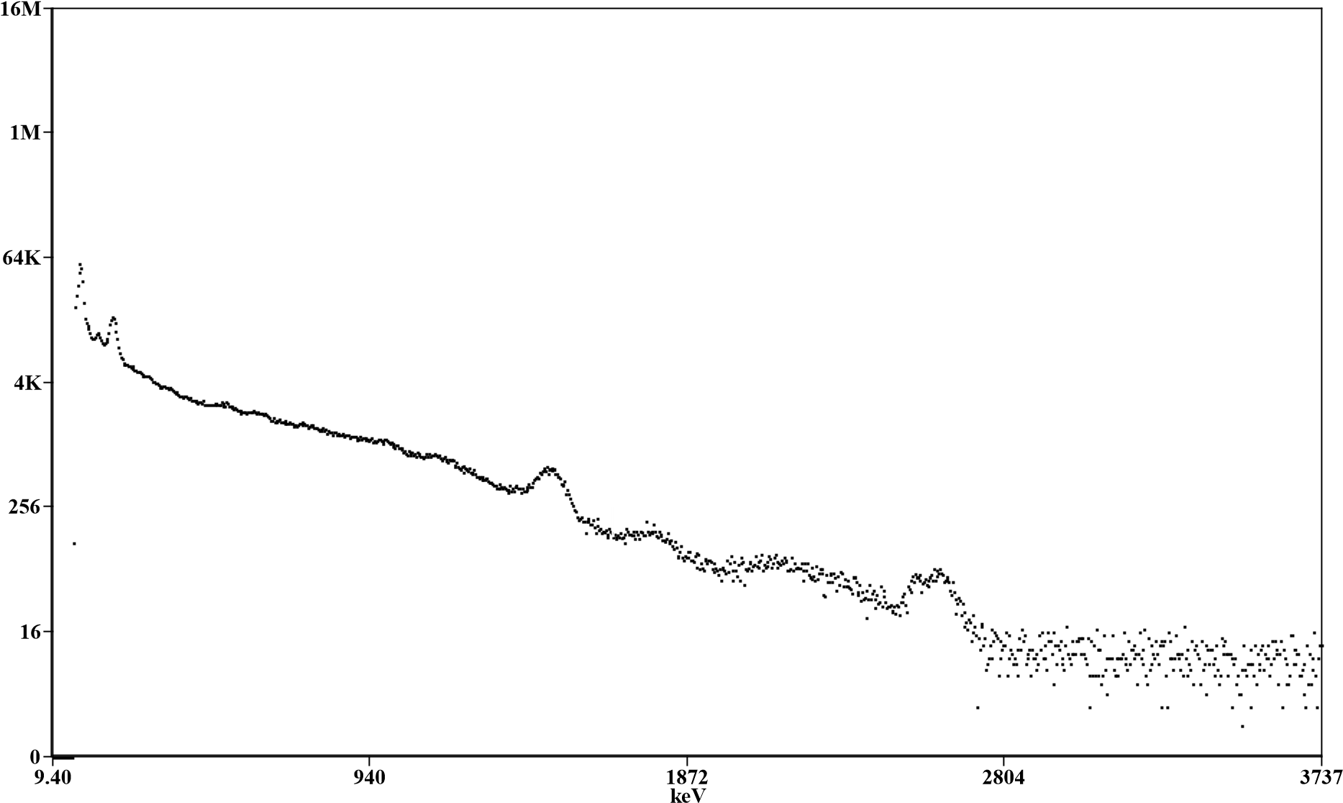
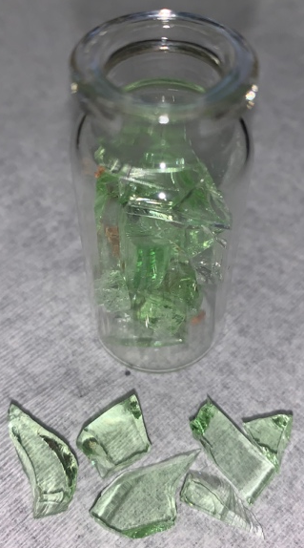
Expected Spectrums
Th-232
K-40
Ra-226
U-238

Slide 4
Background Spectrums

Slide 5
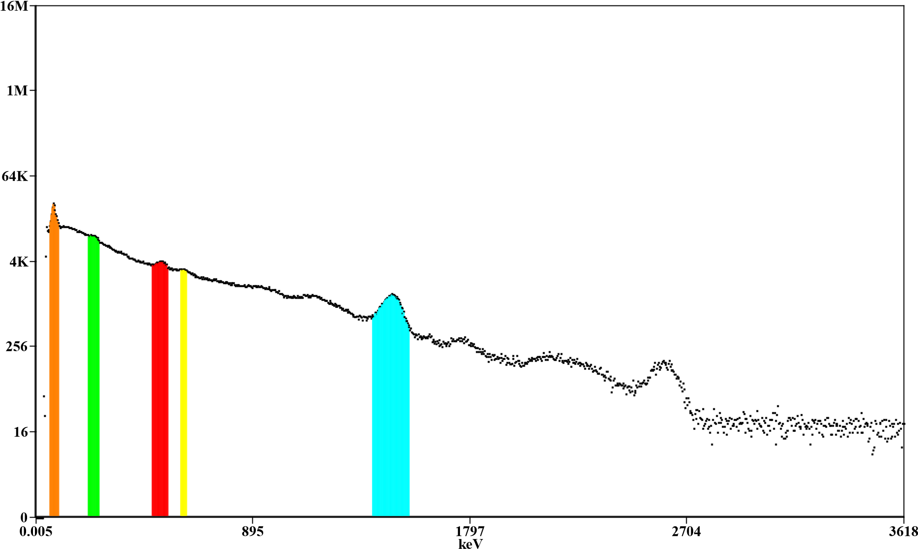
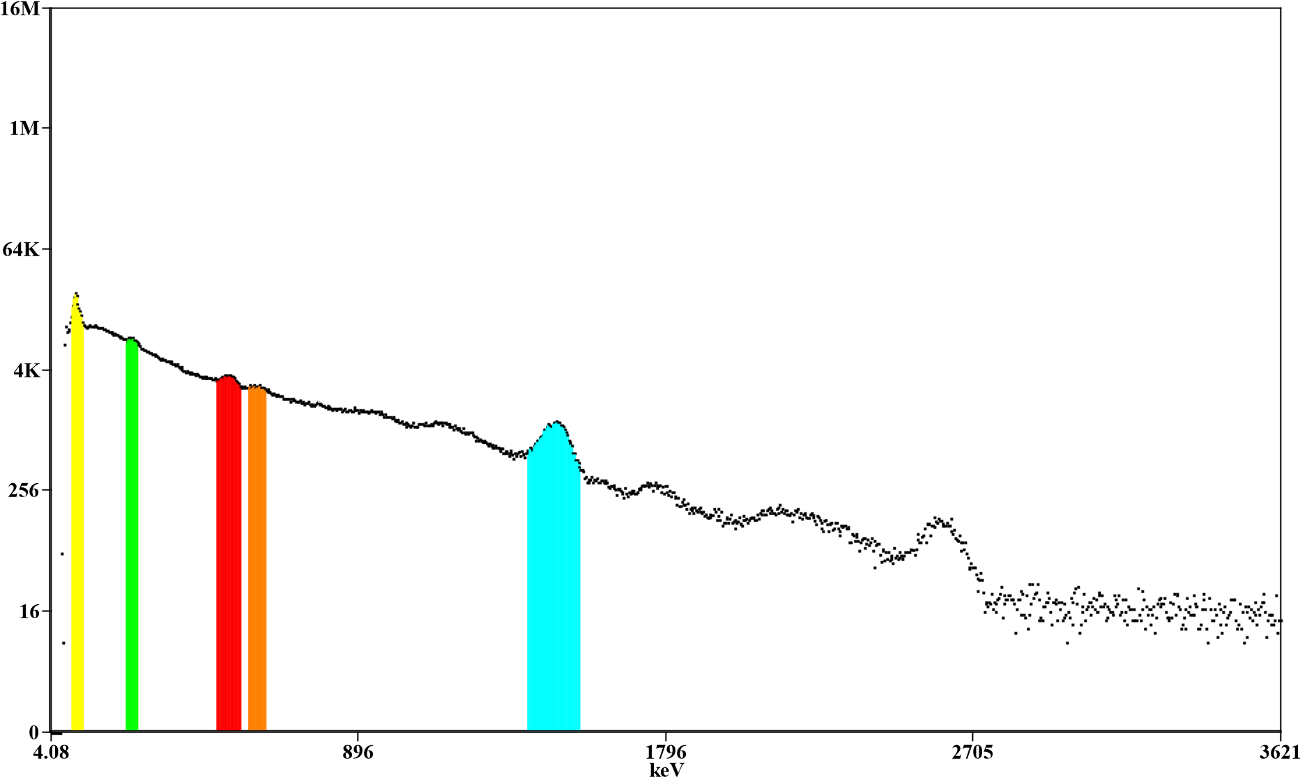
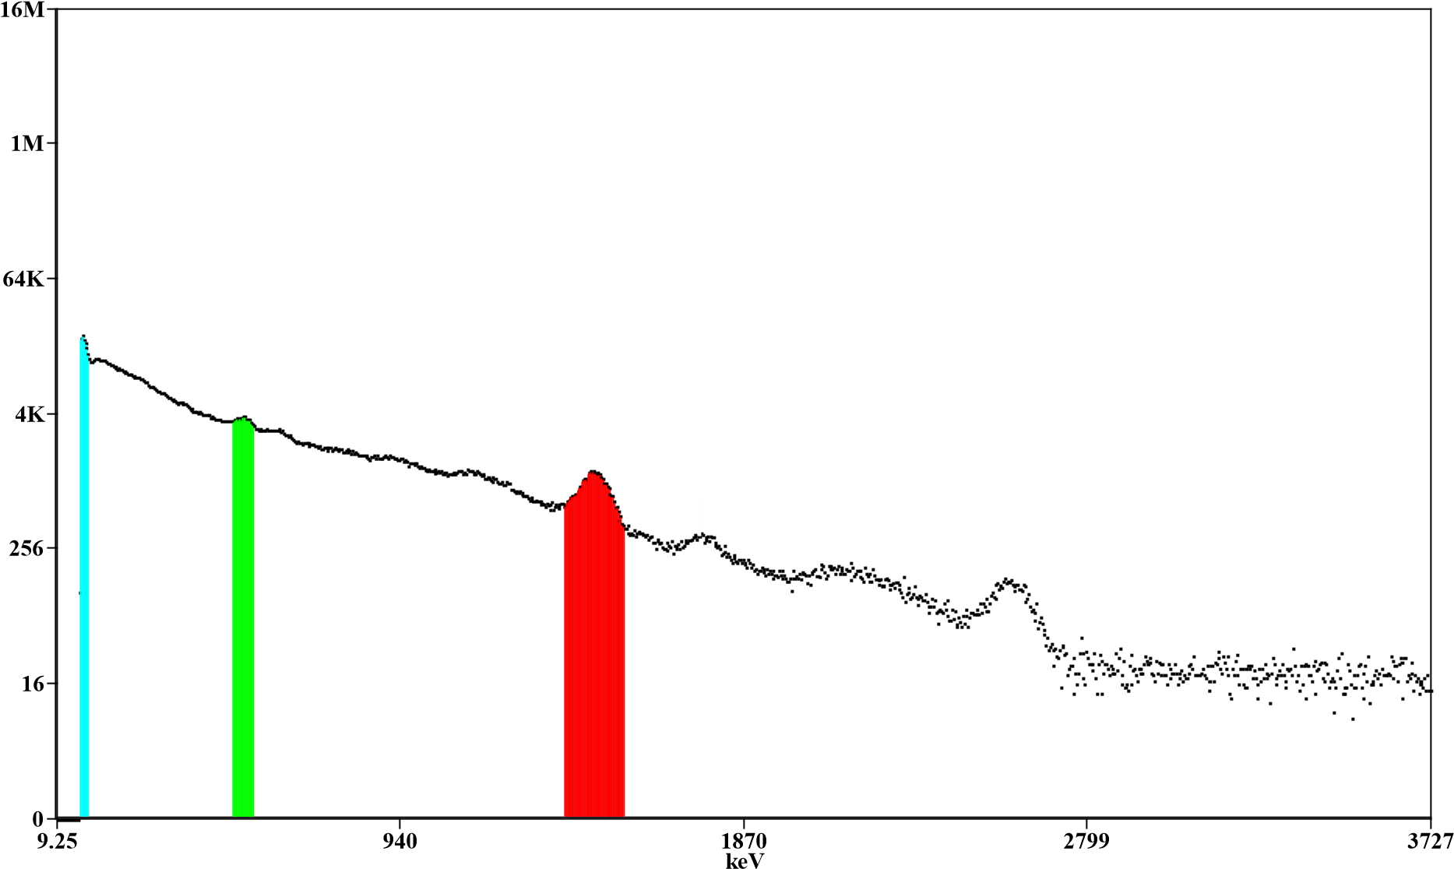
Building Material Spectrums
Portland Cement
Brick
Granite

Slide 6
Results

Slide 7
Resulting Spectrums
1460.8 keV (K-40)

Slide 8
Portland Cement

Slide 9
Portland Cement (0.009 kg)
Nuclide | Measured Activity | Absolute Activity | Dose Rate
Pb-212 | 0.025 ± 0.001 cps | 0.0227 ± 0.0151 Bq | 1.1214 x 10⁻²² J/kg 1.1214 x 10⁻²² Gy 1.1214 x 10⁻²² rem
K-40 | 0.0025 ± 0.0020 cps | 0.056 ± 0.002 Bq | 3.204 x 10⁻²² J/kg 3.204 x 10⁻²² Gy 3.204 x 10⁻²² rem

Slide 10
Brick

Slide 11
Brick (0.0081 kg)
Nuclide | Measured Activity | Absolute Activity | Dose Rate
Pb-212 | 0.0085 ± 0.0005 cps | 0.0189 ± 0.0011 Bq | 3.204 x 10⁻²³ J/kg 3.204 x 10⁻²³ Gy 3.204 x 10⁻²³ rem
K-40 | 0.0001 ± 0.0021 cps | 0.009 ± 0.0189 Bq | 1.1214 x 10⁻²³ J/kg 1.1214 x 10⁻²³ Gy 1.1214 x 10⁻²³ rem

Slide 12
Granite

Slide 13
Granite (0.0075 kg)
Nuclide | Measured Activity | Absolute Activity | Dose Rate
K-40 | 0.0029 ± 0.0017 cps | 0.0264 ± 0.0155 Bq | 1.4418 x 10⁻²⁰ J/kg 1.4418 x 10⁻²⁰ Gy 1.4418 x 10⁻²⁰ rem

Slide 14
Material Estimations
Absolute activity for samples
Measured activity estimates gammas/s
Use standard weight to estimate absolute activity and average amount in home
Upscale number of gammas
Estimate home and human square footage
Divide gammas going in by fraction to obtain gammas/s interacting
Multiply energy by gammas/s interacting
Number gammas/standard weight (J/kg)
Estimate yearly dose

Slide 15
Setbacks
Equipment issues
  Equipment arrival time
  Computer quality
  Access to only one MCA
Conflicting schedules
  PHY-331 occurring simultaneously

Slide 16
Achievements
Nuclides identified in given building materials
Measured Activity calculations
Absolute activity calculations (estimated)
Dose rate calculations (estimated)

Slide 17
Additional Comments Personal Experience
Expansion of research
  Separate experiment to determine photopeak detection efficiency of well-detector
  Contribution of other materials
Experience independently working towards deadline
Overcoming setbacks/challenges
Enhanced technical writing and speaking skills
Lab experience and further understanding of atomic and nuclear physics

Slide 18

Questions?

Slide 20
Material estimations
10 80lb bags of Portland cement (Home foundation)
  K-40: 1.16 x 10⁻¹⁹ J
  Pb-212: 4.07 x 10⁻²⁰ J
1000 Bricks (Home build)
  K-40: 1.98 x 10⁻²⁰ J
  Pb-212: 5.67 x 10⁻²⁰ J
Granite countertop and island
  K-40: 1.96 x 10⁻¹⁸ J
  K-40: 3.27 x 10⁻¹⁸ J

