Slide 1
Electrical Conductivity of P3HT Thin-Film Samples Under Selected Chemical Doping
By: Natalie Clum

Slide 2
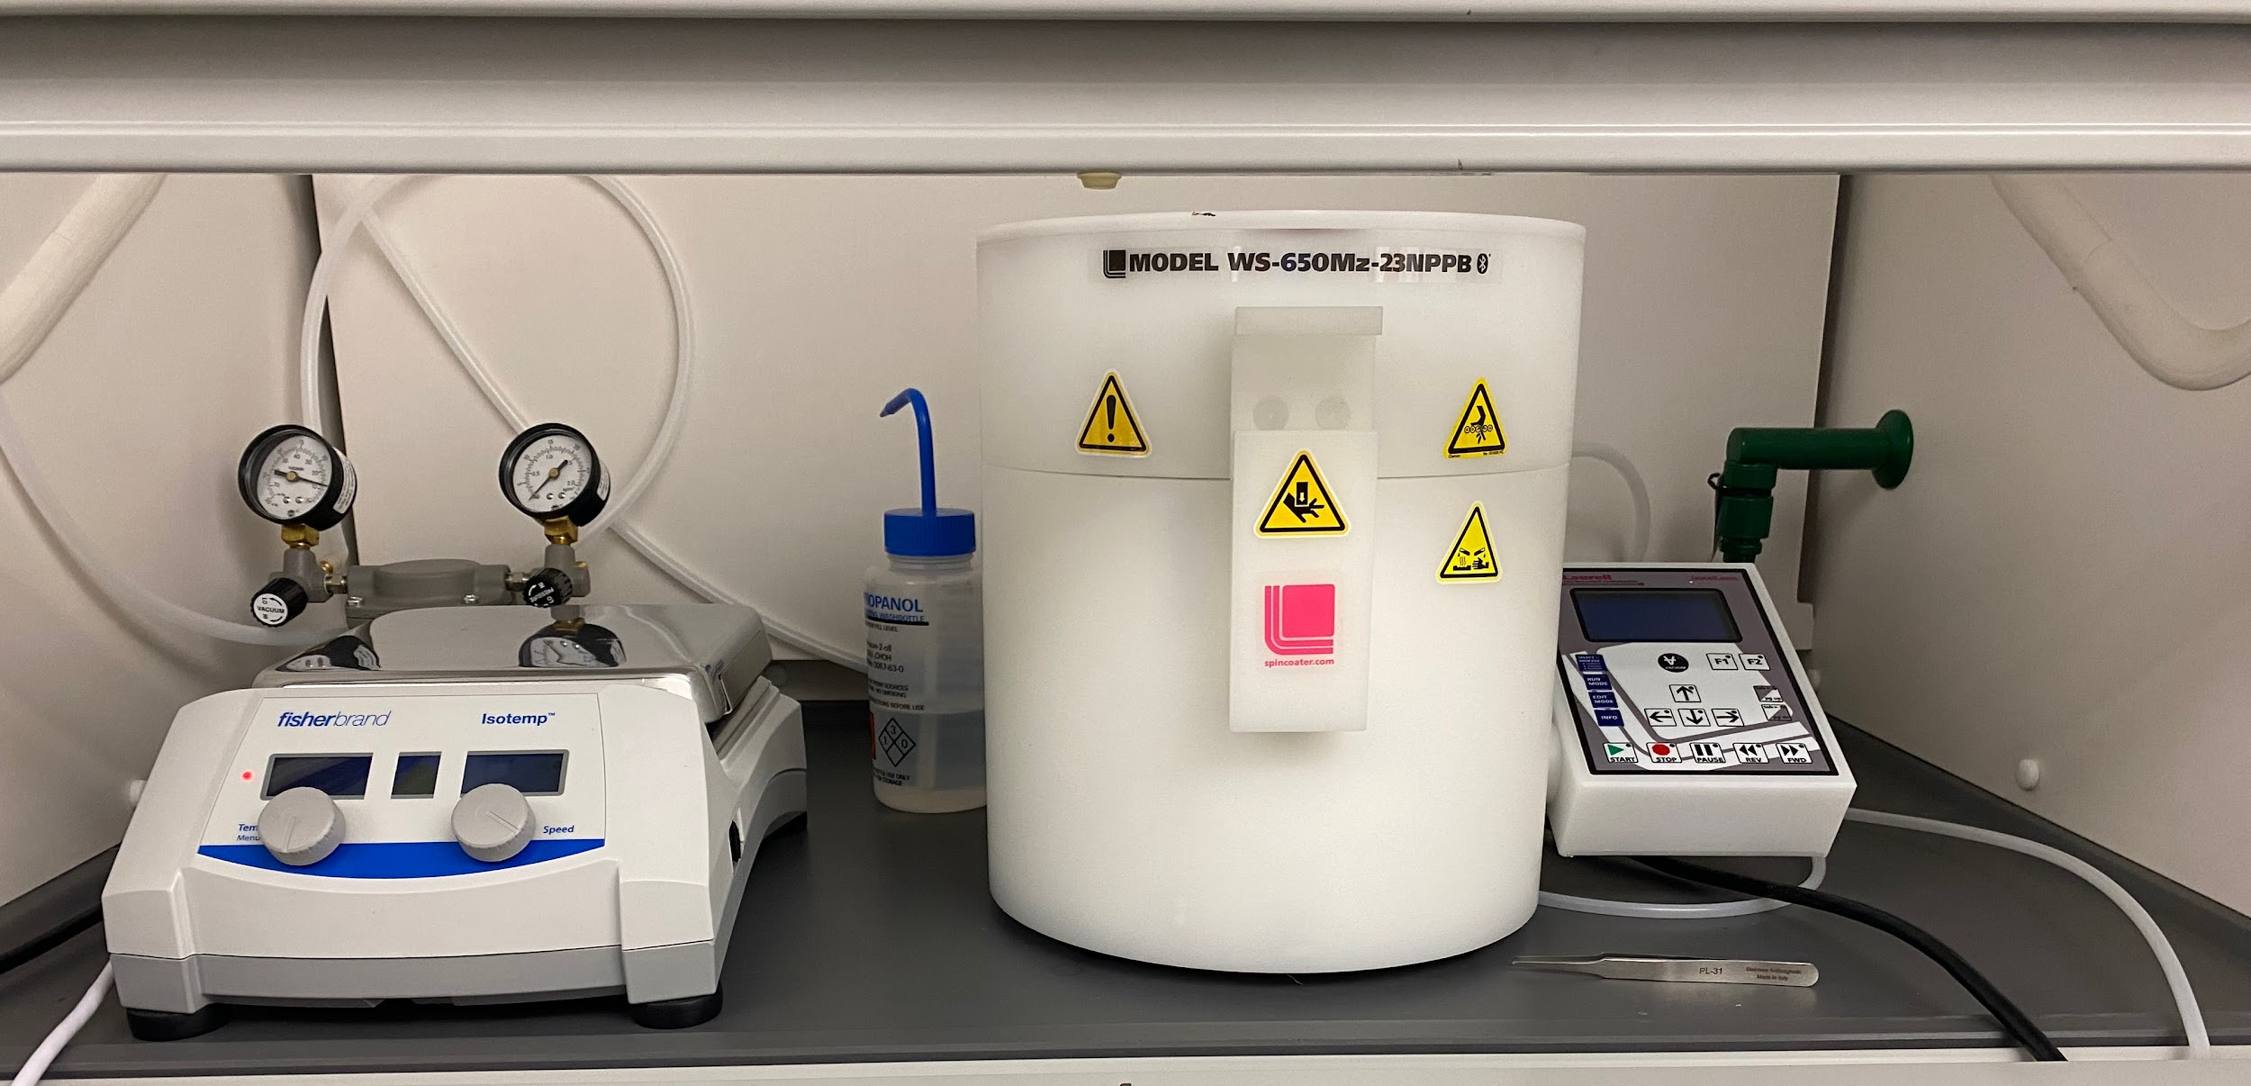
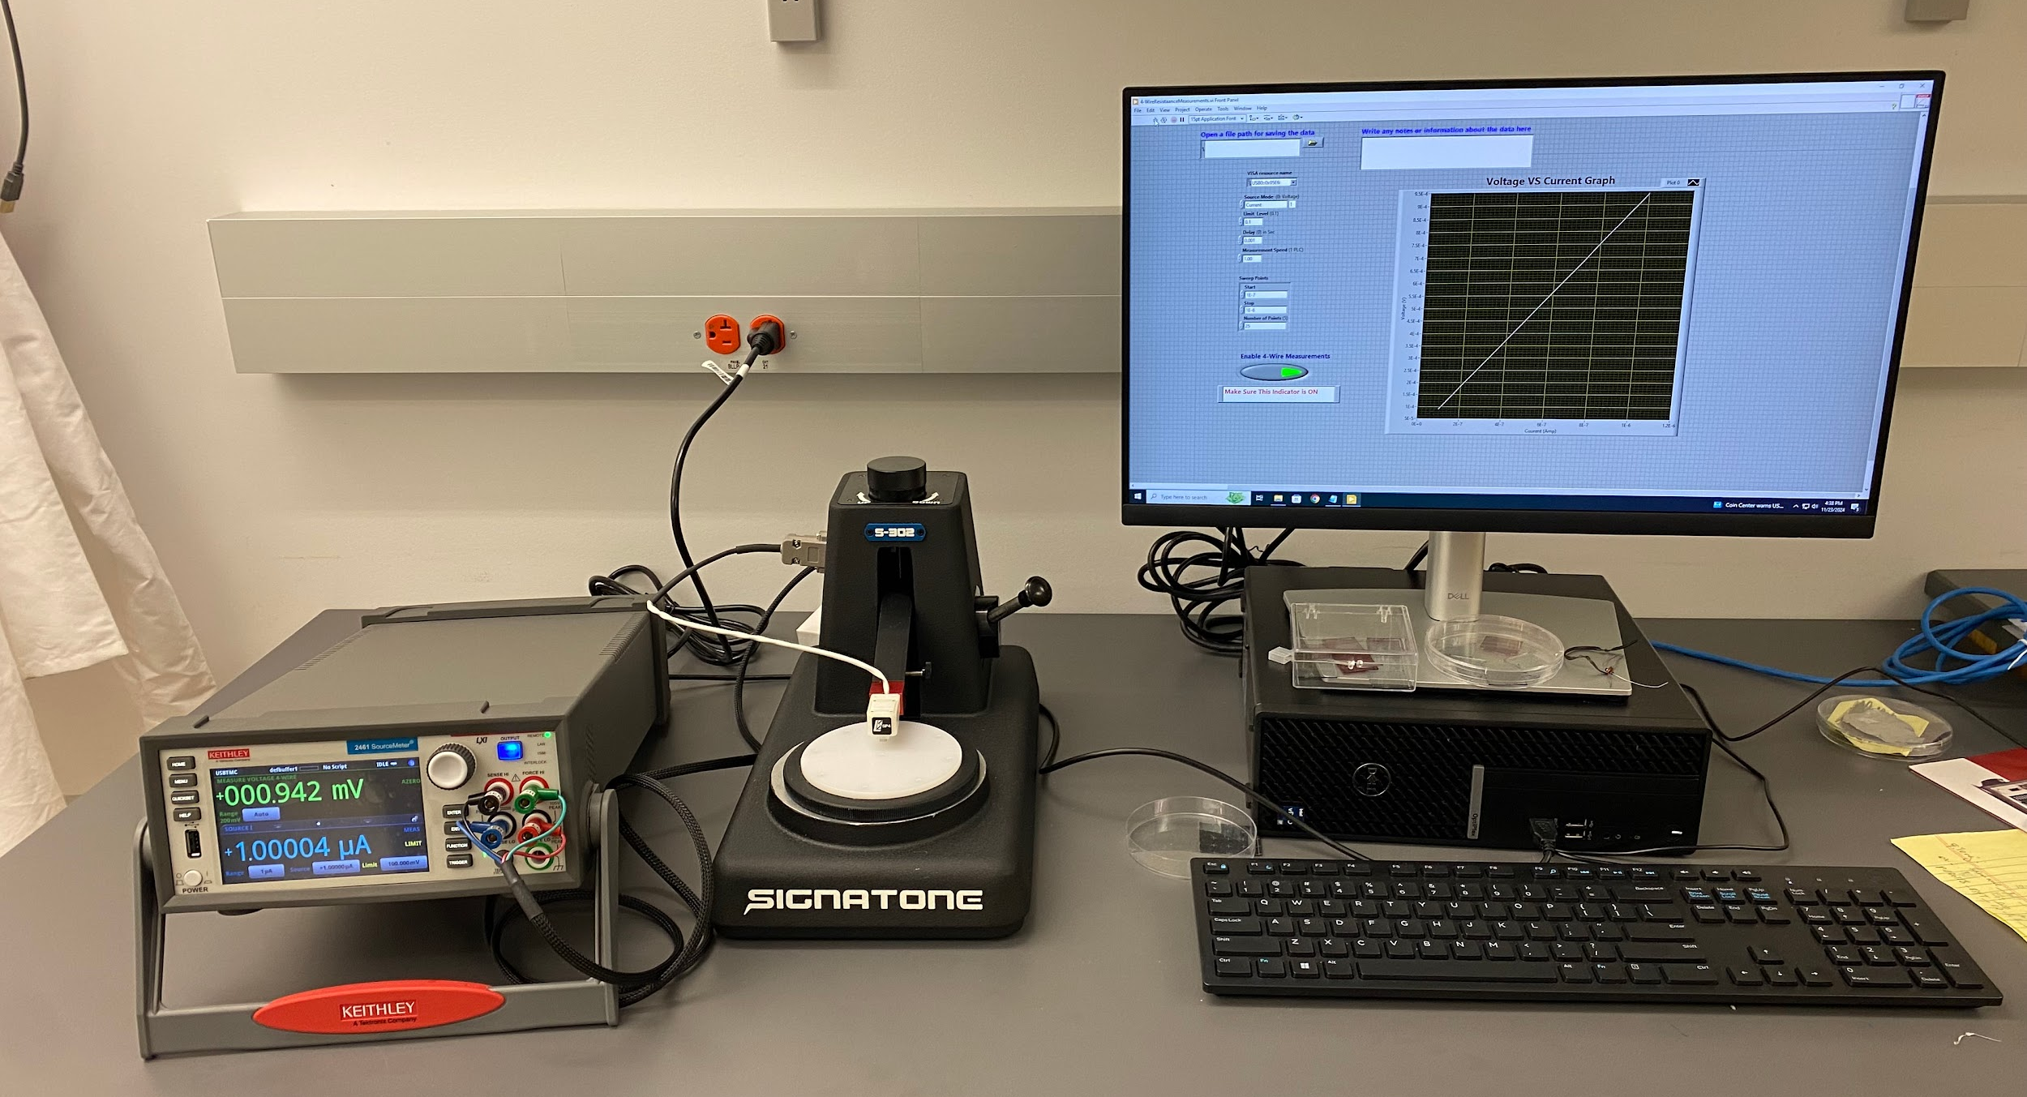
RECAP
Fabricating thin-films using P3HT solution
Comparing the use of organic and inorganic dopants
Measuring the resistivity and calculating the conductivity of each thin-film

Slide 3
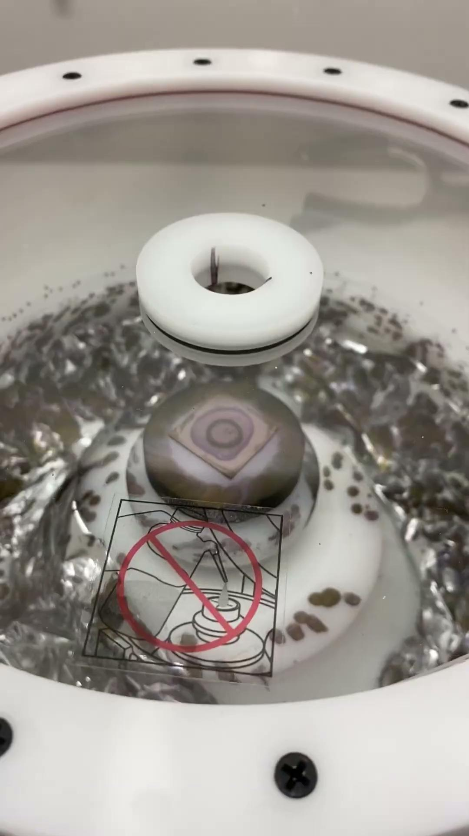
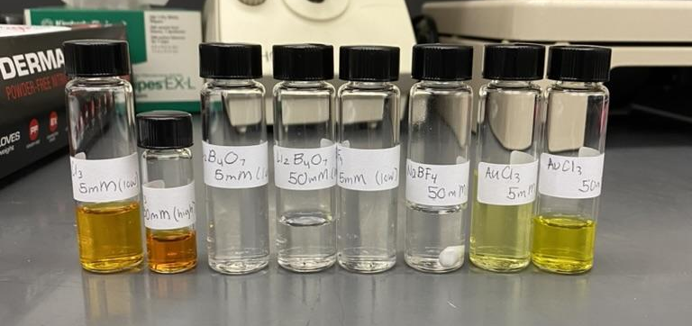
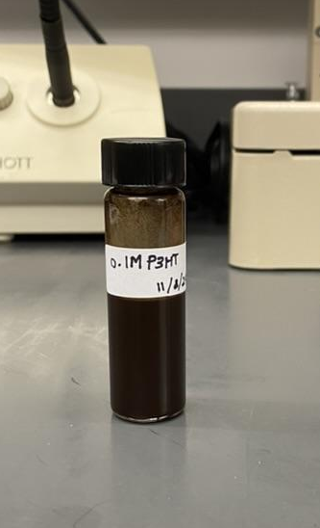
Video of Spin Coating

Slide 4
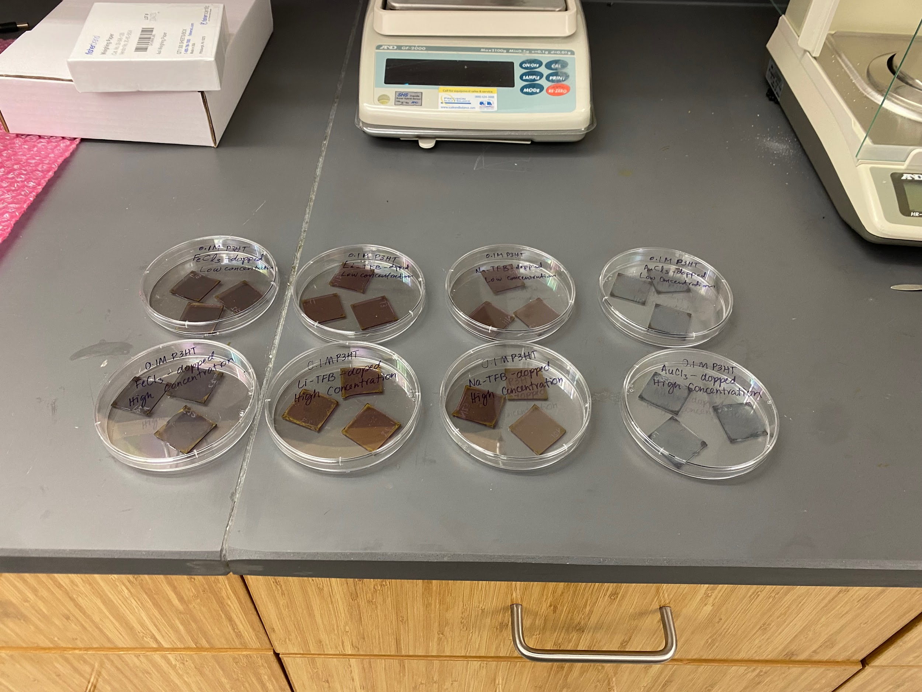
RESULTS

Slide 5
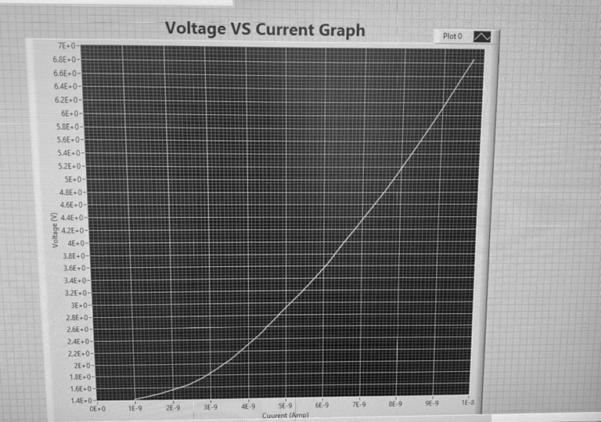
Analysis of Resistivity Measurements
01
How to find Resistivity:
Resistance = slope of voltage vs. current graph
R_{s}= 4.5324 × R
Resistivity = R_{s} × (110×10⁻⁹)

Slide 6
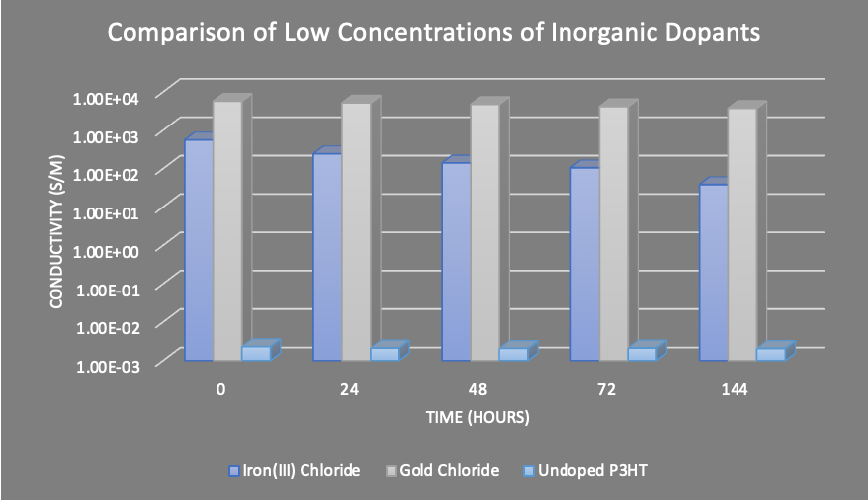
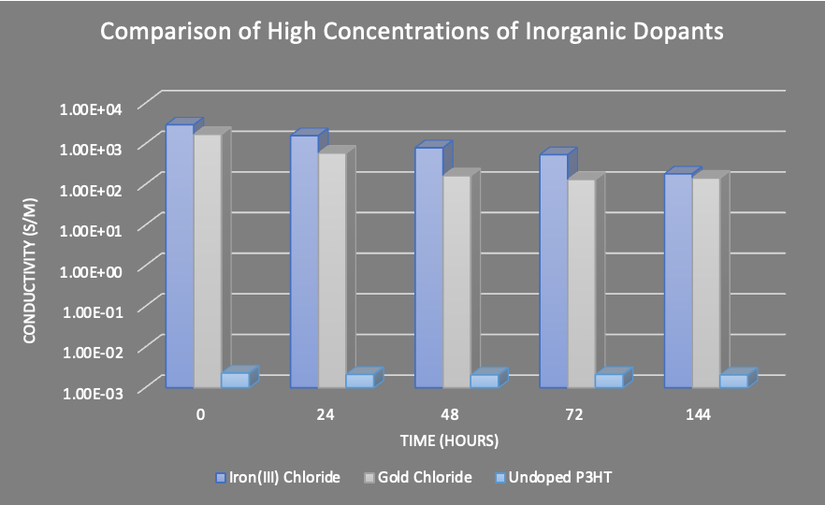

Slide 7
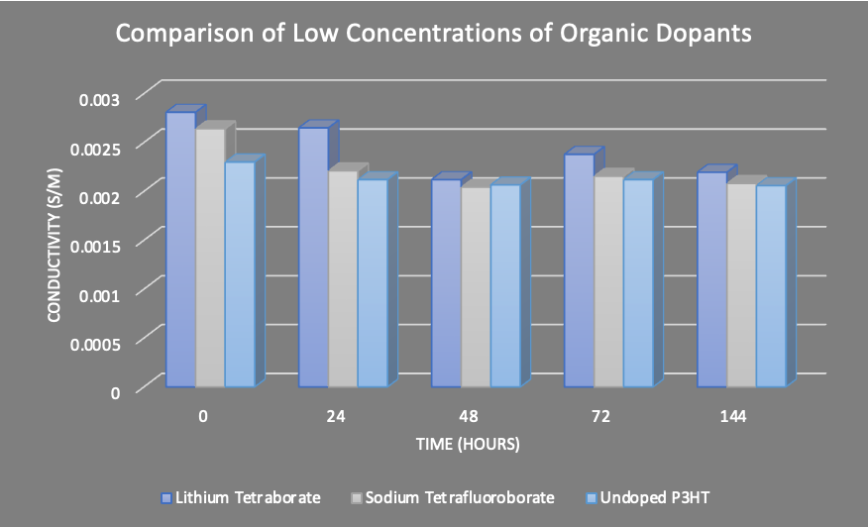
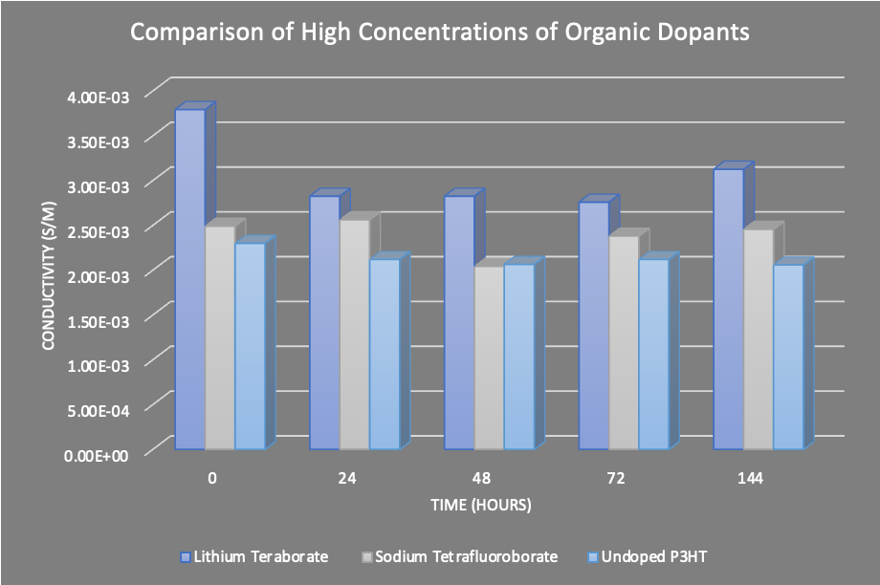

Slide 8
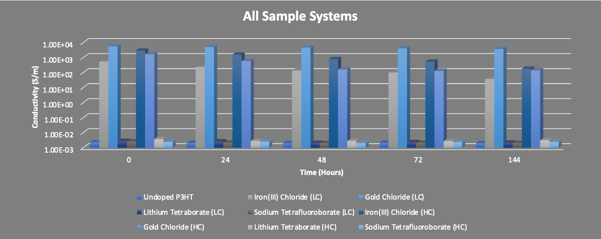

Slide 9
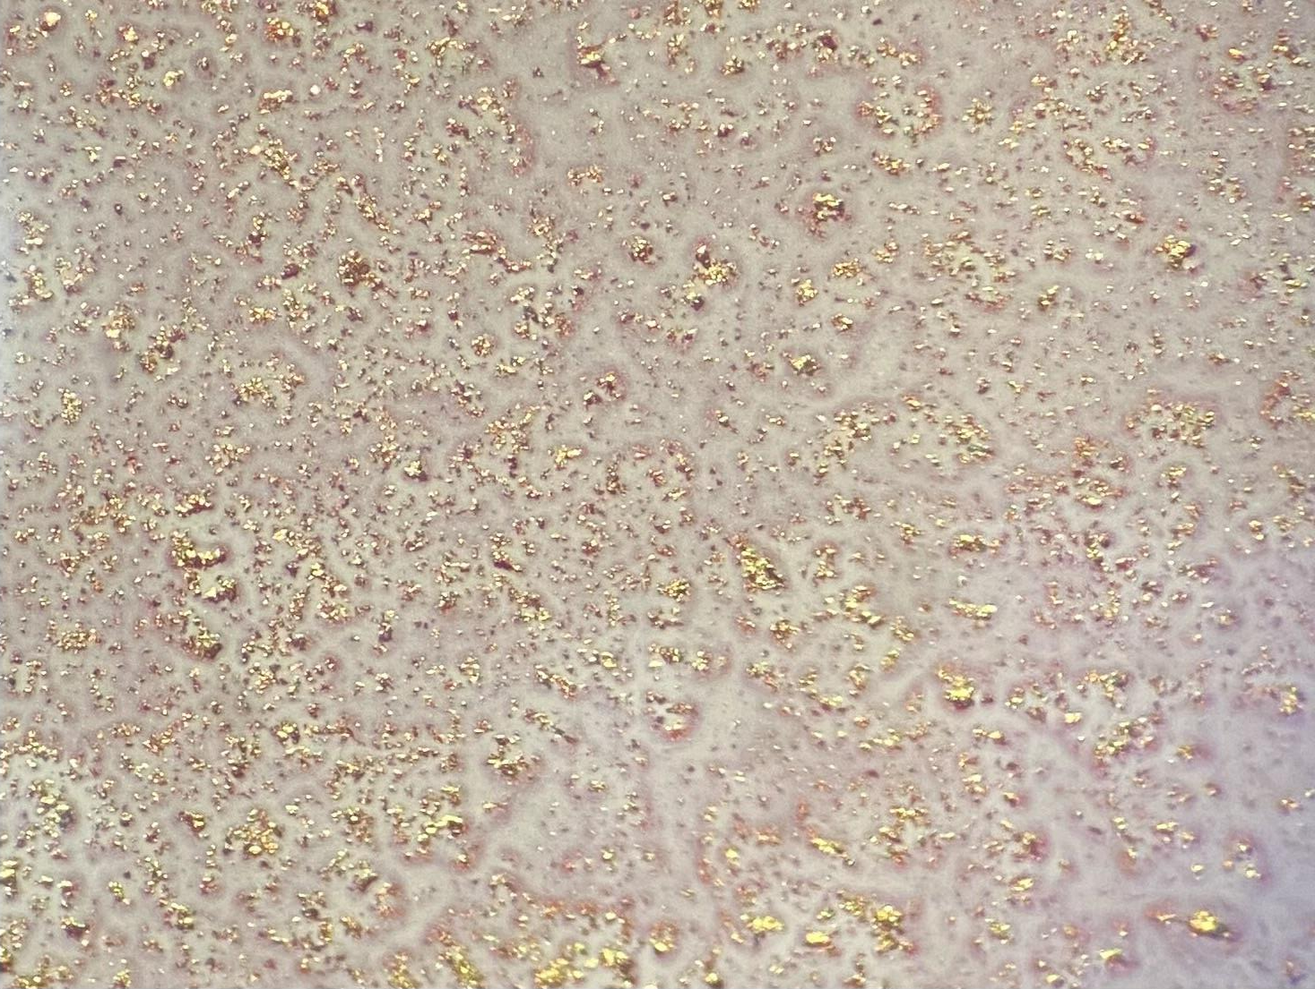
Surface Morphology
02
0.635 mm

Slide 10
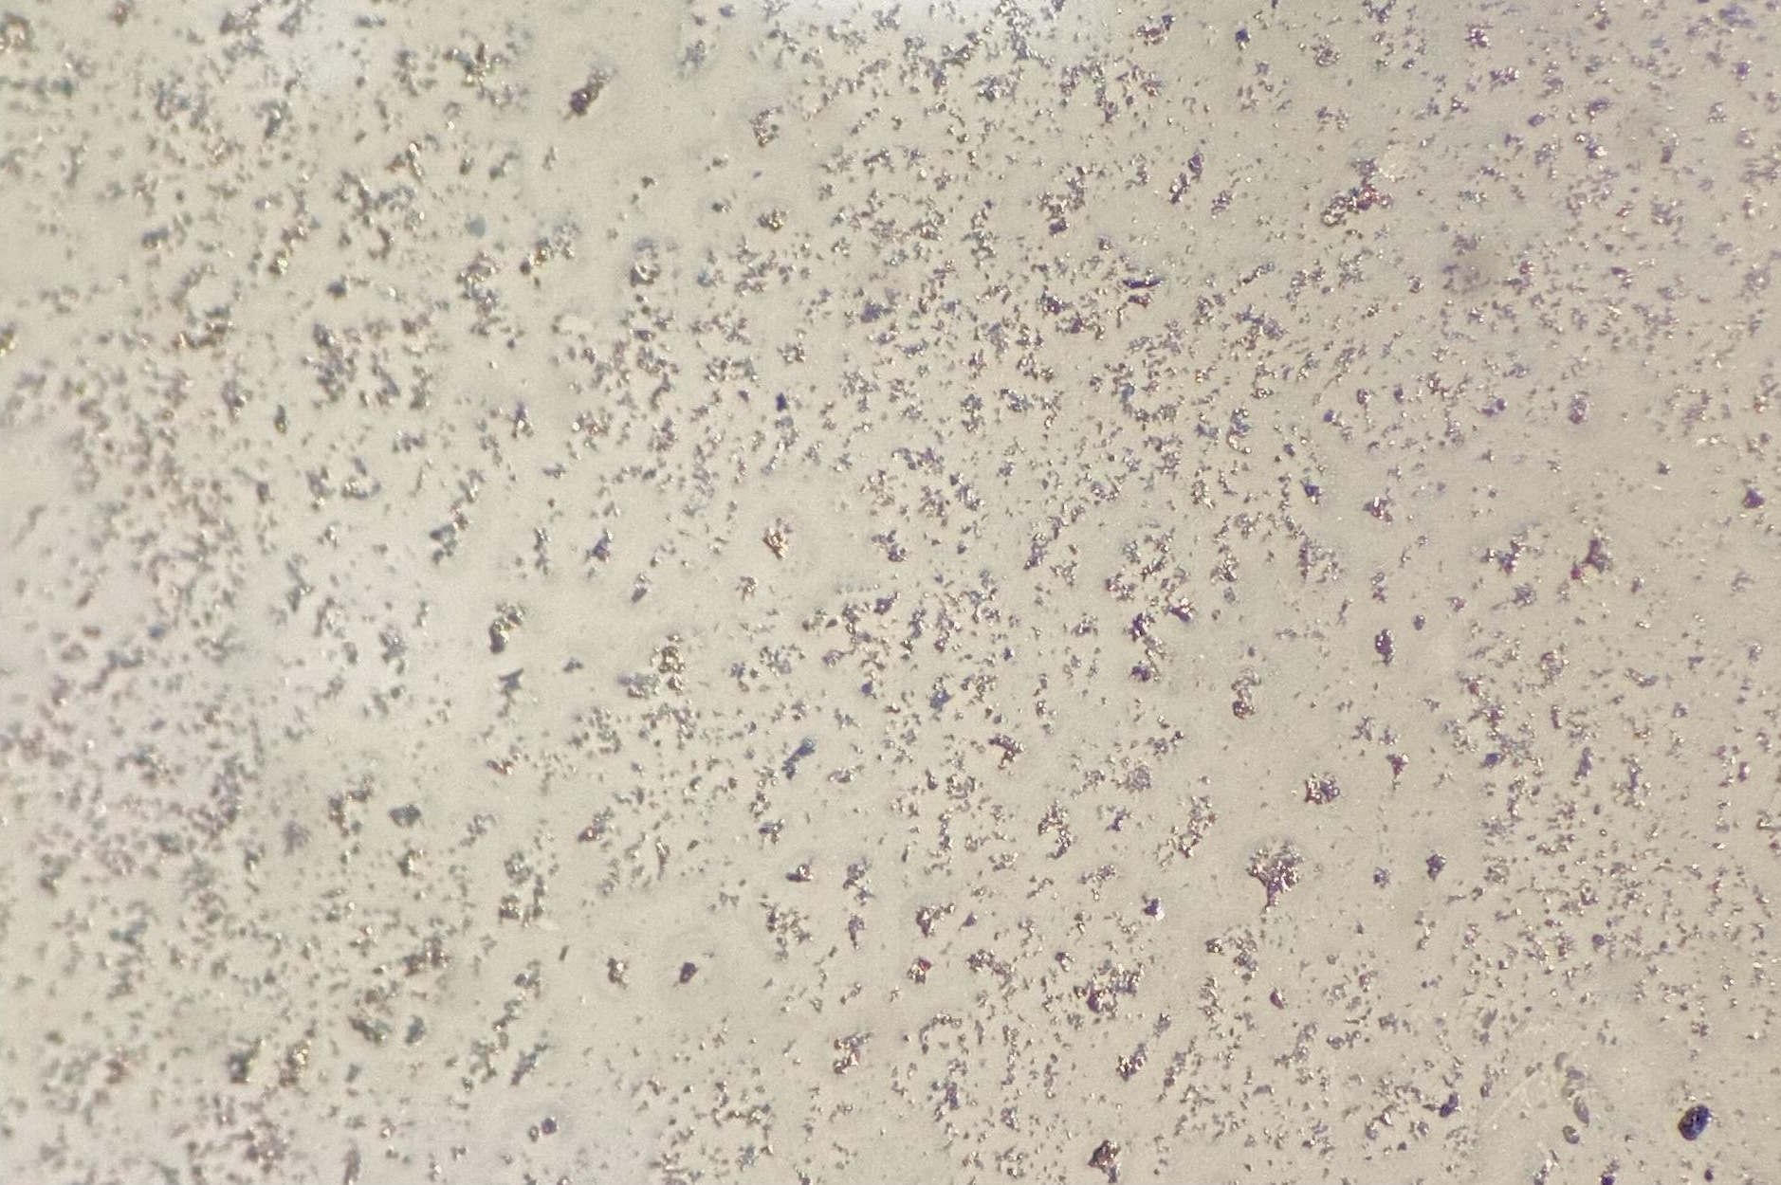
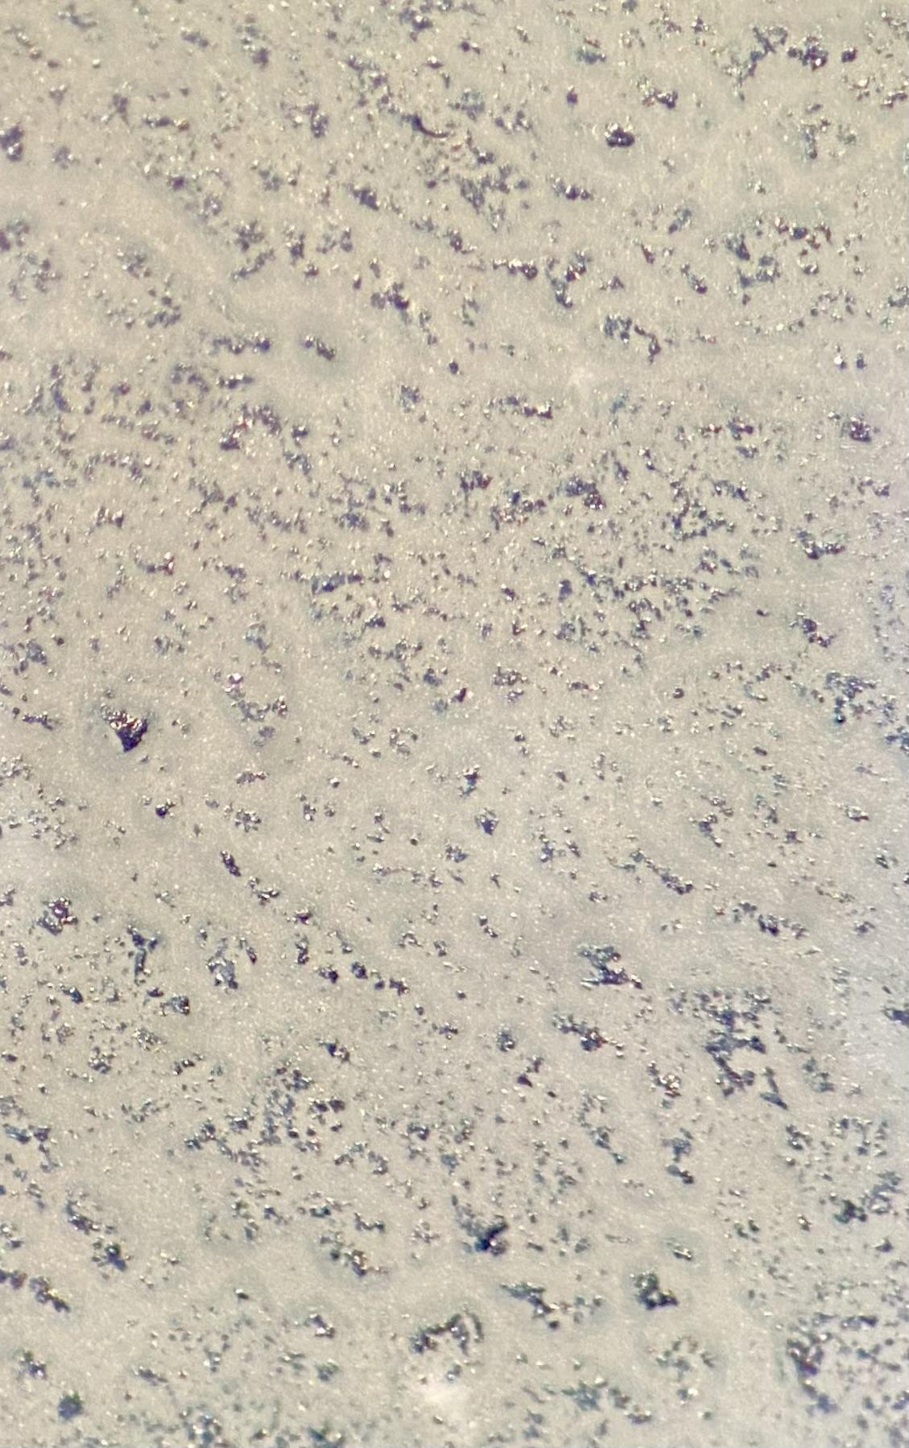
Comparison of Gold Chloride Concentrations

Slide 11
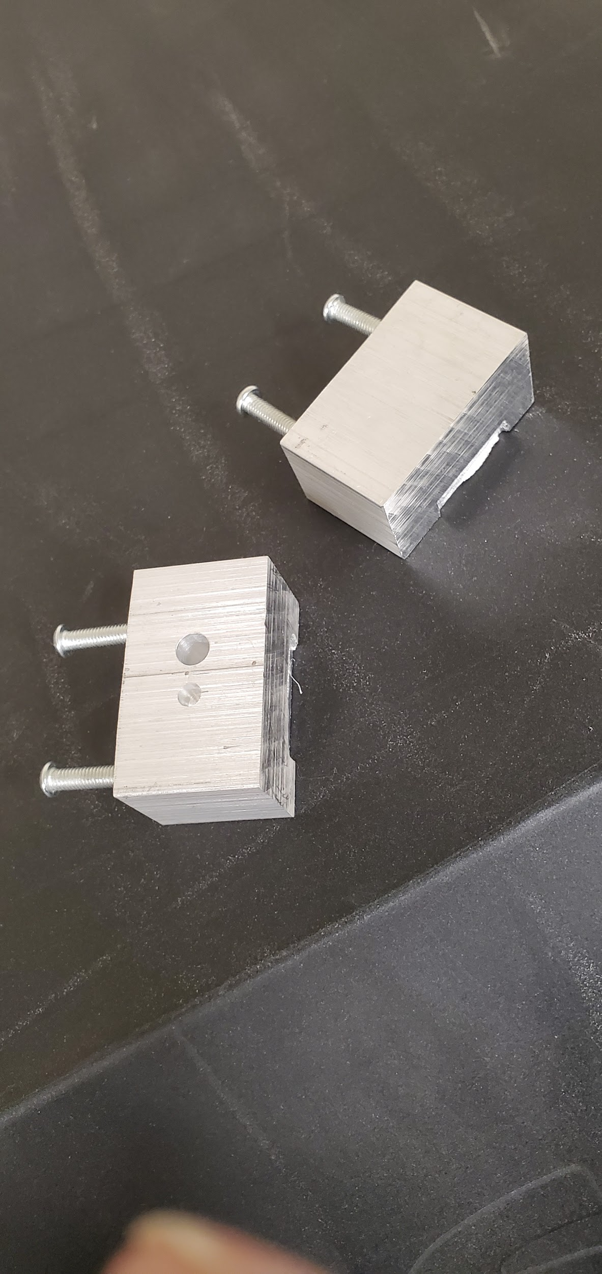
Setbacks
Delay in arrival of materials
Issues with TEP Holder
  Unable to measure Seebeck coefficient

Slide 12
Achievements
Fabrication of thin-films with various dopants
Resistivity measurements and conductivity calculations
Comparison with existing literature
Surface morphology analysis

Slide 13
Overall Personal Experience
Enhanced understanding of organic semiconductors
Advancement of technical skills
Adaptability in overcoming unexpected challenges

Slide 14
Are there any questions?

