Slide 1
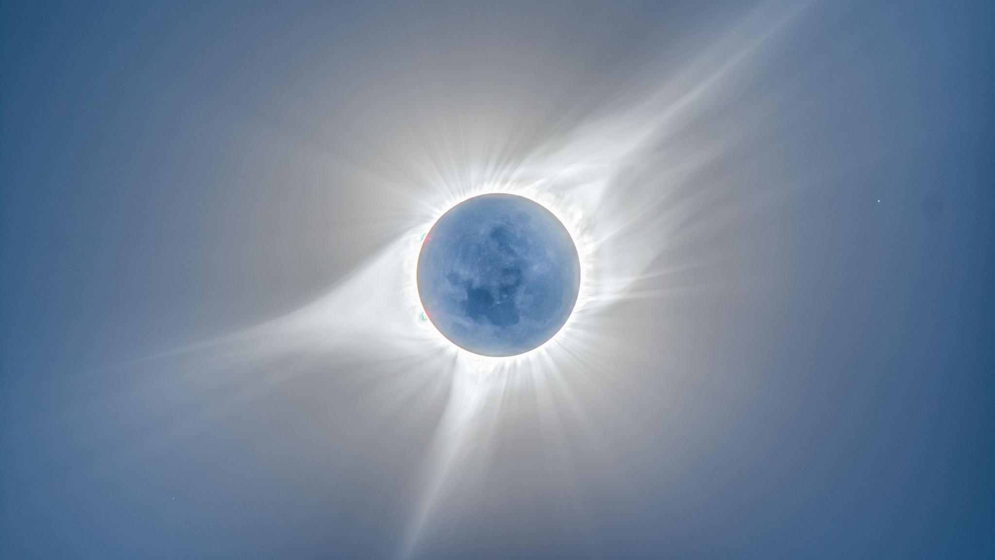
Differential Solar Rotation
Logan Aikens

Slide 2
Overview
Background
Mission
Alternative goals
Key factors
Equipment/software
Capture methods
Results
Key outcomes/trends
Challenges
Implications
Advise/Future notes

Slide 3
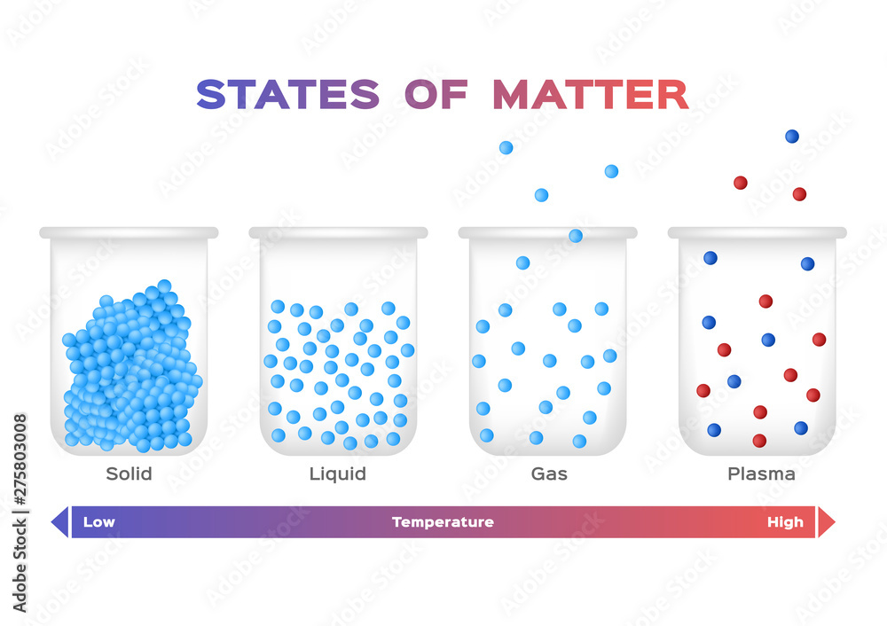
Background
The sun is considered plasma rather than solid and very hot
Sunspots are areas under an intense magnetic field

Slide 4
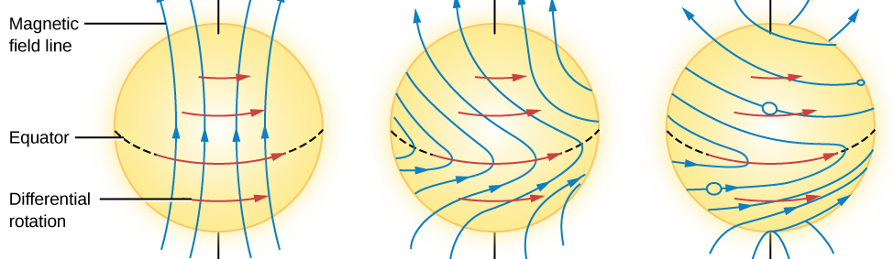
Mission
Calculate the rate of rotation based upon latitude on the Sun’s surface

Slide 5
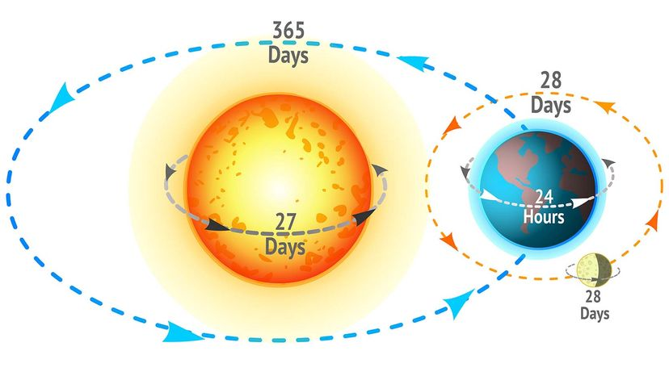
Alternative Goals
Accurately show differential rotation
Capture massive amounts of data
Familiarize myself with the problems of astrophotography

Slide 6
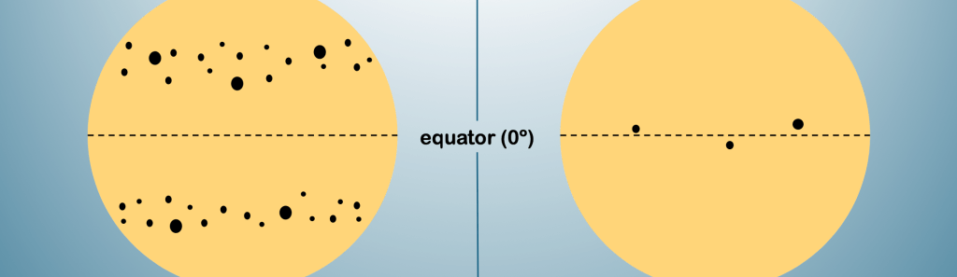
Key Factors
The Sun’s axis angle changes
Sunspots do not tend to form at latitudes higher than 35 degrees

Slide 7
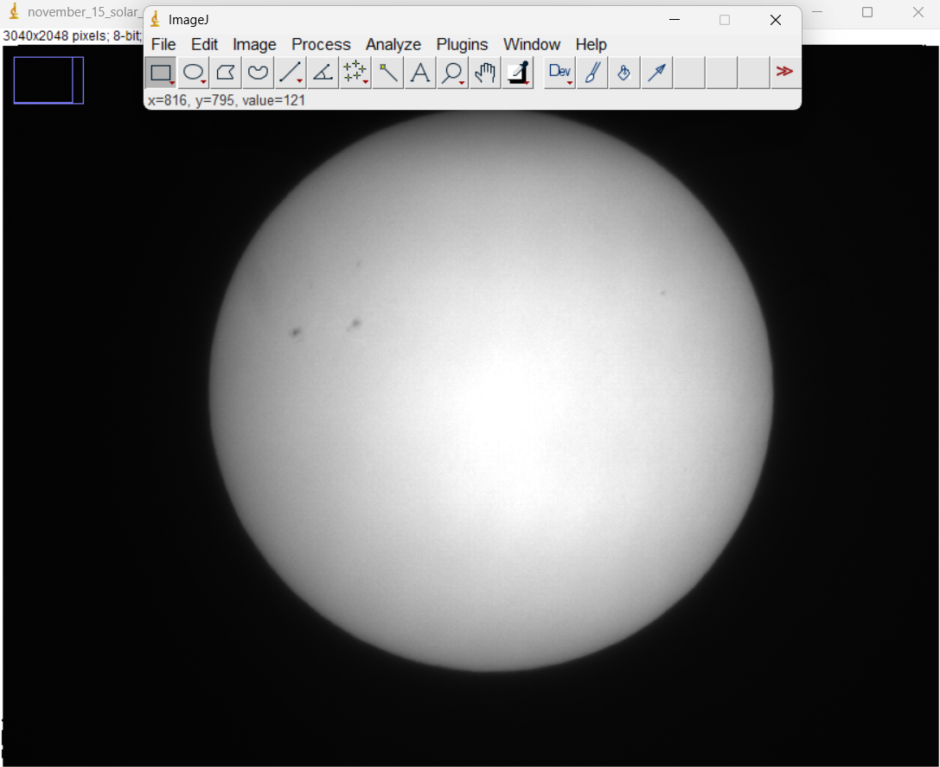
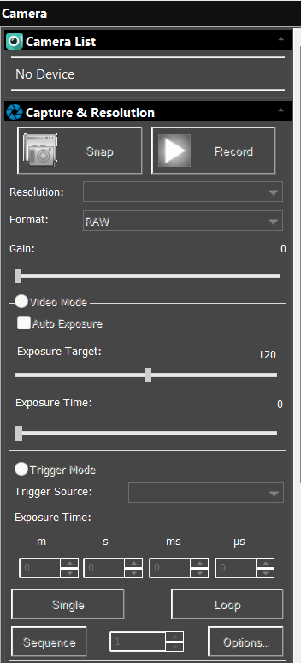
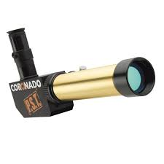
Equipment/Software
Coronado PST
Meade Monochrome LPI-G
Meade Sky Capture
ImageJ

Slide 8
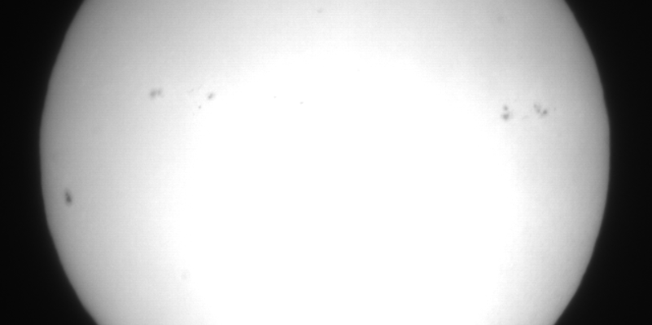
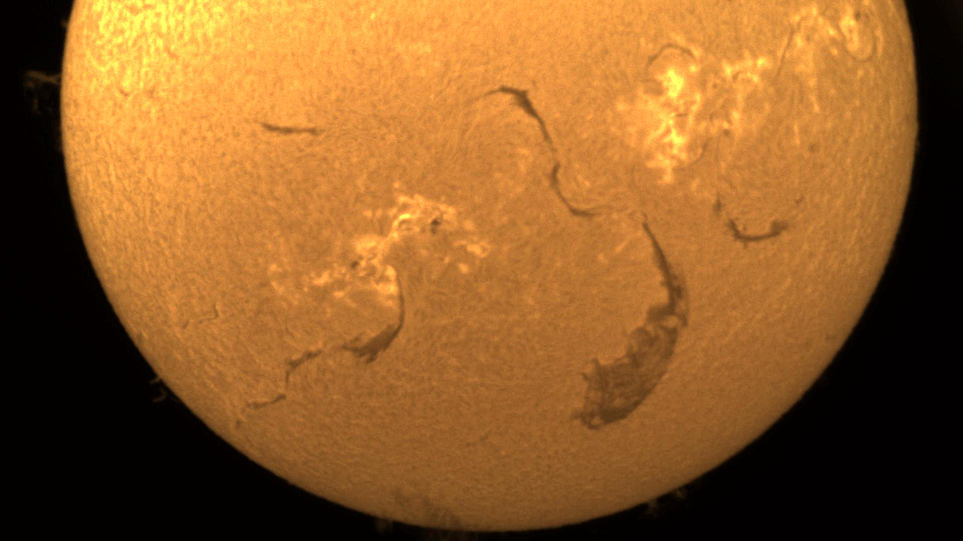
Capture Method
Personal captures
Slooh captures

Slide 9
Results

Slide 10
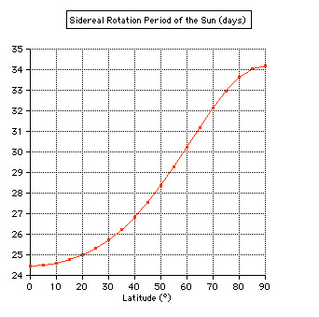
Key Outcomes/Trends
On both sets of data its clear the equator has the fastest period
Although Slooh is lower than expected the trend is there

Slide 11
Challenges
Camera setup/settings
Getting massive amounts of photos
Weather
Correcting the Sun’s axis angle
Time management

Slide 12
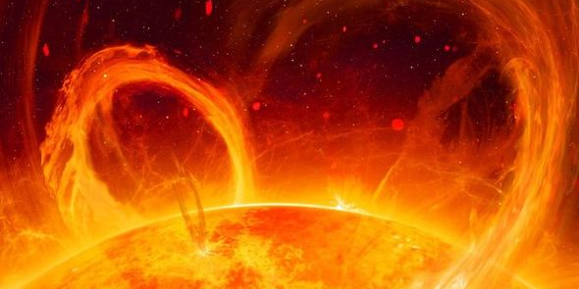
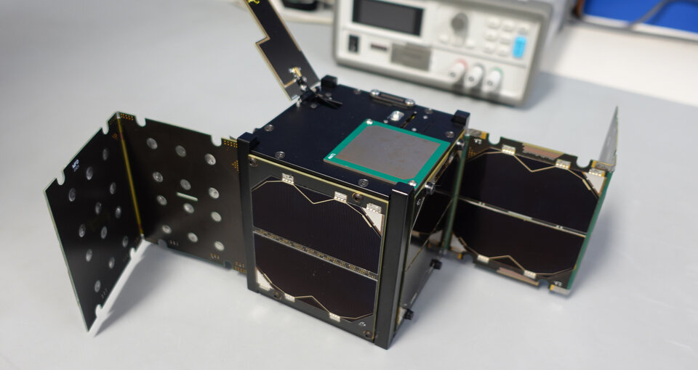
Implications
The earth is affected by the solar radiation of the Sun
Solar wind patterns can be studied more intricately
Coronal Mass Ejections affect Earth’s magnetic field

Slide 13
Advise/Future Notes
Plan writing sections before you start writing
If the weather isn’t terrible, try and take data
Organize data clearly and effectively
Talk to your peers about your project

Slide 14
Thank You

