Slide 1

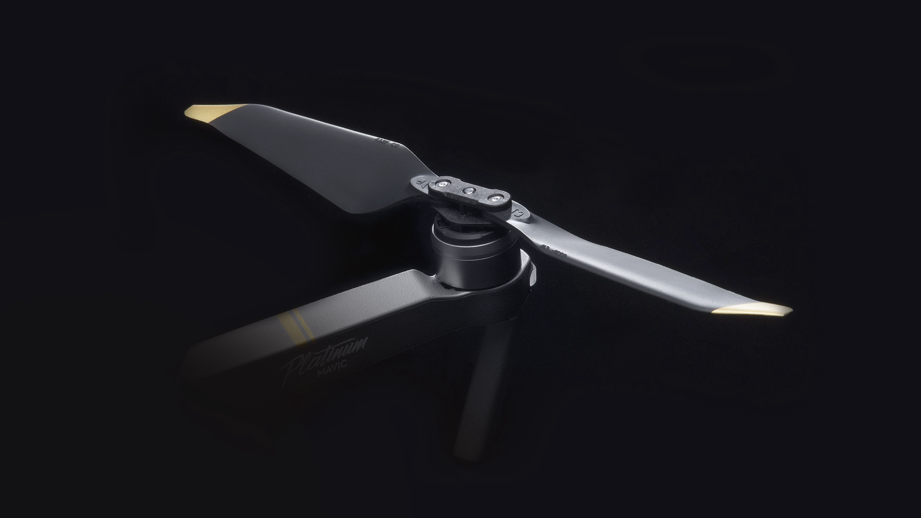
Designing the Future Propeller
By Zander Farr

Slide 2


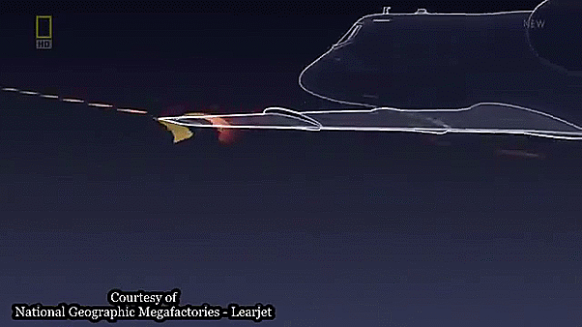
Project Overview
My goal is to design and manufacture a propeller that reduces wing vortices to increase efficiency and noise reduction.
Study the effects of blade count, winglets, and geometry on a propeller’s overall efficiency

Slide 3
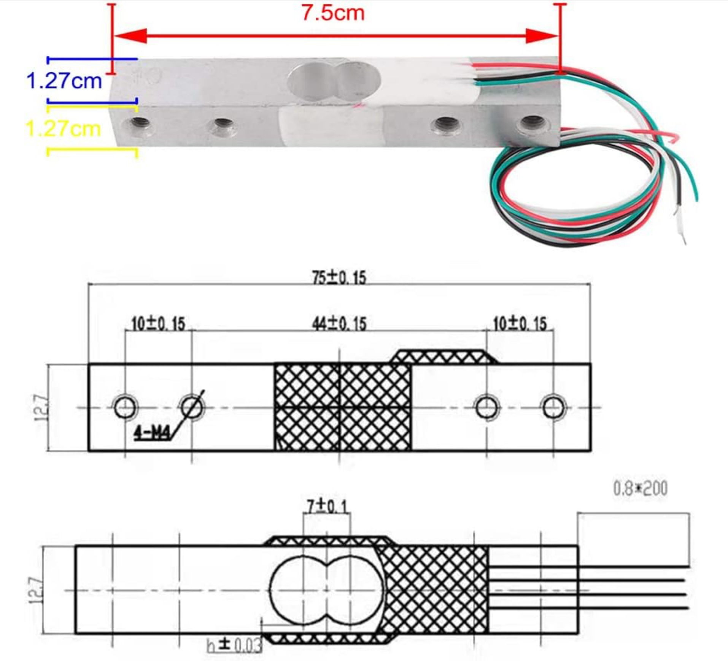
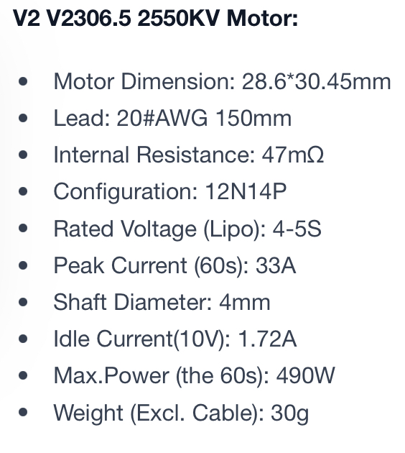
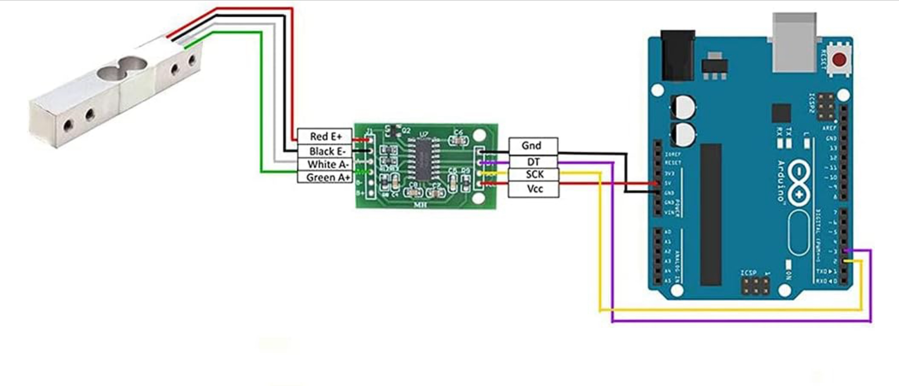
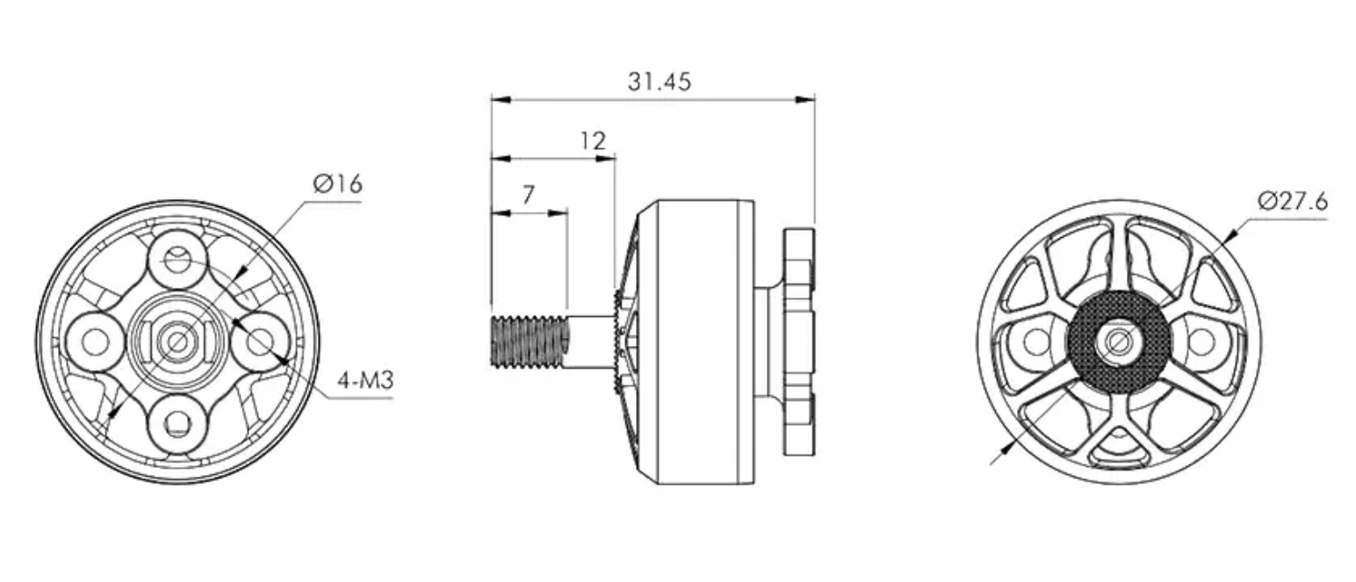
Timeline
Collecting resources – Completed
Construction of thrust stand - Completed
  - Data sheet collection
  - 3D modeling
  - HX711 loadcell, flight controller and ESC soldering
  - 3D printing
  - Construction
  - Load cell code
  - Load cell Calibration

Slide 4

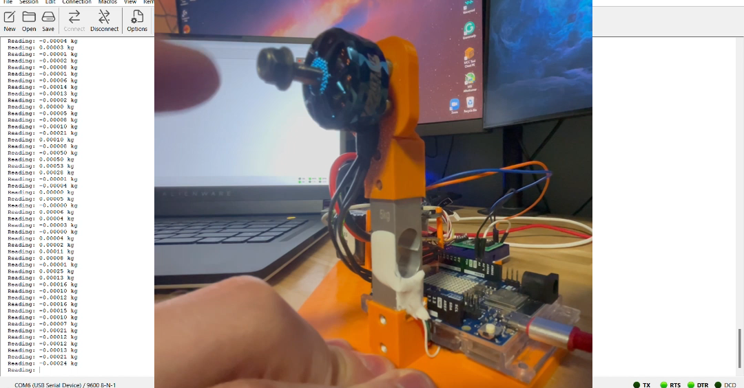




Slide 5
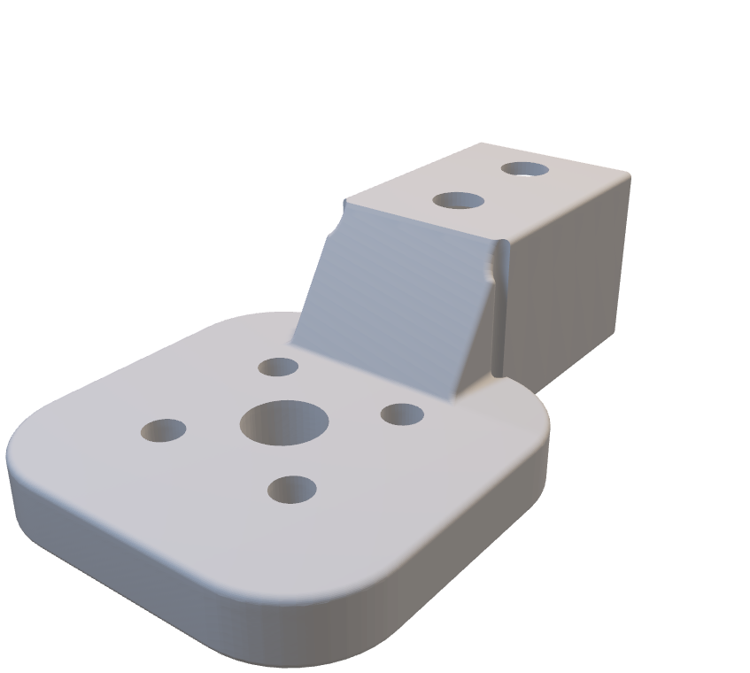
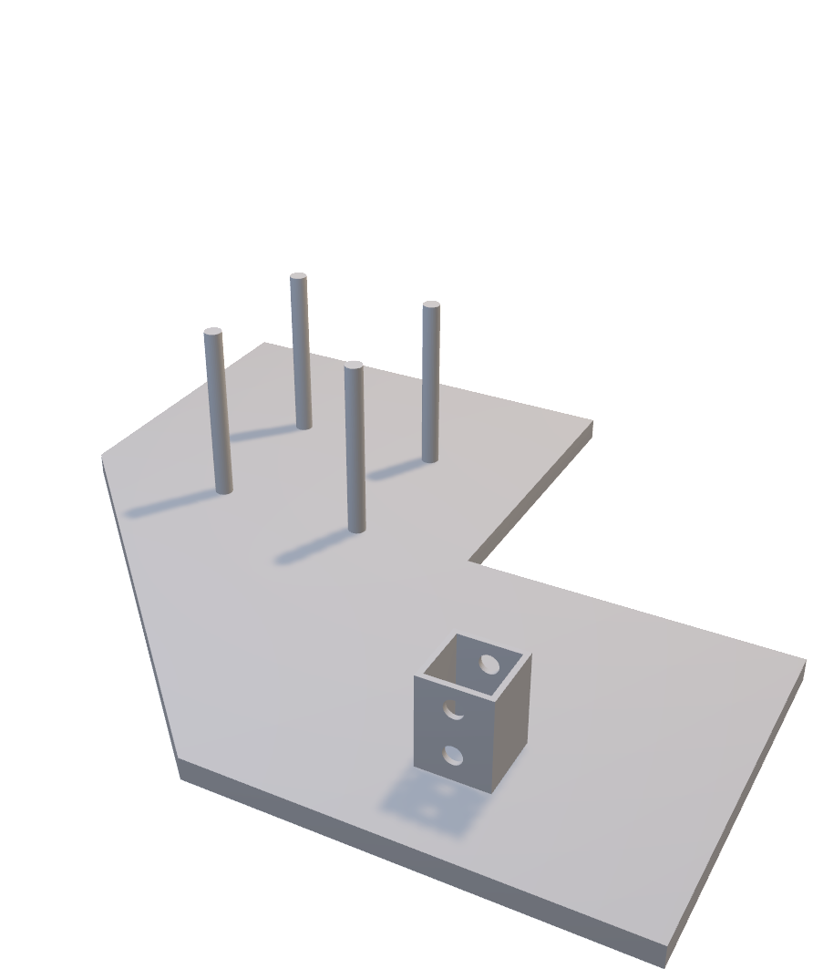

Slide 6
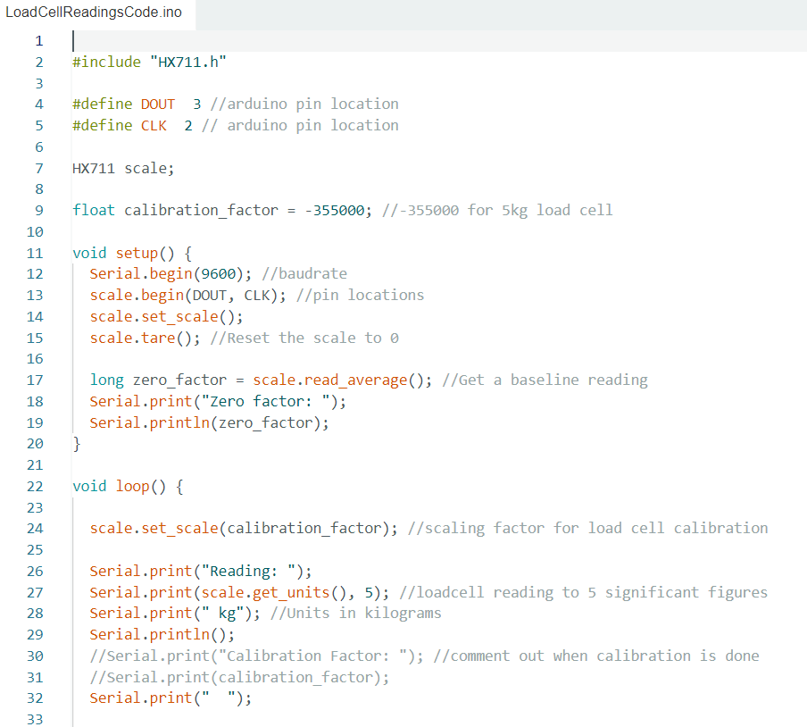
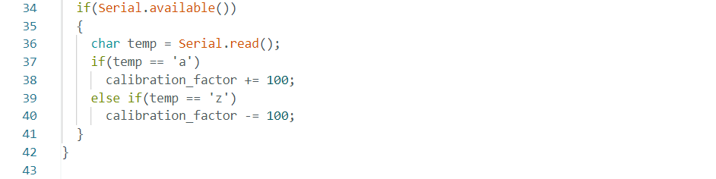
Arduino Code
Some basic read and write code to get the
loadcell functional. Using the HX711 library to calibrate the cell and then reading the loadcell values through the pin 2 and 3 location.

Slide 7
Timeline Continued
Study theory and research – Continual
Annotated Sketches – Working – Completed by October 27th
First Design and preliminary flow simulation – Completed by October 4th
Mathematical Analysis – Completed by October 11th
3D Printing – Completed by October 18th
Data collection – Completed by October 25th
Refine Design – Completed by November 8th
Collaborate with Jeffrey Dessaro – Completed by November 8th
Compare Data to traditional Propellers – Completed by November 15th
Prepare Final Presentation and Project Summary – Completed by December 6th

Slide 9
Plan for the coming weeks
In the next coming week, I plan to finish milestone 3 and continue finishing my introduction. Once the introduction is finalized, I will start writing out the technical aspects of my project including the thrust stand build and propeller theory.

Slide 10
Questions?

