Slide 1
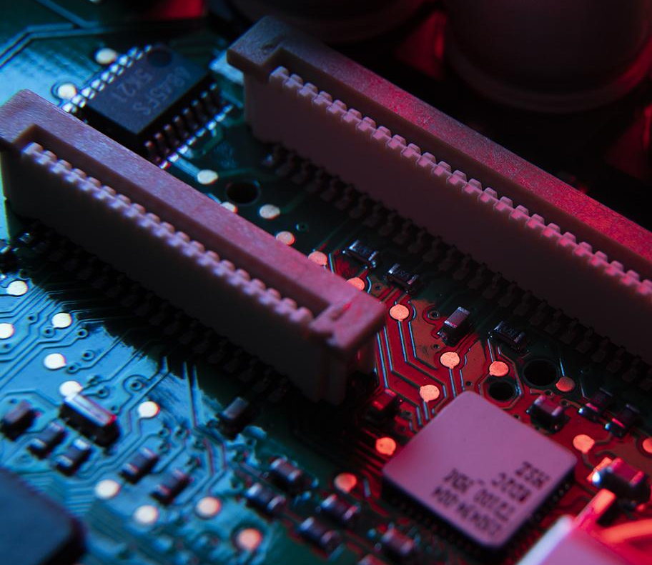
Organic Semiconductors: Analyzing Thin Films
By: Natalie Clum

Slide 2
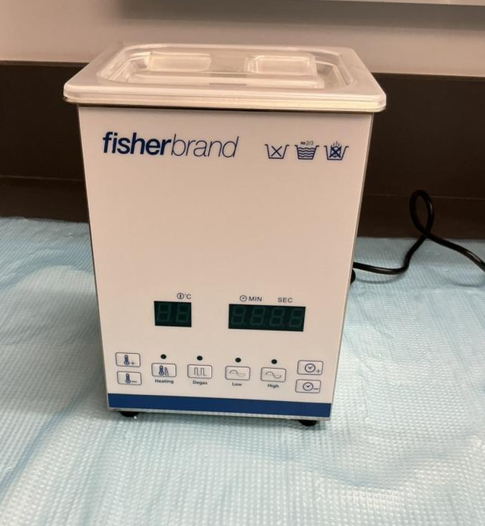
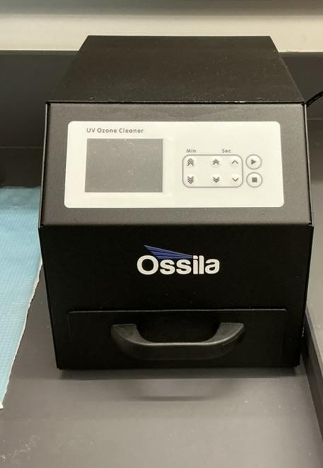
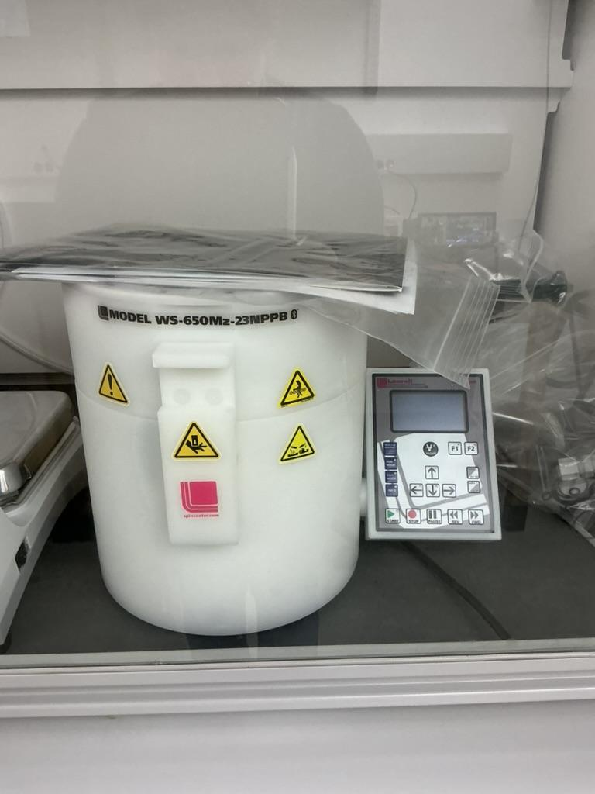
Project Review
Creating thin film using polymers:
rr-P3HT
rra-P3HT
Solvent for the polymer solution:
Chlorobenzene
Doping
used to improve charge carriers and electrical conductivity

Slide 3
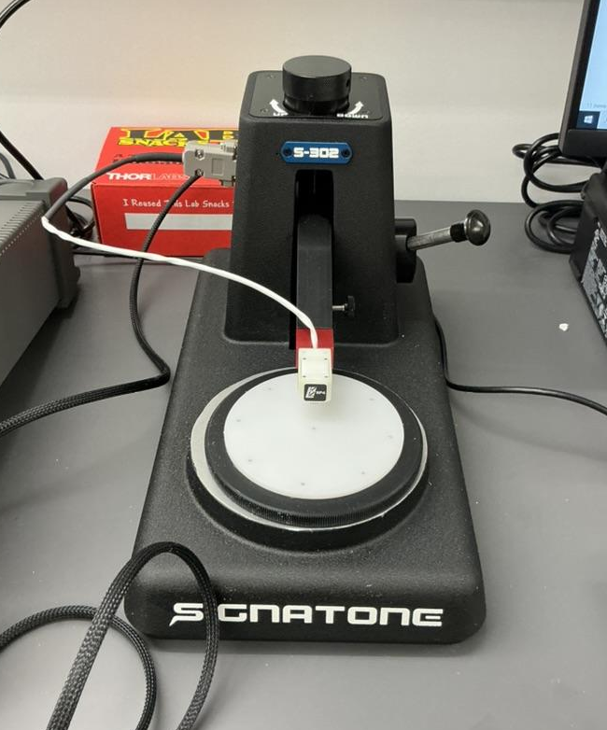
Experimental Measurements
Parameters that are to be measured/calculated:
Resistivity
Seebeck coefficient
Power factor

Slide 4
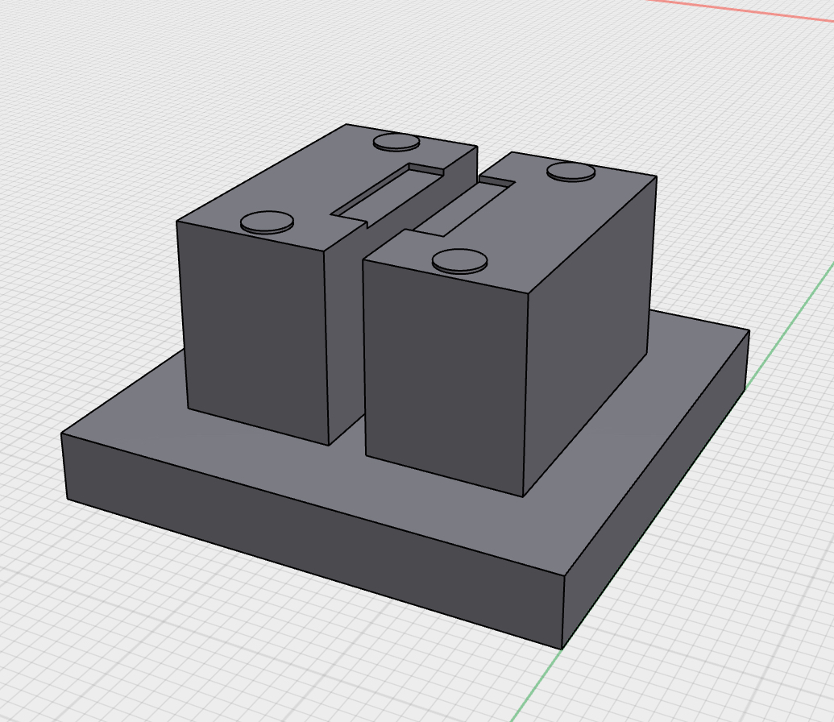
Progress Report
Materials Ordered
Rough Draft of Introduction
3D AUTO CAD design of TEP Holder
Half way through theory research
  Beginning to start writing theory section of report

Slide 5
Reformulation of Milestones
More specific topic
Increased amount of research
Might have to make possible future adjustments to timeline

Slide 6
Next Milestones to Complete
All materials are collected
Introduction and Theory sections of report are finished
TEP Holder is completed
Well developed understanding of Labview
Comprehensive understanding of all lab equipment
Successfully created thin film using polymers

Slide 7
Milestone Timeline
10/7
10/14
11/4
11/22
Introduction & Theory sections should be completed
TEP Holder should be completed
All data should be collected
Draft of report should be completed

Slide 8
Project Weekly Timeline
10/7 - 10/14
Begin conducting research
Next Week :
10/14 - 10/21
Have at least one successful thin film to conduct tests on
Start 3D printing of TEP Holder
Finish rough draft of theory section
Work on lab skills
10/28 - 11/4
Have a significant amount of data compiled
11/4 - 11/11
Finishing up any research and begin analysis of research
11/11 - 11/18
Work on finishing the report

Slide 9
Thank You!
Are there any questions?

