Slide 1
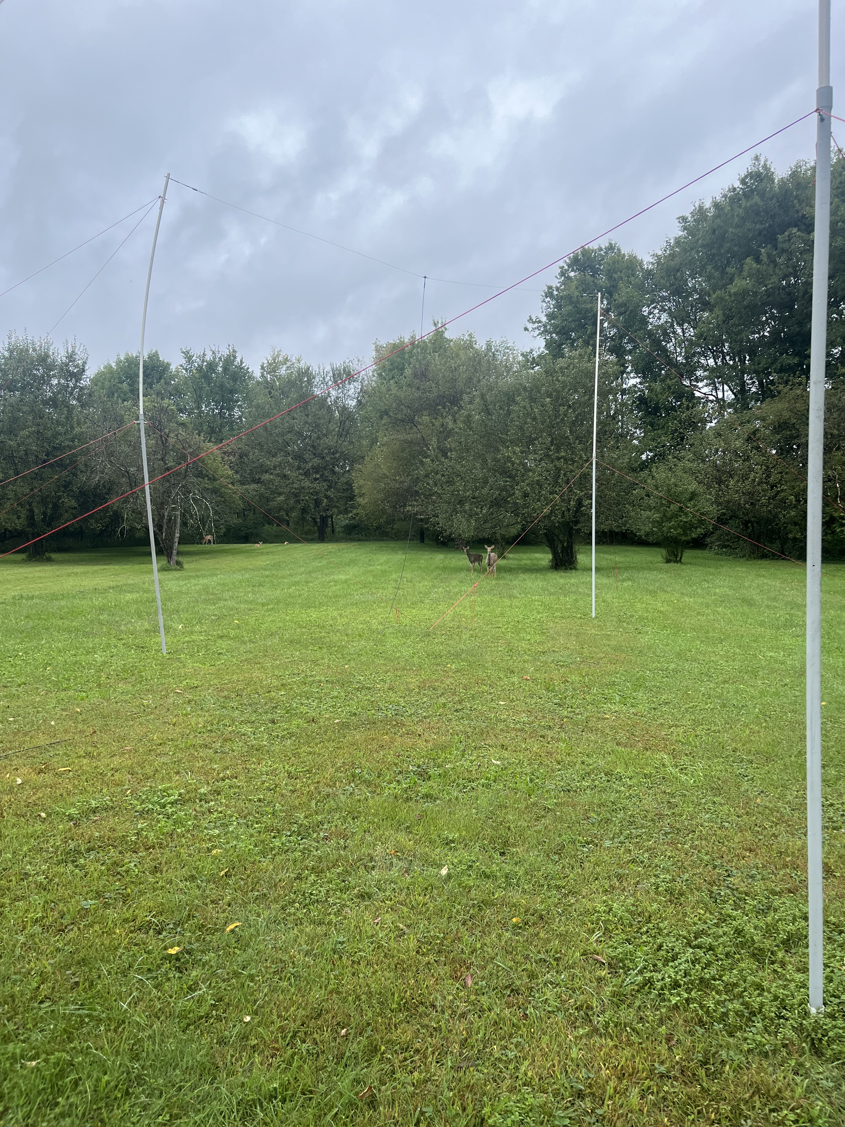
Measuring Radio Waves in the Ionosphere using the Radio Jove Telescope
Danny Bernabe

Slide 2
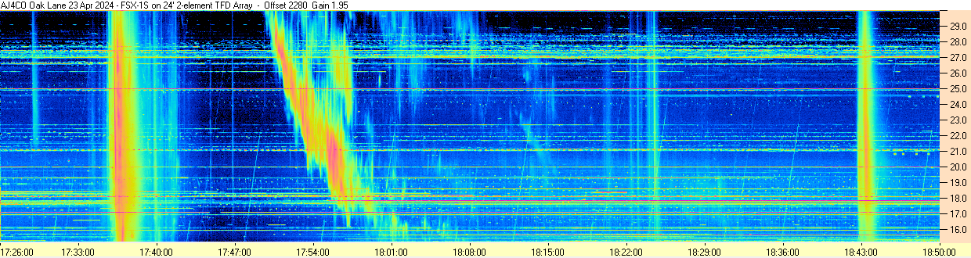
Summary of Project
What is the Radio Jove telescope?
  Measure Radio waves in the Ionosphere
Observe how changing the height of the antenna effects the data received
Observe how ”steering” the antenna effects data collection throughout a day

Slide 3

Progress to Date
Building of necessary equipment for telescope
Preliminary setup and testing
Solar Eclipse setup and data collection
Setup telescope for data collection in different configurations
Acquired a second receiver so I could set up a second antenna to have a control antenna
Troubleshooted issues with data not appearing
Recorded data at 20 ft (control), and have moved one antenna to 15 ft

Slide 4

Problems encountered
Receiver not talking to computer
Wrong version software
Color gain not matching
Length of coax cables not matching
Computer freezing/rebooting, leads to lost data
Explore autosaving options

Slide 5
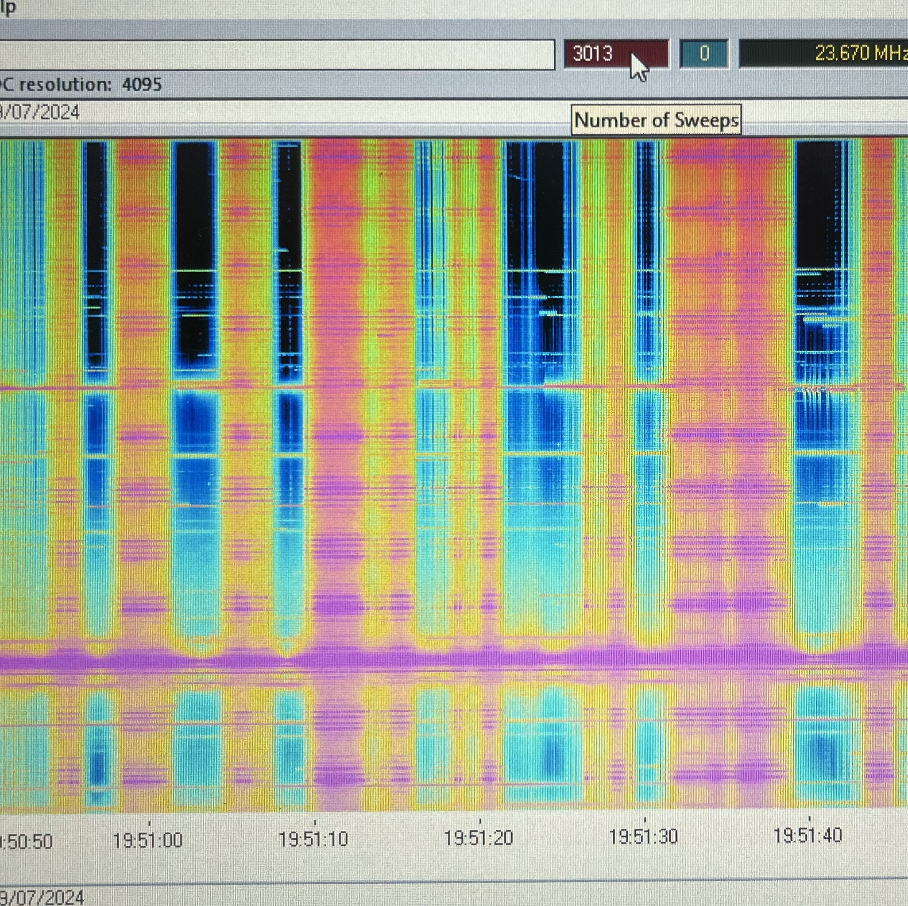
Adjustments to the Project
Decided that having a control to compare the different configurations to
  Making the data match for each antenna/receiver/computer
  Issues with saturation
Observe Jupiter and measure radio waves coming from there
  Easier to predict storms from Jupiter than from the Sun
  Storms are dependent on which longitude of Jupiter is visible from Earth, and where Io is in its orbit

Slide 6

Updated Timeline
this weekend
Move Telescope to 10 ft
5 Oct.
Move Telescope to 10ft/15ft
12 Oct.
Reverse orientation from last week
19 Oct.
Move telescope to 15ft/20ft
26 Oct.
Reverse orientation from last week
2 Nov.
Jupiter Observations
9 Nov.
Processing of data

