Slide 1
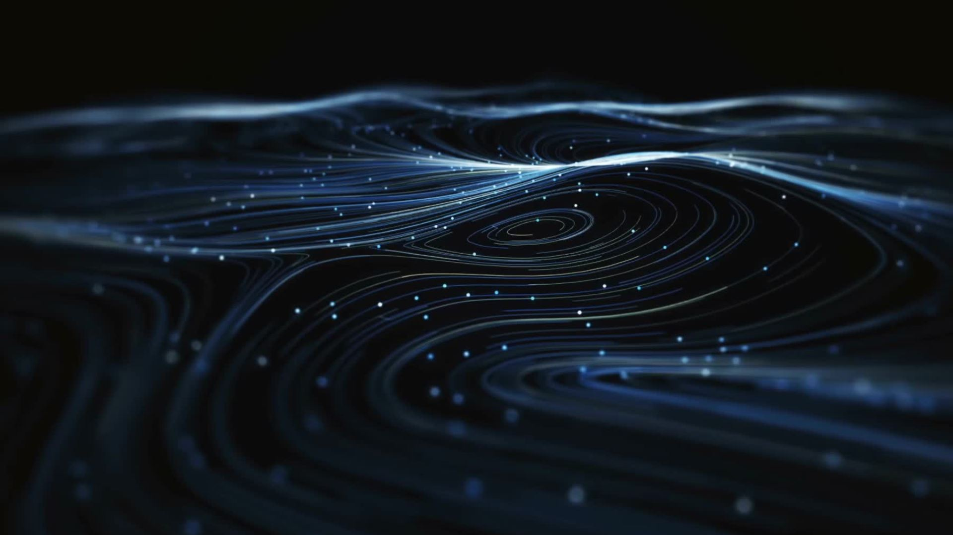
Differential Solar Rotation

Slide 2
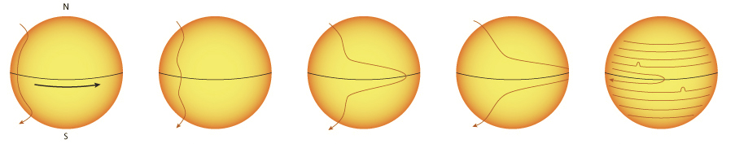
General Overview
The sun is a very hot ball of plasma (not solid)
Sunspots
Analysis/postprocessing
Results and mapping

Slide 3
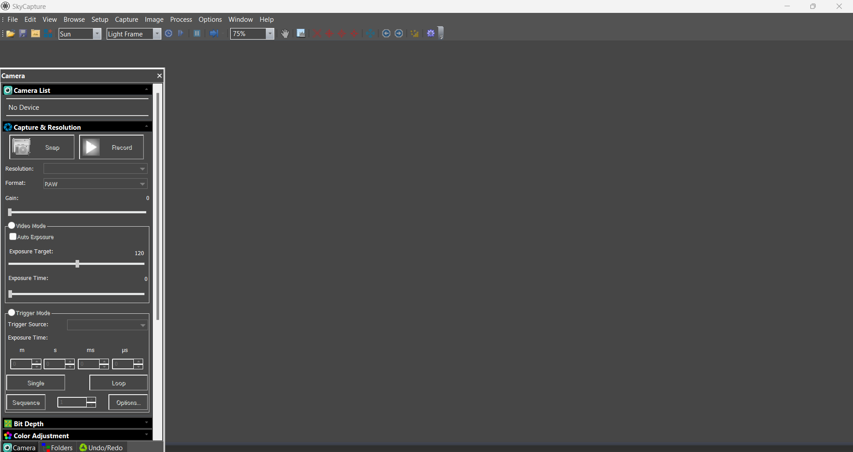
Progress Thus Far
Writing
Mathematical Analysis
Software

Slide 4
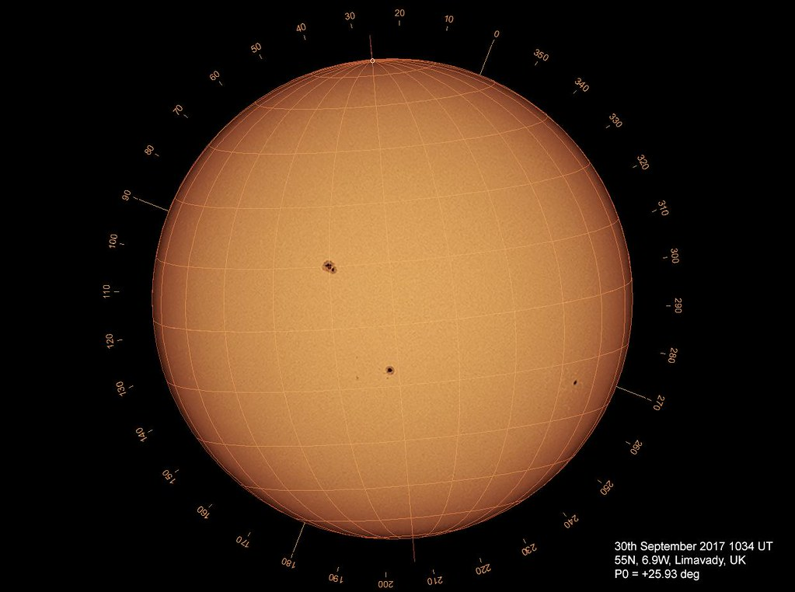
Math
Alignment
Degree/day
Unit Conversion

Slide 5
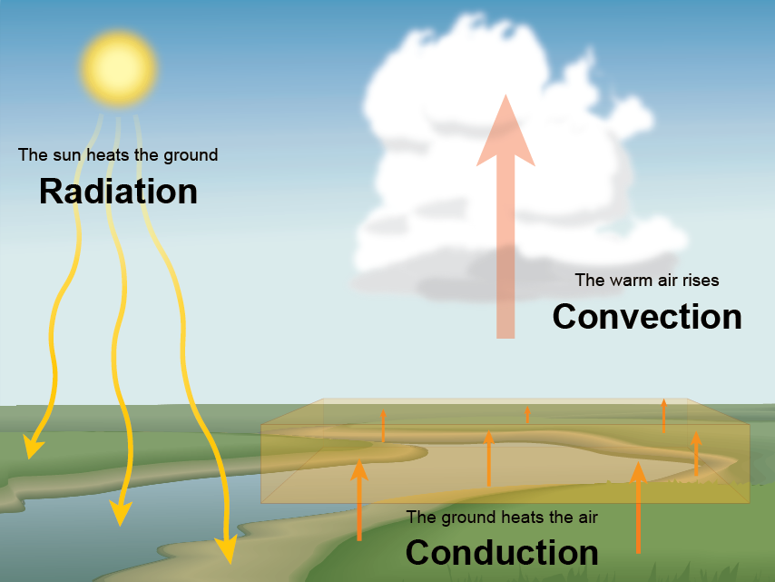
Complications
Camera exposure
Atmospheric heating
The wonderful weather of Syracuse

Slide 6
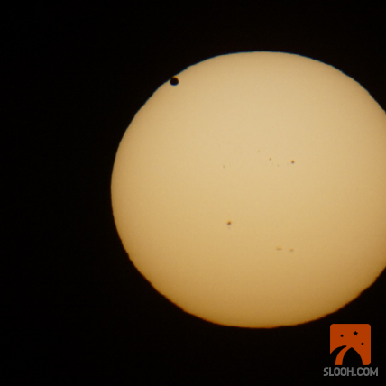
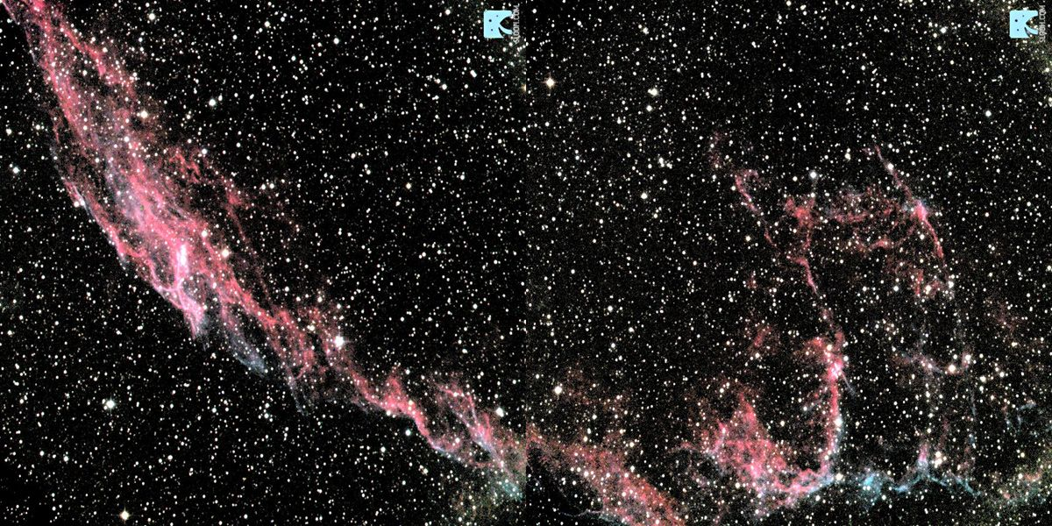
Changes/Additions
Slooh imaging
Schedule

Slide 7
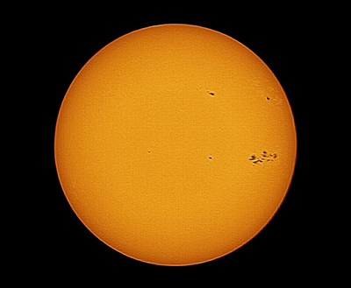

Go Forward/Future Plans
Start taking images on Slooh
Figure out exposure
Begin my rough draft

Slide 8
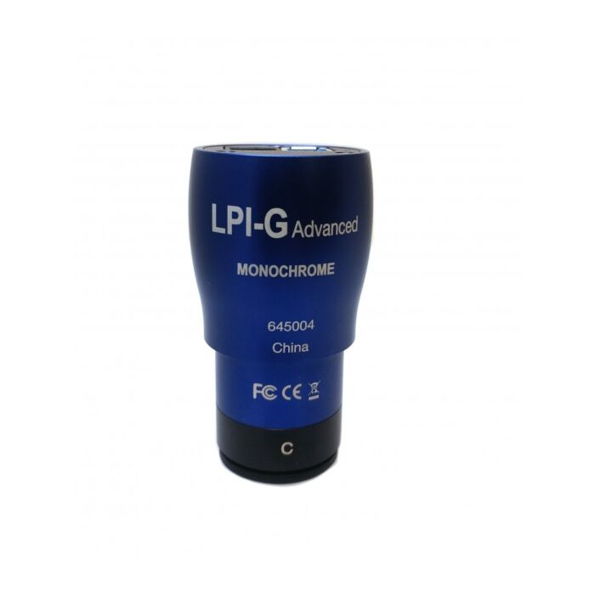

Thank You

