Slide 1
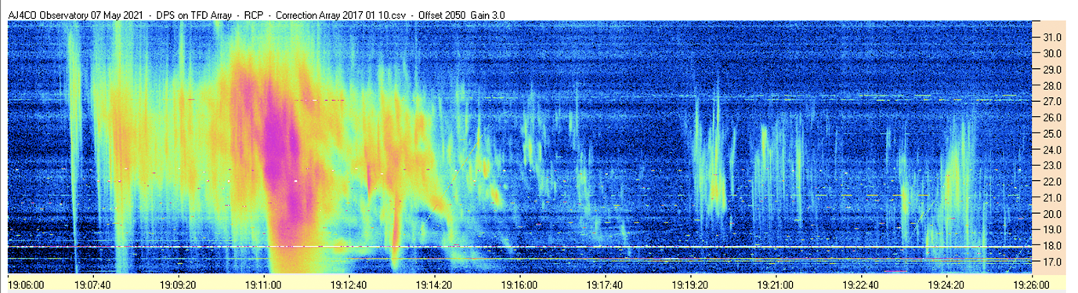
Measuring Energy in the Ionosphere using Radio Jove telescope
Danny Bernabe

Slide 2
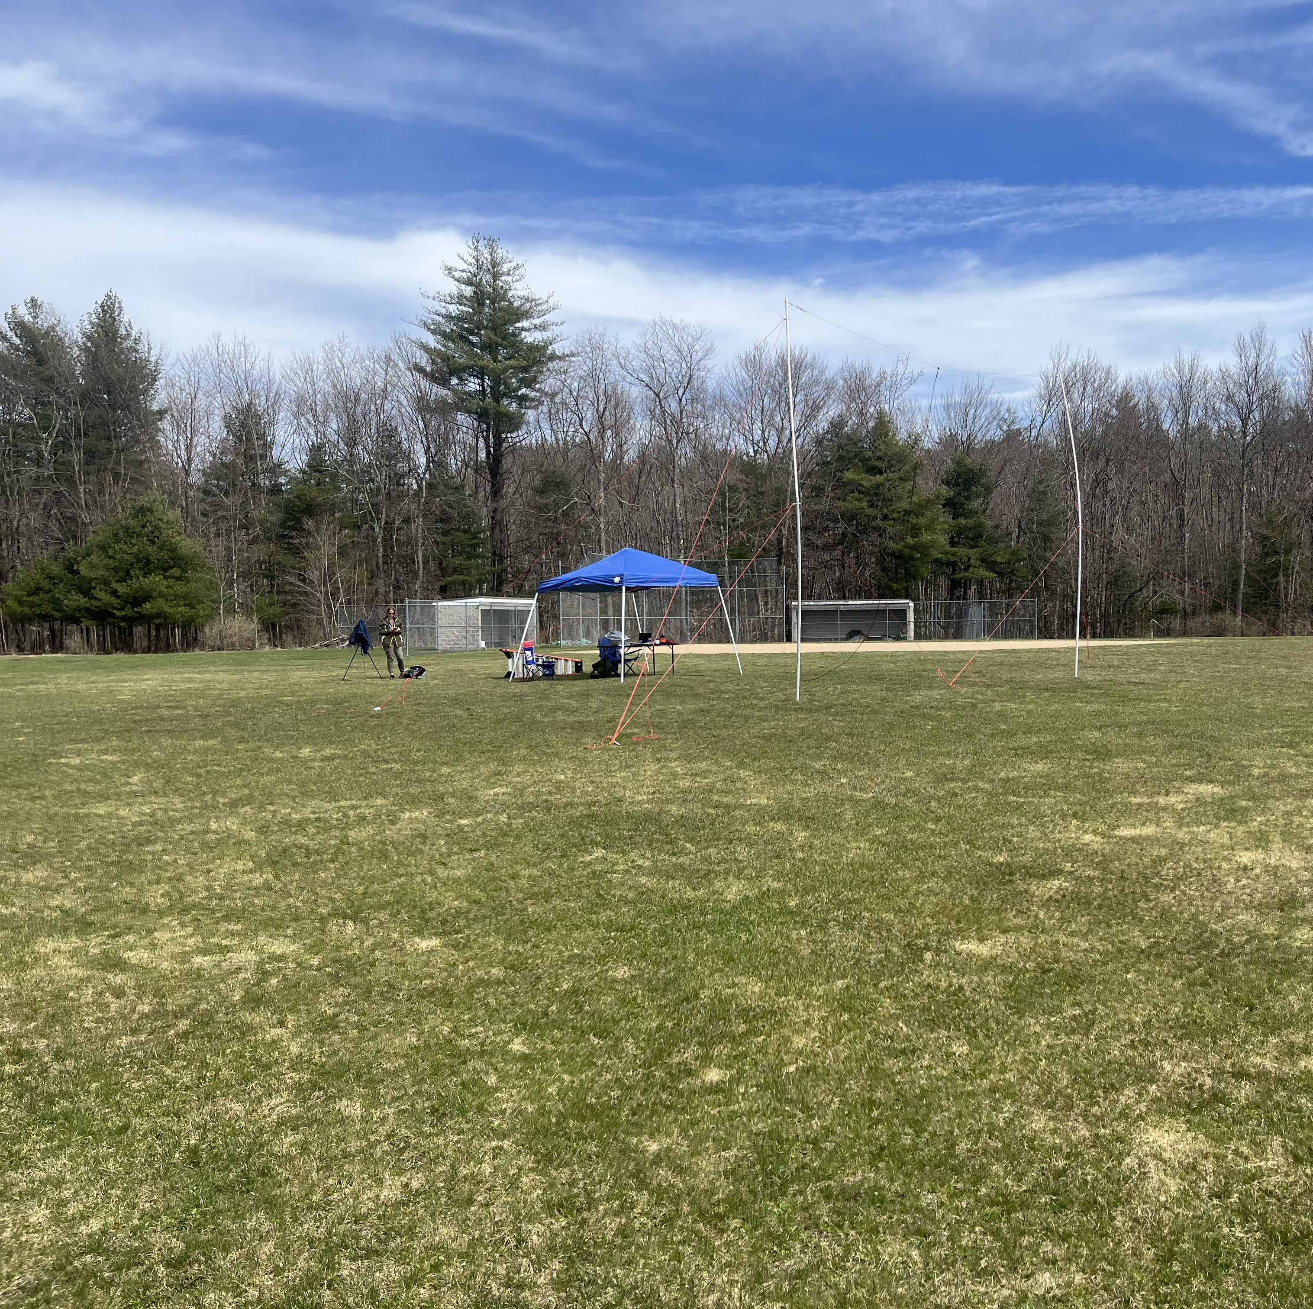
What is the Radio Jove Telescope?
Radio telescope designed to focus on radio emissions from the Sun and Jupiter
Main components include
  Antenna(s)
  The Radio Receiver
  Computer/ Software

Slide 3
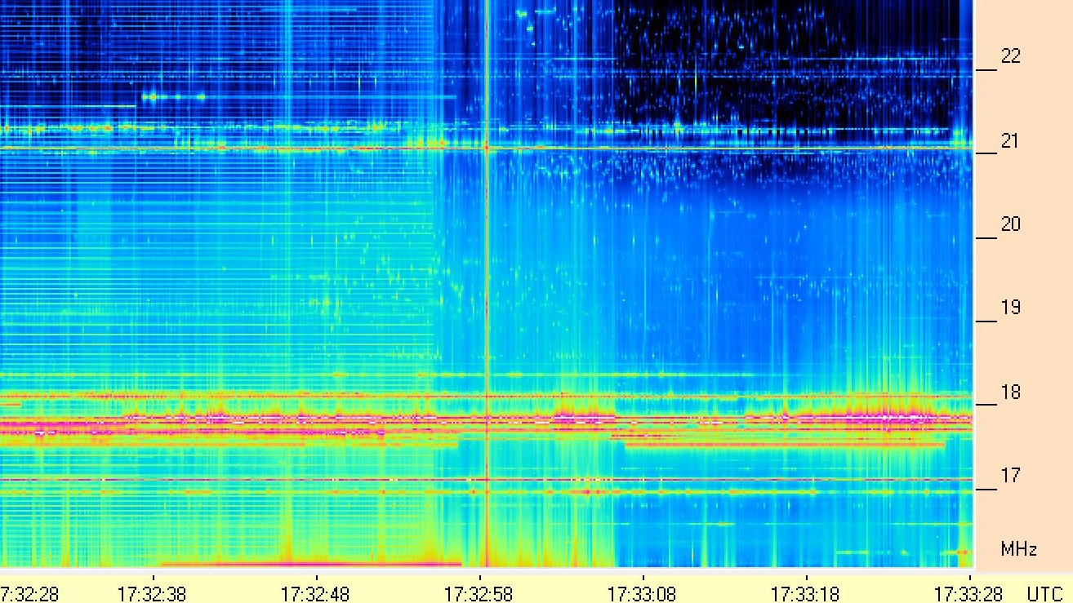
What does the data look like?

Slide 4
Outline of Project
Observe the radio waves present in the ionosphere during the solar eclipse on April 8th, 2024
Observe the differences between setting the antenna to different heights
Observe the differences in changing the vertical orientation of the antenna (steer East vs. steer West)

Slide 5
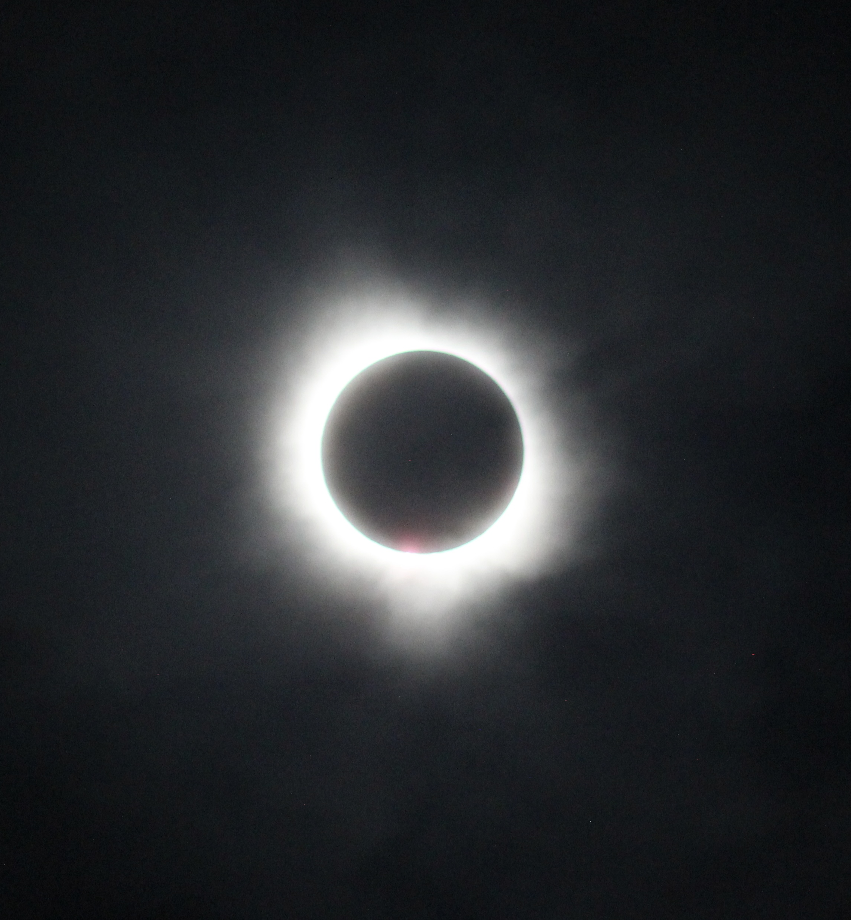
Completed to date
Building of necessary equipment for telescope (mid March)
Preliminary setup and testing (March 29th)
Solar Eclipse recording (April 8th)
Background research (Summer)
Set up telescope for more data collection (August 23rd)

Slide 6
My intended data to collect
All data will be recorded with a singular antenna
Solar observations require one antenna, while observations of Jupiter and Galactic Background require two antennas
Collect data at all 3 heights (20ft, 15ft, 10ft)
Observe if different heights effect the antennas' ability to pick up data over a wider portion of the sky, improve the accuracy of the received data, and to see if there are any noticeable differences in the background frequencies that occur in the data.
One side at 20ft, one side at 15ft, and reverse the other way
Same but at 10ft and 15 ft
Observe if the angle of the antenna skews the “hotspots” in the data to different times in the day

Slide 7
End Objectives
Compare how the radio waves emitted from the sun on a normal day differ from the data collected during the Solar Eclipse
Observe if changing the height of the antenna results in changes in the background picked up be the antenna
Observe if the change in height of the antenna changes the intensity of the received radio waves
Observe if changing the orientation of the antenna to off level changes the timeline on when the ionosphere has the most amount of radio waves present
(Extra bonus) Observe and record a Solar Flare

Slide 8
What is next (schedule)
Troubleshoot data receiver issues (est. completion sept. 8th)
Data recording of various heights and orientations (Sept. 8th – Oct. 26th)
Weather dependent
Processing of data (Oct. 26th to Nov. 16th)
Paper writing (throughout semester)

