Slide 1
Differential rotation of the sun
Logan Aikens

Slide 2
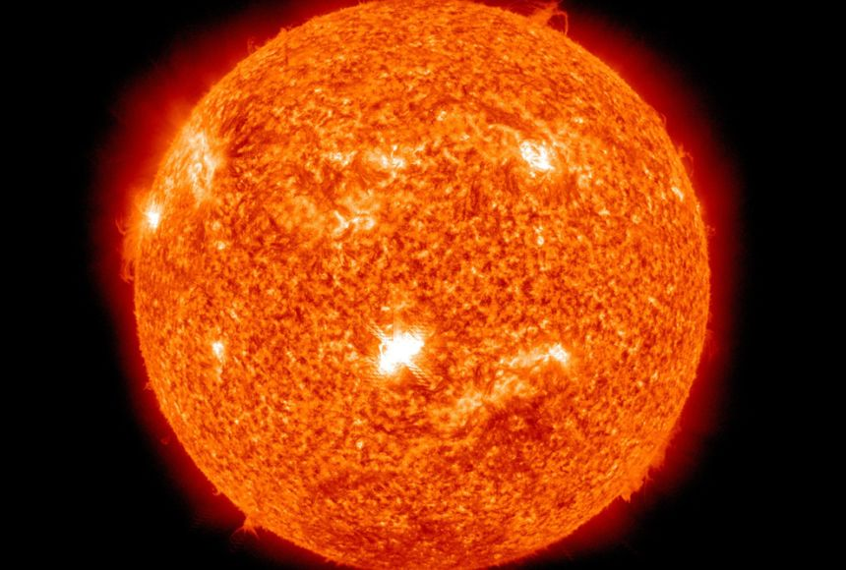
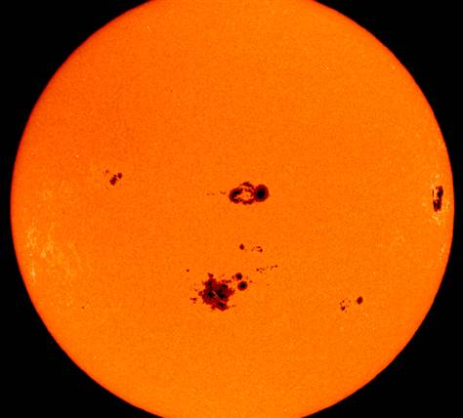
Project Outline
Nature of the sun
Sun spots
Combined tracking and analysis

Slide 3
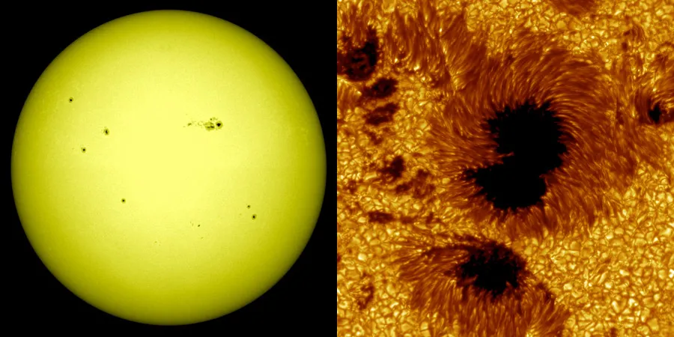
Objectives
Accurately determine the differential rotation
Compile data and capture professional images

Slide 4
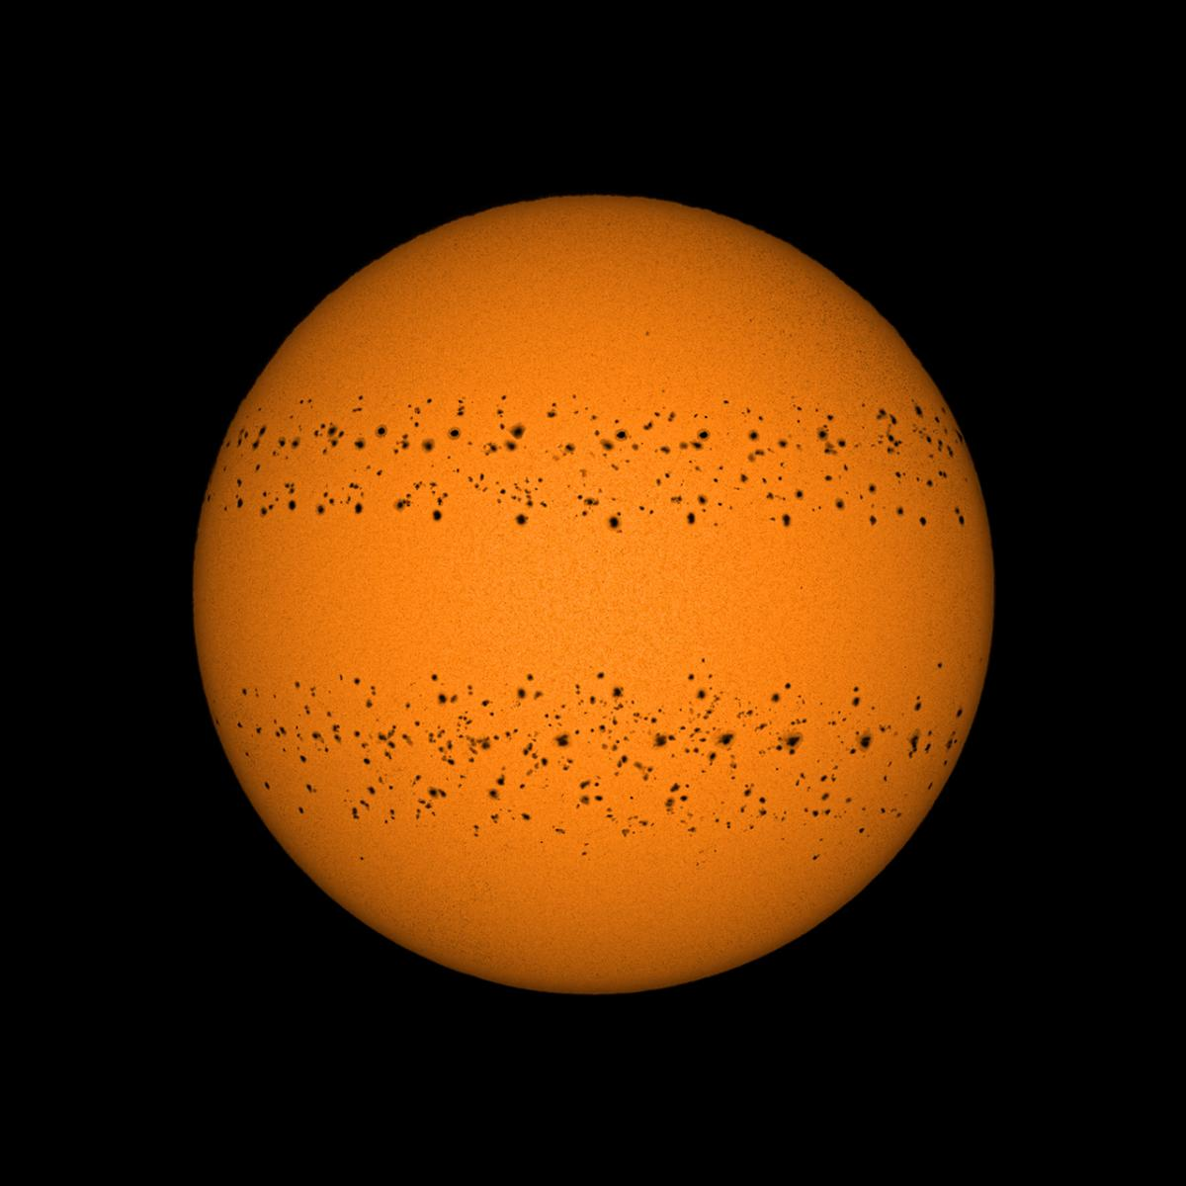
Report Outline
What is differential rotation/research on
Equipment mapping
Liquid mechanics
Sun spots
Mathematical analysis of the data
Mapping/results
Data and images

Slide 5
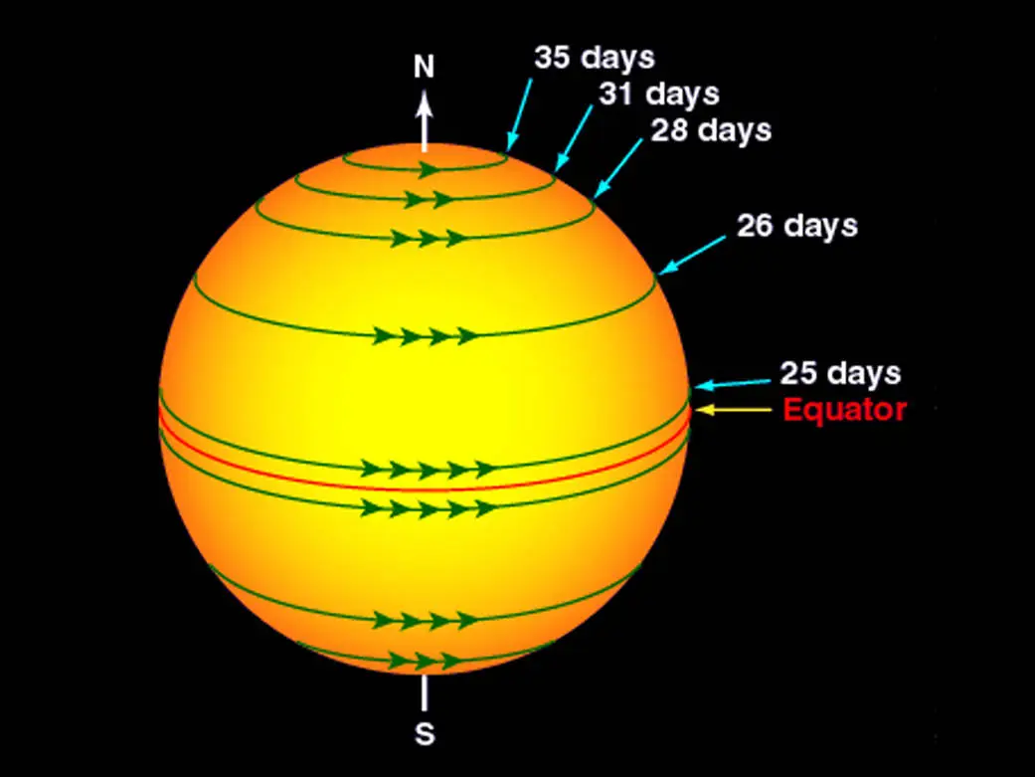
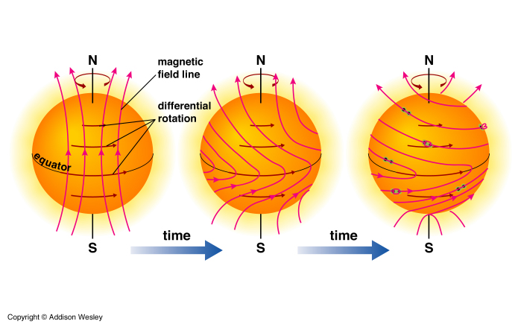
Status Report
Learned to use the telescope
Research on sunspots
Studied what fluid mechanics are happening

Slide 6
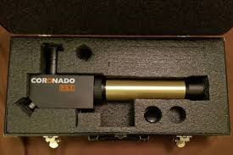
Next Steps
Set up telescope
Start gathering data
Commit and compile

