Slide 1
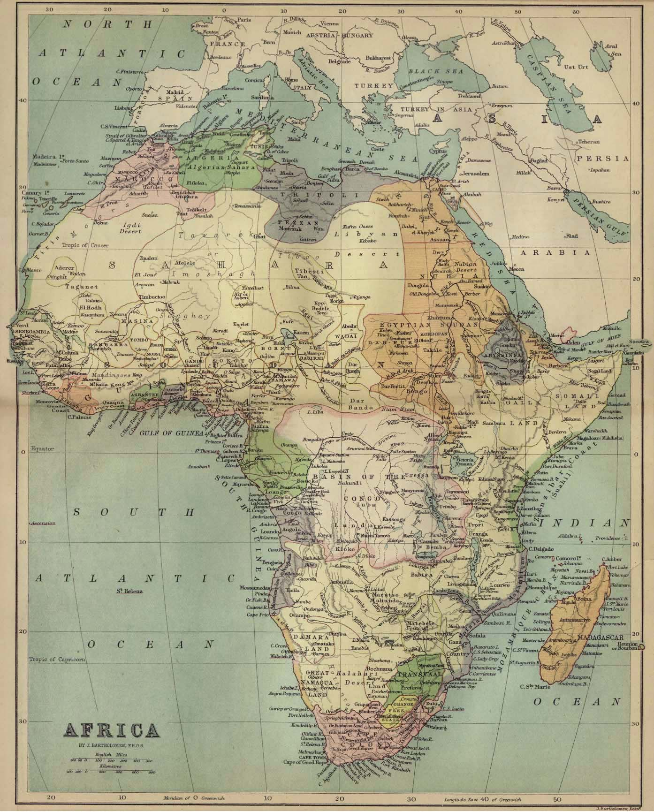

Partition of Africa

Slide 2
The Partition of Africa – aka: “The Scramble for Africa” 1880s to 1890s
Motivations:
1. Moral imperatives and adventurers
2. Economic
3. Nationalism
4. Strategic concerns
5. Political (weak)

Slide 3
LMS (London Missionary Society)- non-conformist Churches
CMS (Church Missionary Society)- Anglican
Catholic Missionaries –
White Fathers,
Holy Ghost Fathers- - Ludwig Krapf
Explorers/Adventurers/ Missionaries:
David Livingstone, Henry Morton Stanley

Slide 4
The Berlin Conference, 1884
Free Trade along major rivers; Niger and Congo.
Slave Prohibition was also a clause discussed in the Conference.
Meeting of European Powers
Principals of Effectivity;
flying flag, established police force,
economic control,
sign agreement From local Chiefs.
Otto Van Bismarck Previously uninterested in expansion
Before Establishment of Colonial Governments, Germany became the main broker in the Berlin West African Conference

Slide 5
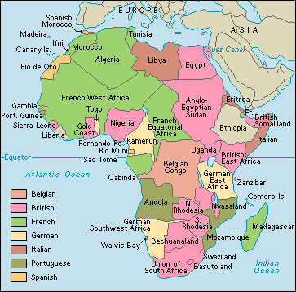

Slide 6
German Colonial Territories
German Southwest Africa
Genocide from Revolt; Herero and Namaqua
Organized Revolt in reaction of exploitation
Many died during armed conflicts
German’s established concentration camps

Slide 7
Togoland was the only successful African colony- good infrastructure and successful agriculture practices
German East Africa- opposed by Hehe tribe, supported by other tribes and relied on their leaders for stability
Kamerun- began as a trading post, 1884 call for German Protection
All colonies were develop through economic activities, later protected by government in face of indigenous resistance
Germany has a short history of colonialism, ended during WWI, colonies taken over by allied powers.

Slide 8
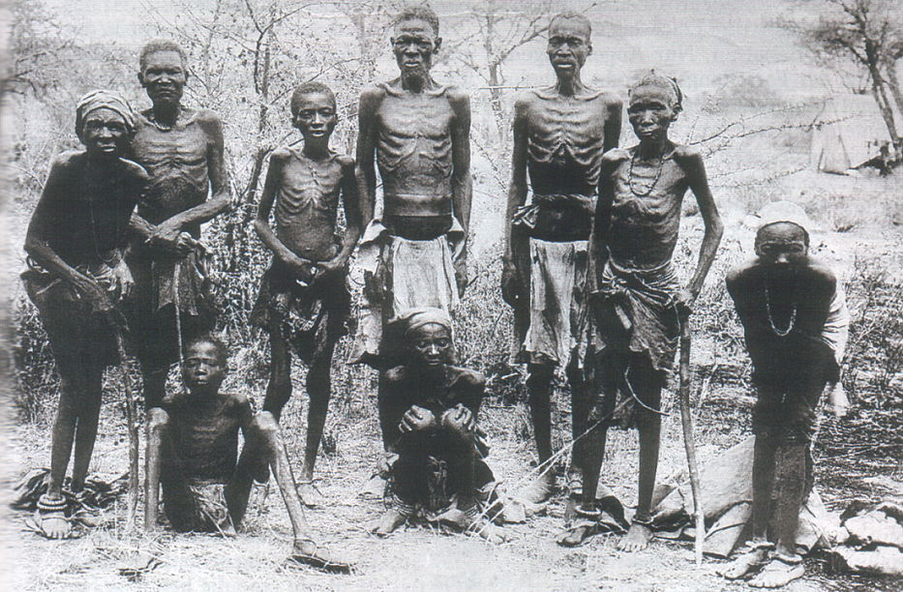

Slide 9
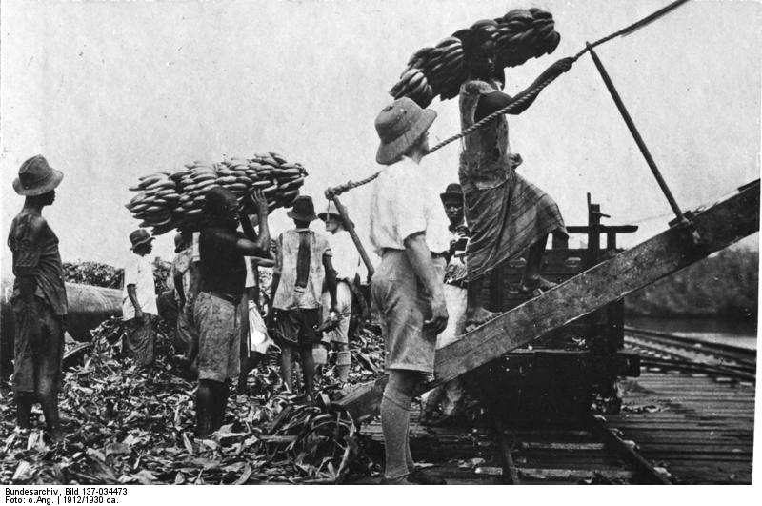

Slide 10
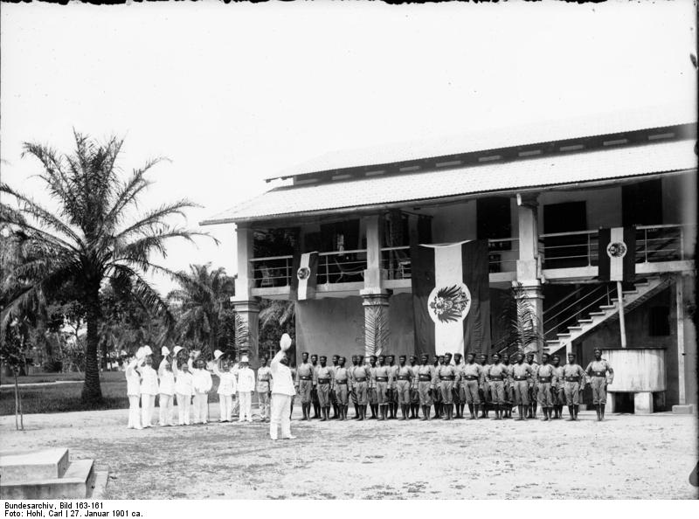
Police Force, 1901

Slide 11
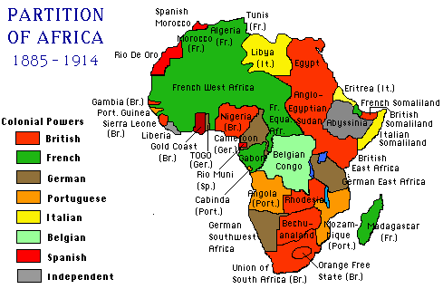
Britain in Egypt and South Africa
Notes:
11

Slide 12
Britain in Egypt:
Britain occupied Egypt because of importance of the Suez Canal.
  Took control over Suez Canal in 1875 because of Egyptian economic crisis.
  The control of this sea route was extremely important for economic and political reasons.
Control of the Nile.
  Britain wanted to control the Nile to control trade and maintain political authority in the region.
  To make sure of the Nile River’s unobstructed flow Britain would go on to take control of Sudan, Kenya, Uganda and Tanganyika.
  Nile River was the most important possession in Africa and Britain wanted to control it.
Notes:
12

Slide 13
Britain in South Africa:
Britain had an eye on South Africa to protect sea routes and trade to India.
Cape Colony
  First acquired in 1795.
  Provided base of operation to subjugate neighboring Boer States.
Consolidates Power:
  Transvaal annexed in 1877.
  Anglo-Zulu War: British defeat Zulu and gain land concessions in South Africa.
    Bloody war.
    Angers Boers in South Africa who want nothing to do with the British.
    Leads to Boer Wars.
Notes:
13

Slide 14
Boer Wars:
First Boer War (1880-1881):
  No winner.
  Britain do not want to get bogged down in a war that’s long, drawn out and far away.
  British Prime Minister William Gladstone signs treaty that gives Boers in Transvaal self government.
Second Boer War (1899-1902):
  Britain’s interest in Transvaal and the Orange Free State is rekindled because of the discovery of gold mines.
  Britain defeats Boers and the Orange Free State and Transvaal are absorbed into the British Empire.
Notes:
14

Slide 15
British Possessions in Africa:
Egypt
Sudan
British Somaliland (part of modern Somalia)
British East Africa
  Kenya
  Uganda
  Tanganyika (later as mandate territory
Zanzibar (part of modern Tanzania)
Bechuanaland (Botswana)
Southern Rhodesia (Zimbabwe)
Northern Rhodesia (Zambia)
British South Africa (South Africa)
  Transvaal
  Cape Colony
  Natal
  Orange Free State
Gambia
Sierra Leone
Nigeria
British Gold Coast (Ghana)
Nyasaland (Malawi)
Notes:
15

Slide 16
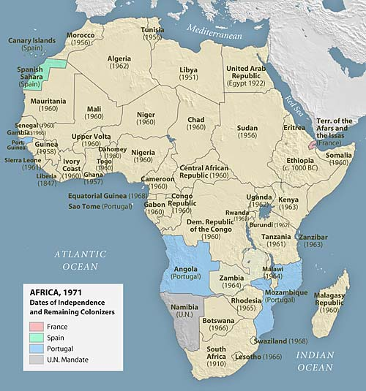
Africa after decolonization:
Notes:
16

Slide 17
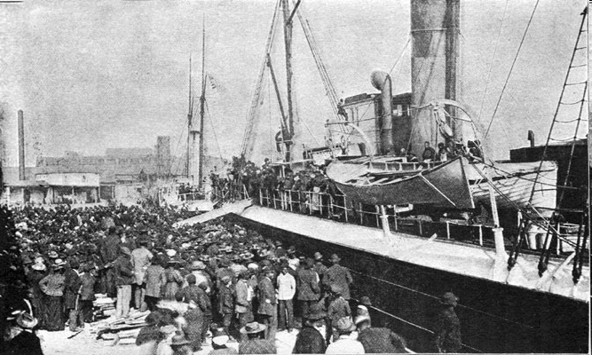
Liberia and the United States of America

Slide 18
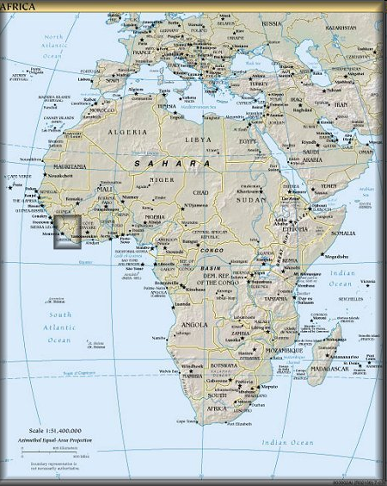
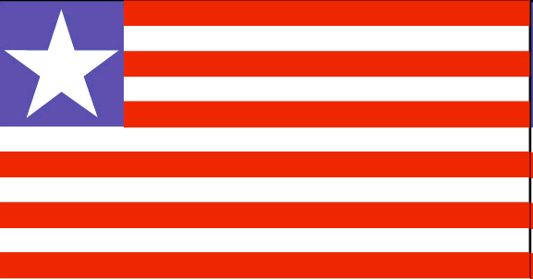
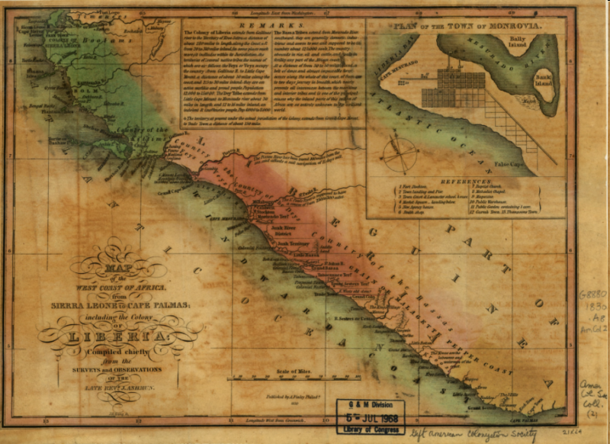

Slide 19
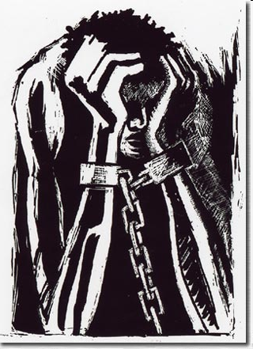
The Atlantic Slave Trade Ends
Britain’s influence of 1807
Abolitionists Movement
  William Wilberforce
  WEB Dubois
  Marcus Garvey
Free American slave question

Slide 20
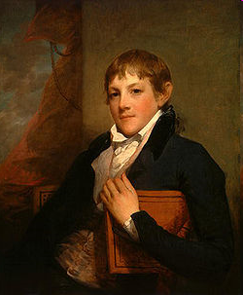
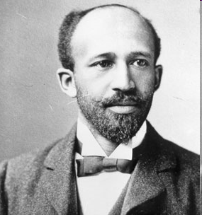
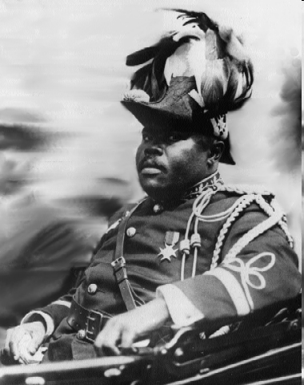
The Colonization of Liberia
The “Back to Africa” Movement
Three very different parties
  American Colonization Society (ACS)
  Abolitionists
  The American Elite
W.e.b Dubois
Marcus Garvey
John Randolph

Slide 21
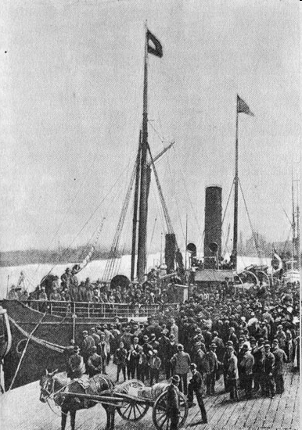
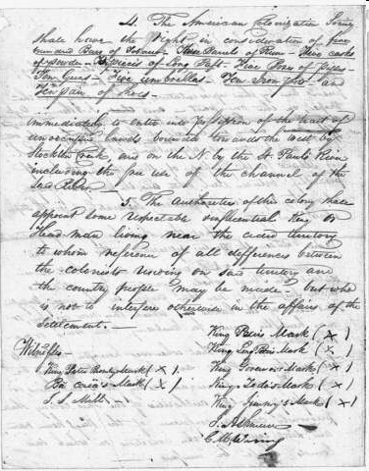
Back to Africa Movement

Slide 22
Back to Africa Movement
Liberia founded in 1822
  Through violence
  Detrimental to ex-slaves living in Liberia
Received little financial support from ACS
Prompted Liberian Independence of 1847
  ACS could no longer support Liberia
  Joseph Jenkins Roberts
  Constitution that exploited indigenous Liberians

Slide 23
Results
Spread of Christianity and Education
  Churches and schools funded by American missionaries
Clinic and hospital infrastructure
  Catered only to ex-slaves
Introduction of Western Culture
Economic Impact
  Rubber (Firestone), palm oil, peanuts
Exploitation of Liberian indigenous population

Slide 24
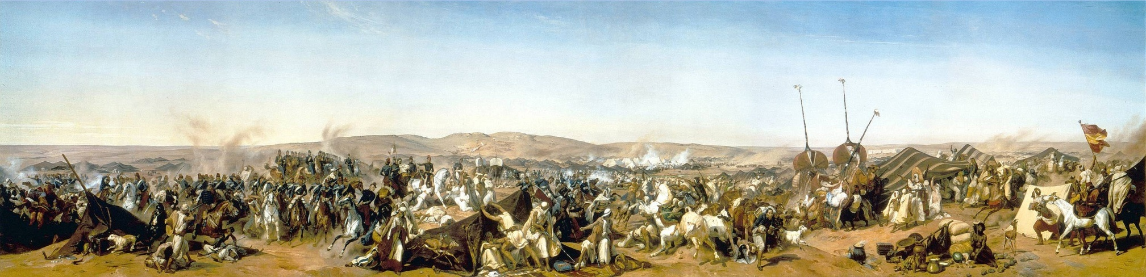
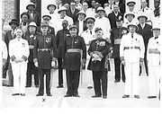
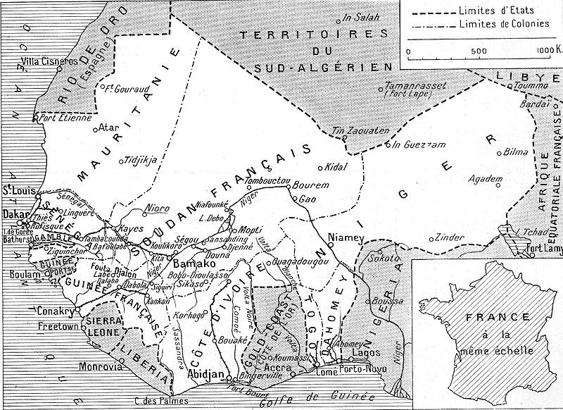
The French in Africa

Slide 25
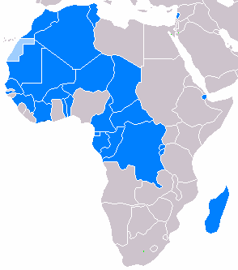
France in Africa
France controlled vast areas of west Africa including the Niger and Senegal River Valleys along with the island of Madagascar.
These regions would be divided into French West Africa and French Equatorial Africa .
The French built a series of forts and railways across the region of west Africa in order to consolidate and to prosper from trade in Sudan.
Areas where French is widely spoken .

Slide 26
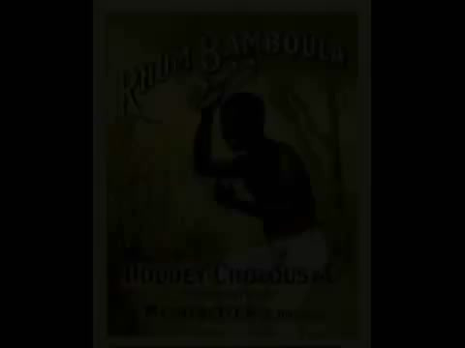
Results of French Activity in Africa
http://www.youtube.com/watch?v=vbX6T57mgVQ

Slide 27
The Congo Free State
1885-1908
King Leopold’s sole ownership.
Land previously untouched due to swamps and disease (malaria/sleeping sickness)
Quinine Prophylaxis
International African Association was the front Leopold used to cover up his future plans.
Hiring of Henry Morton Stanley for exploration.

Slide 28
The Congo
905,000 square miles. Almost doubled French/Portuguese appropriations combined.
Conducted his activities under the guise of philanthropy and assisting/civilizing “the brutes”. In reality he was the brute.
Exports:
  Copper
  Ivory
  Rubber
Dawn of the automobile made rubber a primary motivation in the Congo Free State.
Note the irony in the name Leopold gave his land, Congo FREE State.

Slide 29
Brutality
Rubber Quotas
Punishments: Beatings, whippings, cutting off hands, death.
Porters along the Congo River.
The Force Publique and Congolese killing Congolese.
Heart of Darkness by Joseph Conrad.
International Society for the Suppression of Savage Customs
Roger Casement and the global press.

Slide 30
Leopold’s Loss
Leopold is stripped of his lands by the Belgian Government in 1908 after the global press publicized all of his atrocities/deception of European powers.
Belgian Government takes over and sets up an education system.
Moderate Apartheid.
Worker improvements during the Great Depression.
Calls for equality/suffrage leads to a spark of Nationalism, Mouvement National Congolais.
National elections held in 1960. Joseph Kasa-Vubu becomes the first president of the Democratic Republic of Congo.

Slide 31
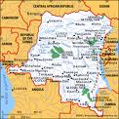
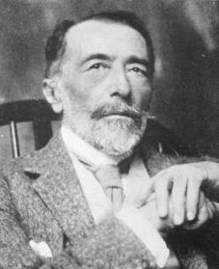
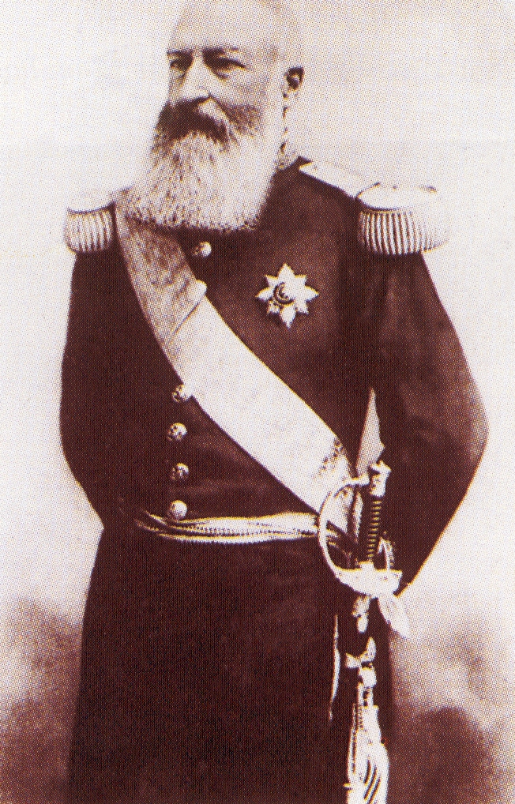


Slide 32
