Slide 2
Questions from last time?

Slide 3
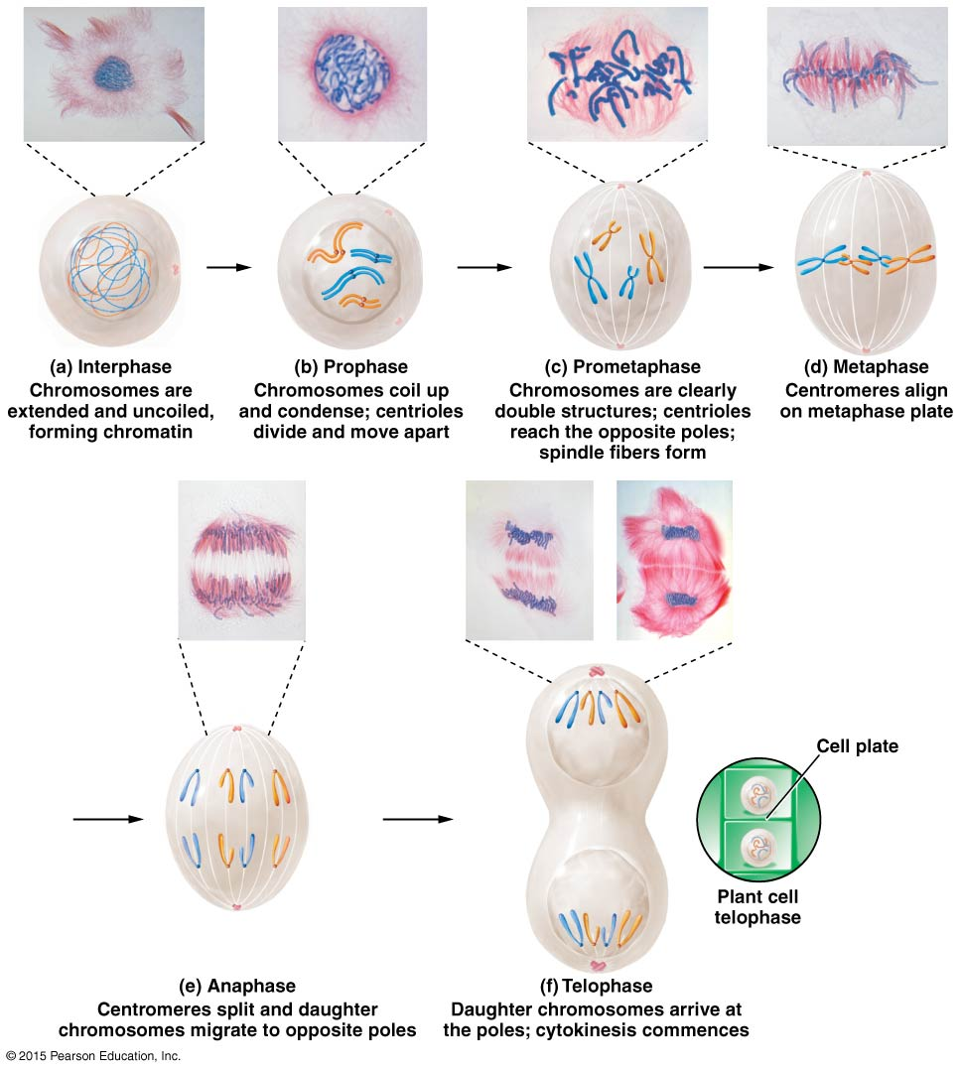
Mitosis Summary

Slide 4
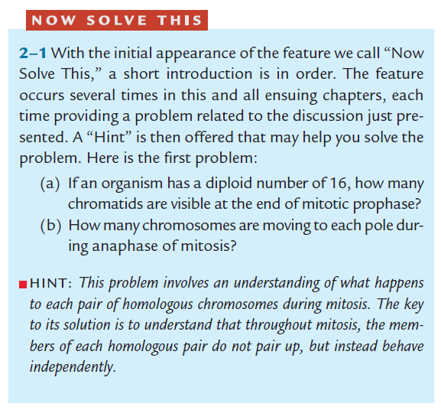
Class Question

Slide 6
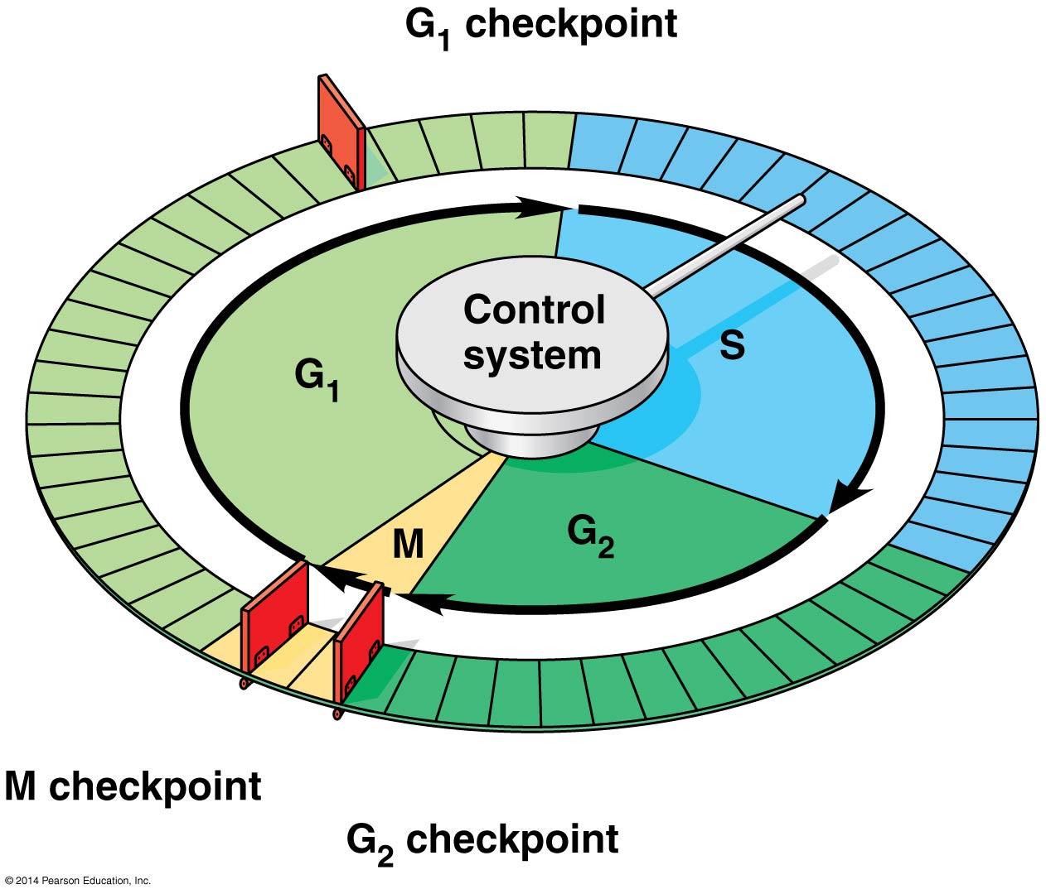
Checkpoint control
Checkpoints determine whether cell cycle proceeds or is halted (checks to make sure cell is ready to keep going, checking for errors in replication, growth or division)
Checkpoints at G₁/S; G₂/M; and M
When good cells go bad:
Cancer cells ignore normal signals of cell cycle and undergo rapid proliferation

Slide 7
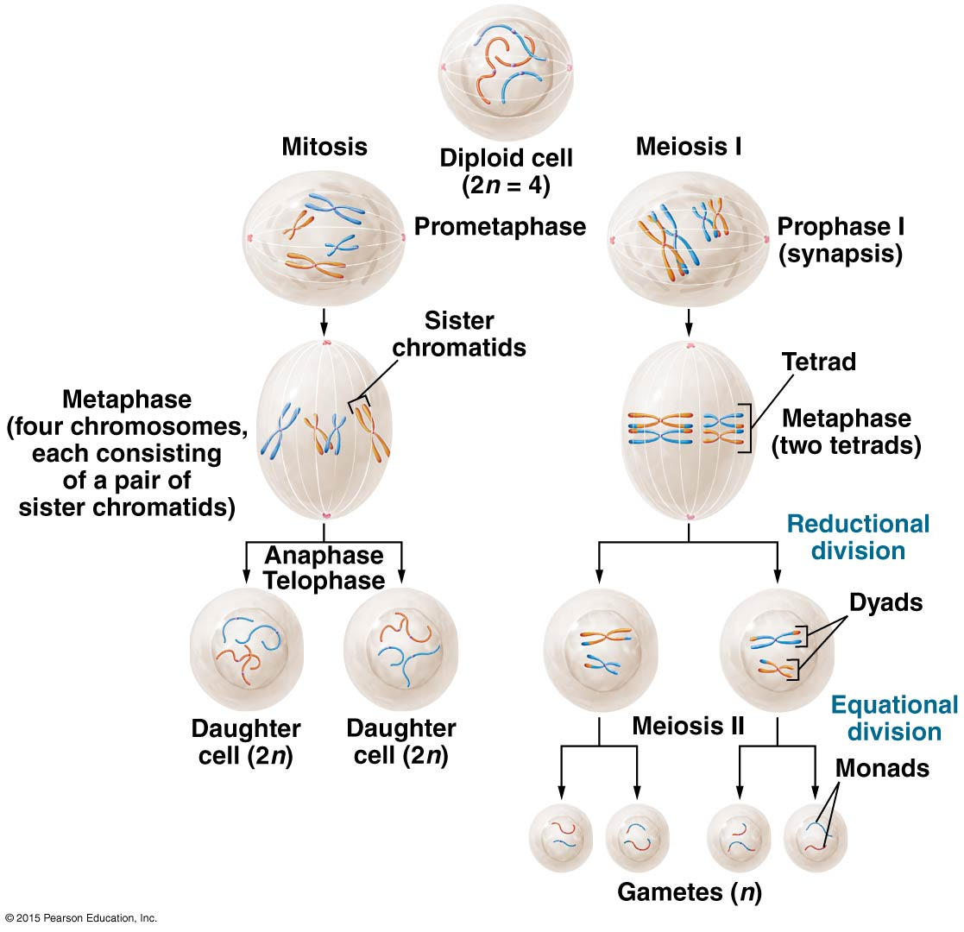
Mitosis/Meiosis Comparison

Slide 8
Stages of Meiosis
Meiosis I Is reductional (ploidy goes to n as homologous chromosomes separated)
Prophase I – pairing of homologous chromosomes and crossing over (to increase diversity in offspring)
Meiosis II is equational (ploidy stays at n as sister chromatids separate)
Prophase II, Metaphase II, Anaphase II, Telophase II
Metaphase I, Anaphase I, Telophase I
Direct
No interphase/ replication (G1/S/G2) between Meiosis I and II

Slide 9
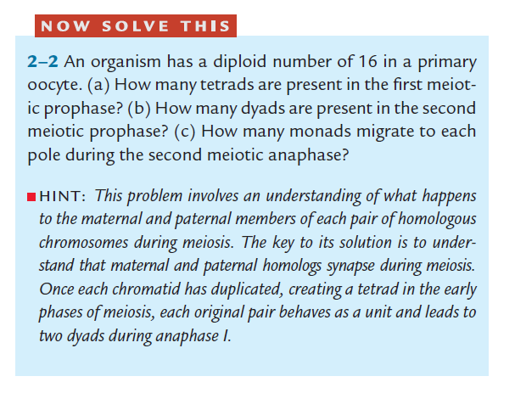
Class Question
chromosomes
chromosomes

Slide 11
Class Question
Notes:
Animal has 2n=8 value. Cell looks like these (name stage): 4 singles each side (anaphase MII); 4 doublets (anaphase MI), 8 doublets (not exist) Mitosis would be 8 singlets in anaphase

Slide 12
Diversity of Gametes (Life)
Comes during Prophase I
Crossing Over
-look at chromosome level
-will look at DNA level in Lab #12
(and Anaphase I)
Law of Segregation

Slide 13
Prophase I
Can be broken into 5 substages:
Leptonema: Thin threads, Initial stage of condensation
Zygonema: Synapsis of homologous chromosomes (Tetrads formed but not seen)
Pachynema: Recombination (crossovers) fully started; checkpoints
Diplonema: Tetrads fully visible; Chiasma – place of crossover is evident
Diakinesis: all chiasma have terminalized
Degree of condensed chromosomes
Remember, DNA was already replicated in S phase, as chromatin condenses, begin to see all 4 chromatids of tetrad
Notes:
Prophase I
Stages of Prophase I = specific cytological names that go back to the 1980s-early 1900s
Leptonema = initial condensation stage
Zygonema = synapsis of homologous chromosomes
Pachynema = recombination, Pachynema checkpoint
On’t see the effects of recombination until the end of Pachynema therefore will attribute to Pachynema – though actually stats back in Zygonema
Pachynema Checkpoint: if thinkgs don’t look right, then cell surveys can initiate cell death
Diplonema: Chiasma visible
Chiasma = cytological structural representation of crossing over
Barbara McClintock got her initial claim to fame by emonstarting the 1:1 relationship between chiasma and recombination
Diakinesis: chaisam terminalized

Slide 14
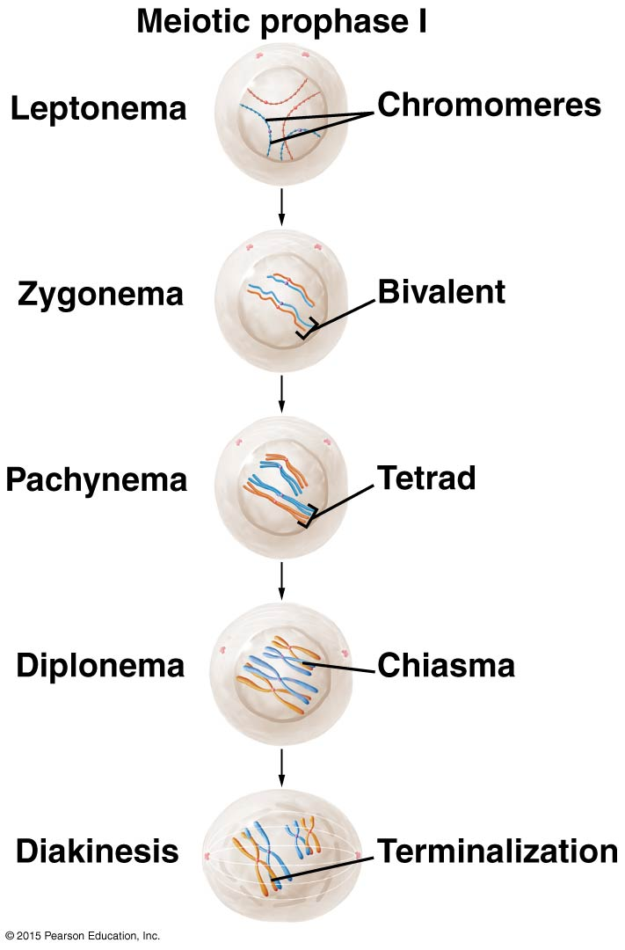
Prophase I
Will see differences in slides in lab
Notes:
Prophase I
Stages of Prophase I = specific cytological names that go back to the 1980s-early 1900s
Leptonema = initial condensation stage
Zygonema = synapsis of homologous chromosomes
Pachynema = recombination, Pachynema checkpoint
On’t see the effects of recombination until the end of Pachynema therefore will attribute to Pachynema – though actually stats back in Zygonema
Pachynema Checkpoint: if thinkgs don’t look right, then cell surveys can initiate cell death
Diplonema: Chiasma visible
Chiasma = cytological structural representation of crossing over
Barbara McClintock got her initial claim to fame by emonstarting the 1:1 relationship between chiasma and recombination
Diakinesis: chaisam terminalized

Slide 15
Chromosome/DNA terms
ploidy: deals with the number of sets of chromosomes
  haploid = 1n = one set of chromosomes,
  diploid = 2n = two sets of each chromosome,
  etc
C-value – lowest amount of genomic DNA found in a cell of an organism (ie haploid cell)
  1C = DNA content in haploid
  etc
gametes
somatic cells

Slide 16
Class Question
Animal has n=2 value. Can you indicate n- and c-values for a diploid cell during all stages from G₁ through end of mitosis? Through end of meiosis?
Know for quiz
Notes:
2n = 4
Mitosis: G1 (2n, 2C), S (2n, 4C), G2 (2n, 4C) M (2n, 2C)
Meiosis: G1 (2n, 2C), S (2n, 4C), G2 (2n, 4C), MI (n, 2C), MII (n, c)

Slide 17
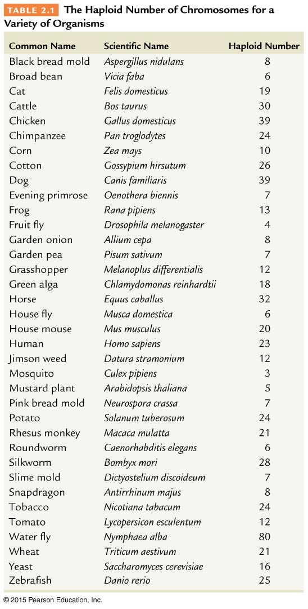
Genome size and organisms
No correlation between # chromosomes and complexity of an organism (n-#)
Little correlation between genome size and complexity (c-#)

Slide 18
Meiosis Variations

Slide 19
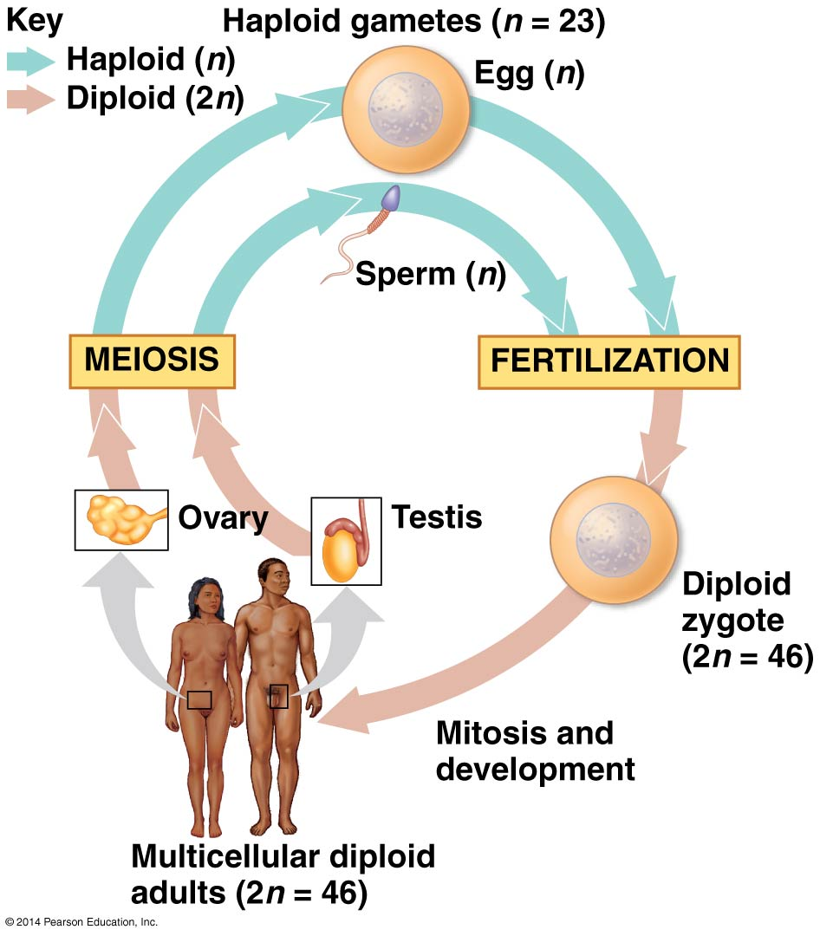
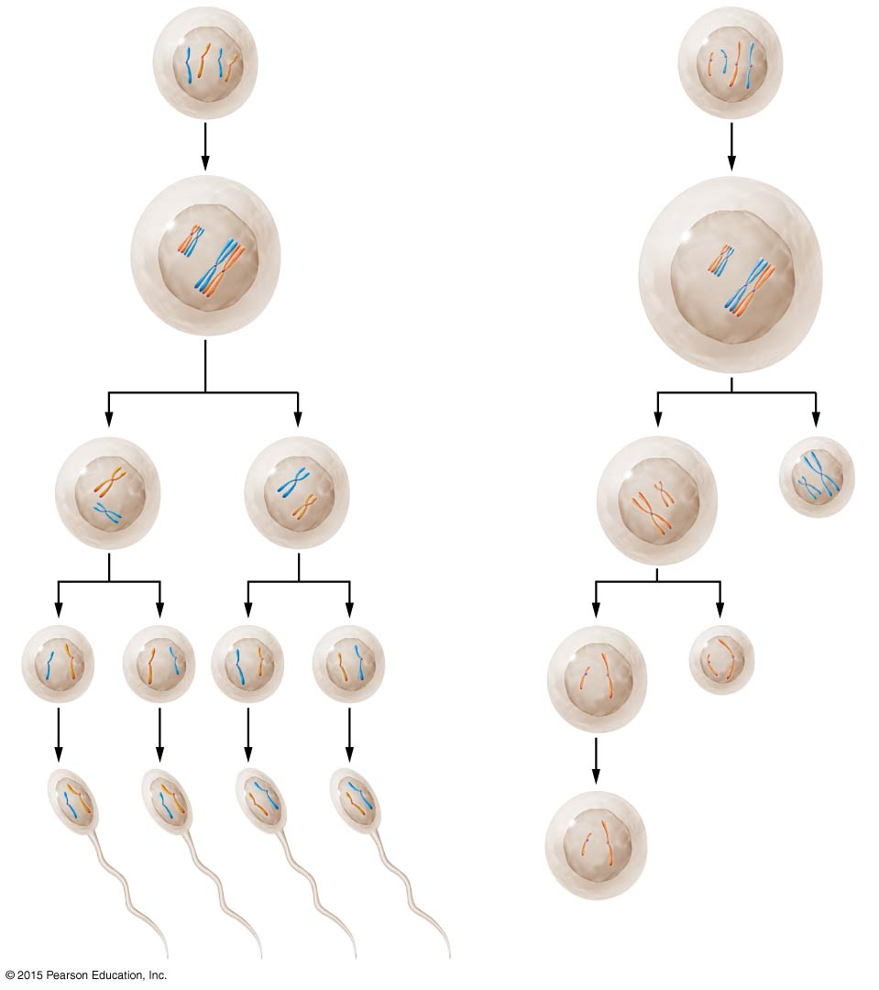
Animals - Spermatogenesis
Signal to enter cell cycle
spermatogonium
Meiosis I
2n
Primary spermatocyte
2n
Secondary spermatocytes
Meiosis II
Spermatids
n
Differentiation
4 gametes produced per spermatagonium
Spermatazoa
Notes:
Male gametes formed in testes. Know terminology

Slide 20
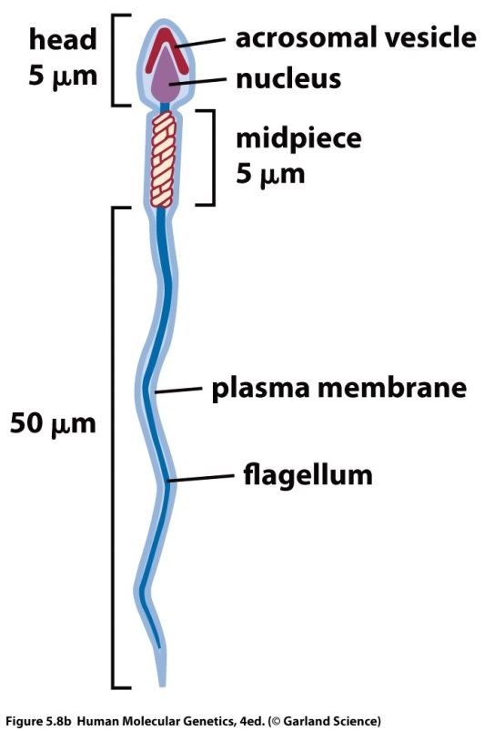
Maturation of Sperm
Most of cytoplasm eliminated, DNA repacked
Centrioles become basal bodies, form flagella
Internal structures moved (ie mitochondria) to power movement

Slide 21
Animals - Oogenesis
Signal to enter cell cycle
Oogonium
Meiosis I
2n
Primary oocyte
2n
Unequal division of cytoplasm
First polar body
May or may not go through division
Secondary oocyte
Meiosis II
Unequal division of cytoplasm
Second polar body
Ootid
Differentiation
Only 1 gamete produced per oogonium
Ovum
Notes:
Female gametes formed in ovaries. Know terminology

Slide 22
Progression of Oogenesis
Timing:
  Mammals: designation starts before birth
    At birth, all eggs to be produced are arrested as Primary Oocytes in Prophase I
    Puberty triggers development and release of an egg/month
  Other cases: Ascaris (roundworm)
    Sperm interacts with egg when it is still only a primary oocyte.
    Sperm pronuclei waits around in egg as egg completes both divisions of meiosis

Slide 23
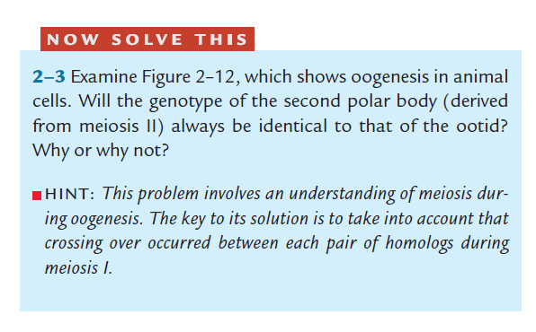
Notes:
Crossing over – no. Purpose is increase variety.

Slide 24
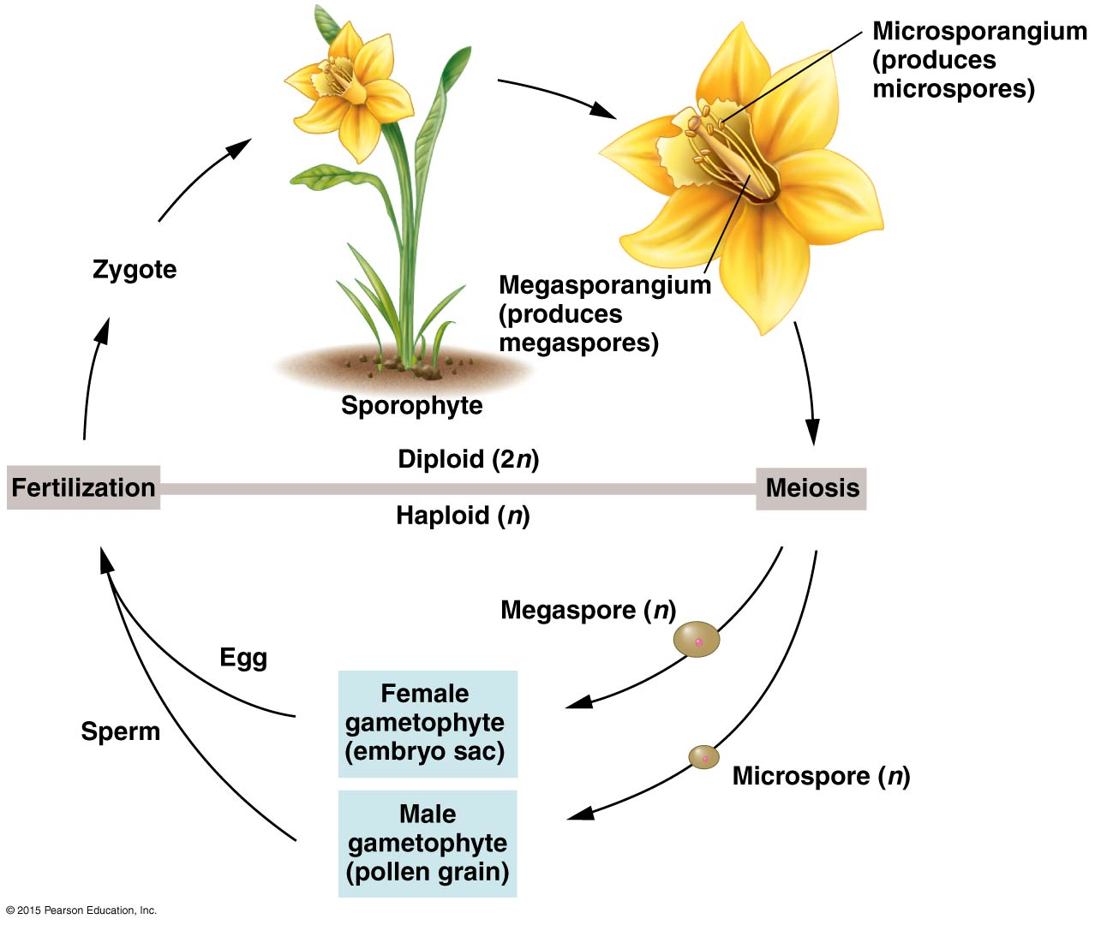
Plants – Alternation of generations
Sporophyte (2n plant tissue)
Meiosis produces haploid spores (n)
♂ microspores (made in anthers)
♀ megaspores (made in ovule)
Mitosis of spores then produces gametophytes (n) for fertilization and recreation of sporophyte (2n) state
(text: Fig 7.2; pgs 165-167)
Notes:
Know terminology. Read lab 6. Info not in textbook. PG 165-167!!!

Slide 25
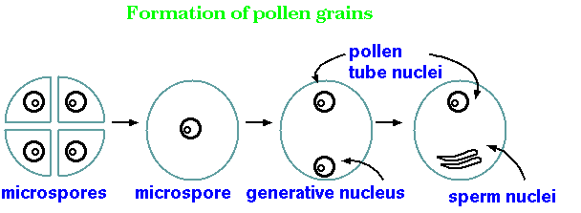
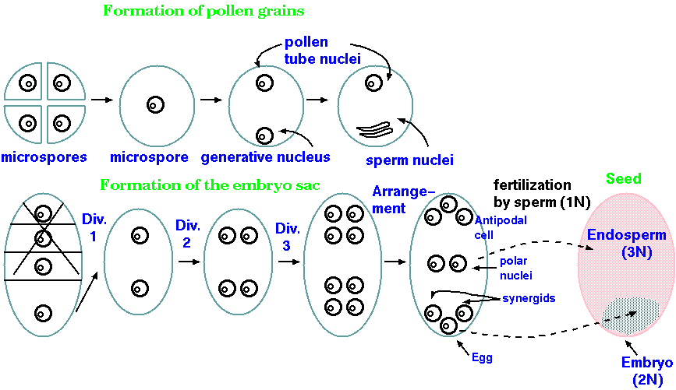
Microsporogenesis
male gametophyte
pollen tube nuclei
all 4 mature
Pollen Mother cell (anther)
meiosis
mitosis
no cytokinesis only karyokinesis
microspores
microspore
generative nucleus
mitosis
only kk
sperm nuclei
Why 2 sperm nuclei?
+
differentiation of surface coat creates pollen grain containing male gametophyte
Megasporogenesis
female gametophyte
Megaspore Mother cell (ovule)
only 1 functional
meiosis
mitosis
mitosis
mitosis
only kk
only kk
only kk
megaspore
megaspores
8 nuclei in female gametophyte
Pics from http://home.cc.umanitoba.ca/~frist/PLNT3140/l03/l03.4.html
Notes:
Pics from http://home.cc.umanitoba.ca/~frist/PLNT3140/l03/l03.4.html

Slide 26
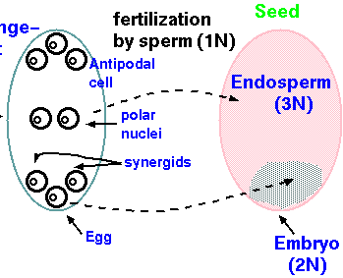
Plants – Double Fertilization
seed
pollen transferred from anther to stigma causes male pollen tube nuclei to develop pollen tube down style to ovary/ovule to carry sperm nuclei to female gametophyte
8 nuclei in female gametophyte + 2 sperm nuclei
http://home.cc.umanitoba.ca/~frist/PLNT3140/l03/l03.4.html
3 Antipodal and 2 synergid nuclei eventually degenerate
1 Egg nuclei (female) merge with 1 sperm nuclei (male) to make 2n (diploid) embryo
2 polar nuclei (female) merge with 1 sperm nuclei (male) and create 3n (triploid) endosperm
  Endosperm serves as food source for growing embryo

Slide 27
For Next Time
Quiz on Mitosis/Meiosis
Stages
Drawings
n-/c-values
animal/plant terminology

