Slide 1
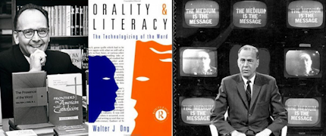
The Medium is the Message: McLuhan, Ong, & Media Ecology
Vincent W. Hevern, SJ, Ph.D.
COR 400
January 29, 2019

Slide 2
Marshall McLuhan (1911-1980)
Canadian English & Media Scholar
Taught Walter Ong, SJ, at Saint Louis U
Taught at U of Toronto 1968-1980
Author
The Gutenberg Galaxy (1962)
Understanding Media: The Extensions of Man (1964)
War & Peace in the Global Village (1968)

Slide 3
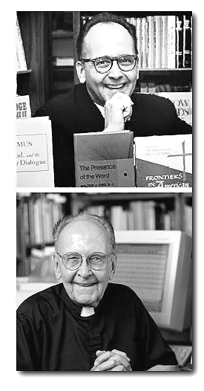
Walter J. Ong, S.J. (1912-2003)
Jesuit priest & English scholar
Student of McLuhan 1941
Taught at Saint Louis U 1953-1989
President, Modern Language Assn.
Author
The Presence of the Word (1964)
Orality & Literacy: The Technologizing of the Word (1982

Slide 4
Three Major Shifts In Media
Primary Orality → Literacy
Literacy → Printing
Printing → Techno-Digital Culture

Slide 5
Primary Orality Demonstration (1)

Slide 6
The experience of hearing & song
Rudolph the Red-nose reindeer,
had a very shiny nose.
And, if you ever saw him,
you would even say it glows.
All of the other reindeer
used to laugh and call him names.
They never let poor Rudolph
join in any reindeer games.
(43 words, 217 characters)
Atikho the caribou possessed
a glossy snout which sometimes,
when people saw it,
believed it to be luminous.
All the other caribou used
to chortle and taunt him.
They always omitted the abject Atikho
from their frolicking.
(37 words, 215 characters)

Slide 7
Primary Orality Demonstration (2)

Slide 8
Directions to Hunting
The hunting ground is found by walking for three days toward where the sun sets in the summer and, when you see a tall hill with evergreen trees on top, turn to your left, cross the stream that is about 10 feet wide, and walk for a half a day. There you will find a watering hole at which many animals will come to drink.

Slide 9
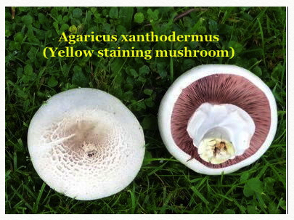
Which should you eat?

Slide 10
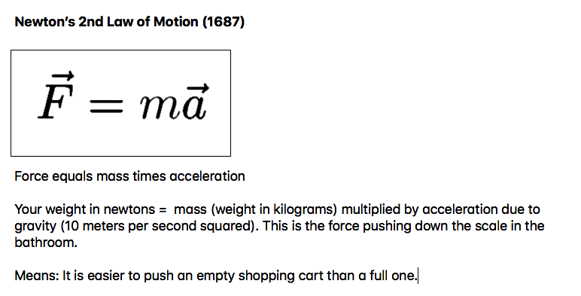
Modern Physics

Slide 11
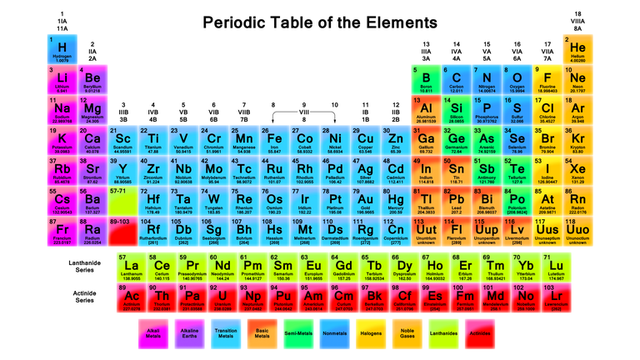
Dmitri Mendeleev (1869-1871)

Slide 12
The World of “Primary Orality”
A world without any writing

Slide 13
Characteristics of Orality
Agonistically toned
Empathic & participatory
Homeostatic (only incrementally dynamic)
Situational rather than abstract
Additive rather than subordinate
Aggregative rather than analytic
Redundant (copious)
Conservative
Closely oriented to the human life world in concrete concerns

Slide 14
Literate Culture
A world with writing

Slide 15
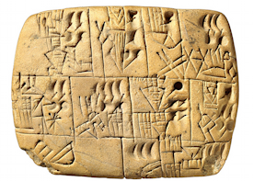
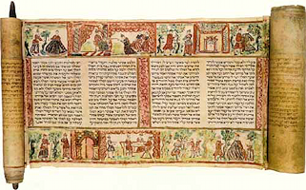
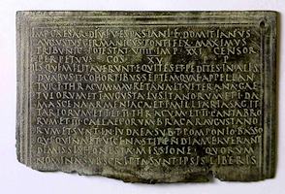
Literate Culture
Reading and writing was generally limited to a small percentage of the population (e.g., Rome =10%)
Writing allowed
Consulting data multiple times
Exchange of information at great distances
Uniform laws & procedures
Financial, land, and contractual rights/obligations
Thinking becomes more internalized
Associated with the rise of broadly-embraced religions

Slide 16
Print Culture

Slide 17
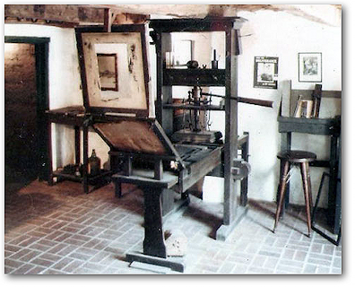
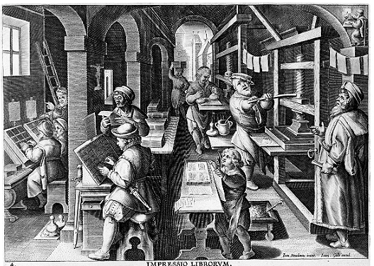
Print Culture
What is visual and seen is more trustworthy than what is heard
Distance & objectivity in the printed word
Reading books allows individual private and extended reflection
Information to a larger public and many more became literate
Modern science methods & knowledge made possible
Freedom from conservative pathways

Slide 18
Techno-Digital
Culture

Slide 19
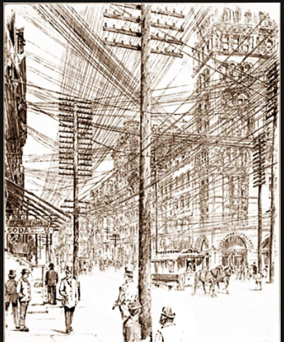
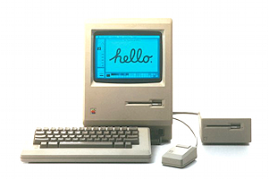
What is the Techno-Digital Age?
19th century inventions using electricity & other material processes (technological…)
Photography (1826), Telegraph (1838), Telephone (1876), Motion pictures (1895), Commercial Radio (1920), TV (1947)
20th-21st century digital innovations
CDs (1982), Digital phones (1992), World Wide Web (1982), personal computers (late 1970s),

Slide 20
McLuhan: Major Themes
Media as extensions of the human body & its abilities
“The Medium is the Message”
“The Global Village”

Slide 21
Media as Extensions of the Human Body
All forms of technology allow us to do things we otherwise couldn’t do or can now do more easily
Microscopes, telescopes, trains and cars, telephones, televisions, smart phones, FaceTime…
BUT, these extensions also numb us to the effects of technology
Different media require more sensory processing by the audience than others

Slide 22
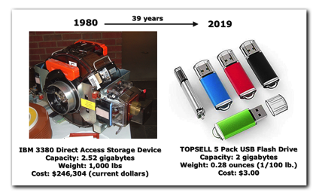
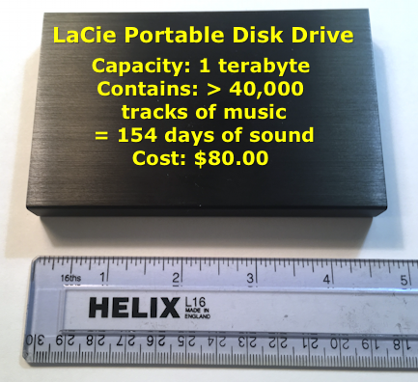
1980 vs. 2019
My 2019 portable disk drive with 1TB capacity at a cost of about $80.00 is
the equivalent of over 350 IBM drives from 1980 and
would have cost $97.7 million then

Slide 23
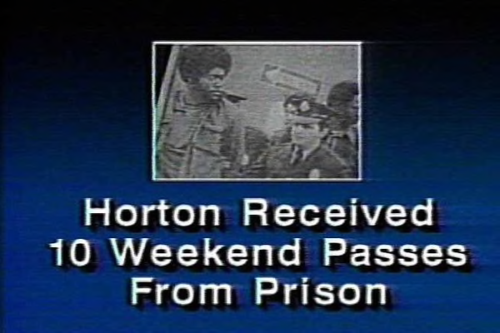
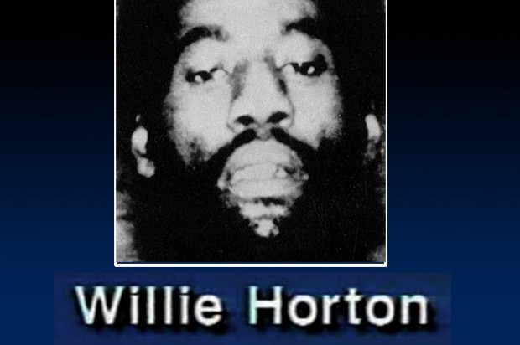
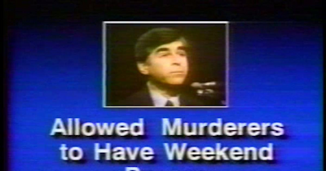
“The Medium is the Message”
Pay attention to the medium by which messages are being sent. The medium itself creates powerful conditions that influence the nature of the received message. They affect how we think, feel, etc.
Consider the (in)famous “Willie Horton” ad (1988)

Slide 24
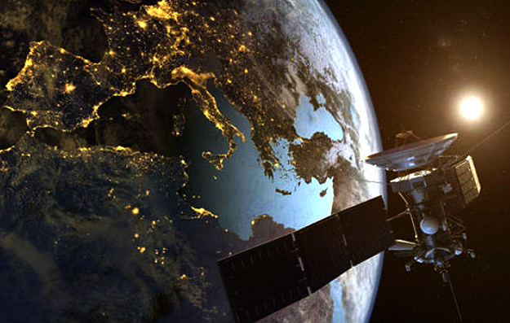
The Global Village
Electronic media (esp. television) creates a world-wide “village”
Western media spreads Western cultural products around the globe. Homogenizes cultures & reduces diversity
Villages, however, are places where fighting and friction take place. Villages often tend toward tribalism and rejection of others.

Slide 25
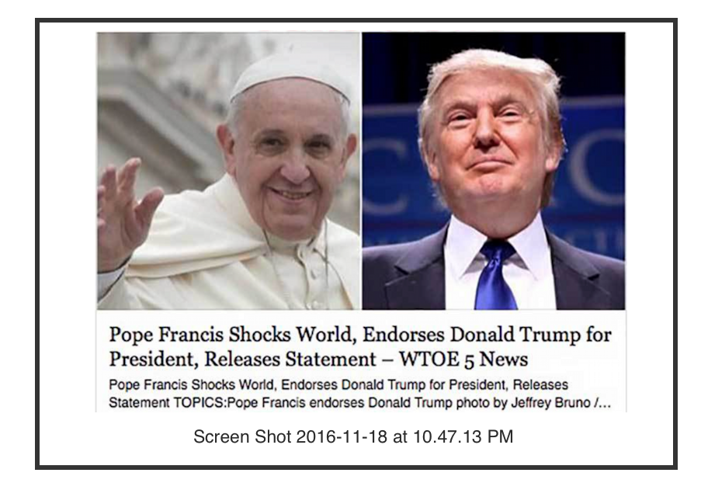
The Global Village: Fake News and Other Problems
McLuhan died before ever seeing the Internet. However, in his concept of the “Global Village” he suggested there might be downsides
Rise of Tribalism and Factions
Bullying
Spreading “fake news”

Slide 26
“Secondary Orality” (Ong)
New forms of orality arise from new media that are based on sound and voice (TV, movies, telephones, live concerts, etc.)
Intermix with literacy & textual-written-printed media
Importance of the printed word tends to be undermined, e.g., libraries less important
Movement toward group memberships & group experiences (rock concerts, fan clubs, SOCIAL MEDIA like YouTube)

