Slide 1
Introduction to RefWorks
Tom Keays
keaysht@lemoyne.edu
Notes:
Welcome to this introduction to RefWorks class. Over the next hour or so, I’m going to try to give you a good understanding of what the program is designed to do and how you can use it to improve your research productivity.

Slide 2
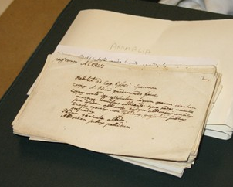
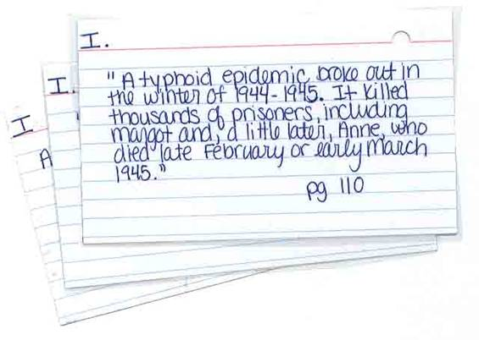
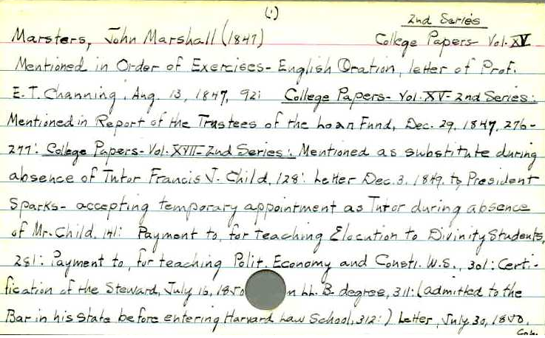
Notes:
Researchers at some point find that, in order to cope with a large array of information that they are assembling, that they need to be diligent in collecting and recording information about their sources. Most researchers eventually hit upon some system that lets them record complete and accurate bibliographic information about the articles and books that they have read for purposes of finding them again in the future and for citation purposes.
Note cards are a common system that lets individual references be filed together in whatever order is needed to associate them with similar works and to provide a ready mechanism for using them when it comes time to write up their research. Note cards can also be used to transcribe the reader’s notes and observations regarding the works.
New students in the iSchool are generally required to transcribe citations by hand following the APA (American Psychological Association) style manual to introduce them to the principles of creating citations against a set of rules and, probably more importantly, to make the aware of the potential pitfalls of sloppy work.
At the doctoral level, you should already be competent in these skills. So, while manually transcribing citations is by no means an unnecessary skill, it is persnickety and tedious work, prone to errors and, ultimately, much less productive than using digital tools to capture, organize, and format bibliographic references for you.

Slide 3
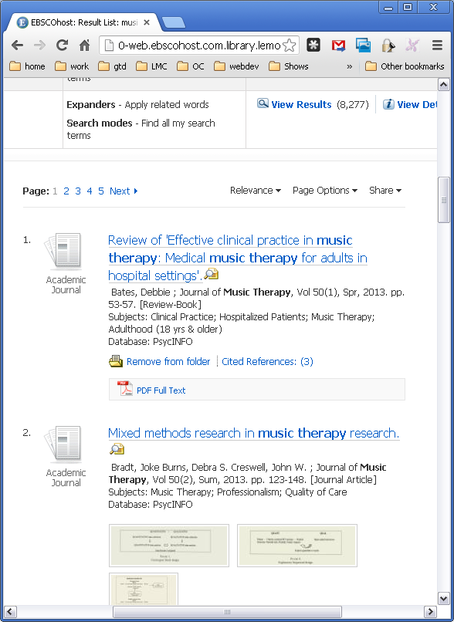
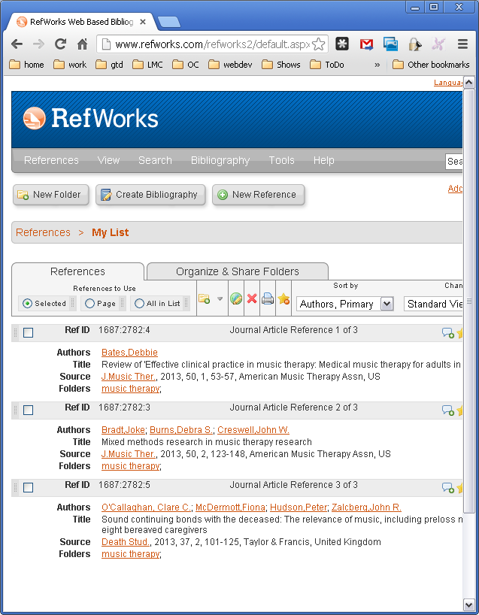

Slide 4
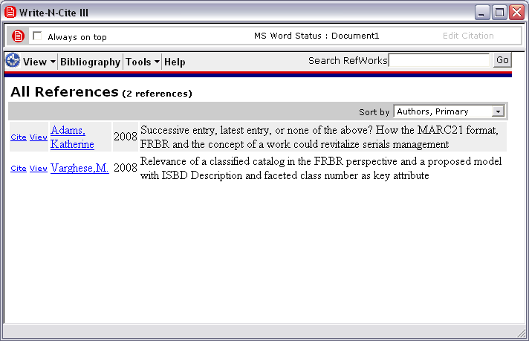
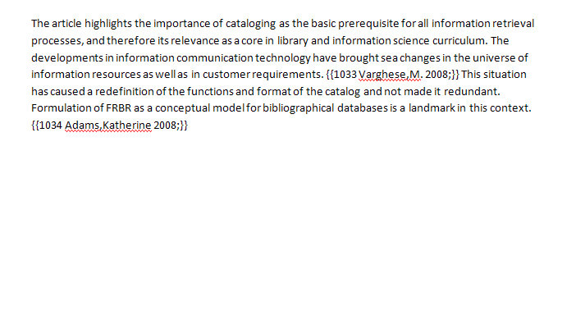
Notes:
Once you move from the citation collection phase and enter into the process of writing up your research, RefWorks is still one of the tools of choice.
Write-N-Cite is a free accessory program that you download from RefWorks to your workstation. Once you are logged in, it acts as the conduit for citing references from RefWorks into your paper. You do this by placing your cursor in your Word document at the point where a citation needs to go. Then click the Cite link next to the appropriate citation displayed in Write-N-Cite to embed a citation marker into your paper.
By clicking the Bibliography button, Write-N-Cite transforms the citation markers into full citations that follow whatever style you specify … and it simultaneously generates a full bibliography of your cited works at the end of your paper.

Slide 5
Why RefWorks
Accessible
Web-based like most of the databases that you use
Capture citations while you are doing research
Workflow
More than one way to import citations into your database
Organization
Folders allow you to structure how you want to organize so you can find things again easily
Writing
Write-N-Cite integrates your research with the writing process
Sharing
RefShare lets you share folders of citations via a link
Can create throw-away accounts for class projects and group work
Read-only password

Slide 6
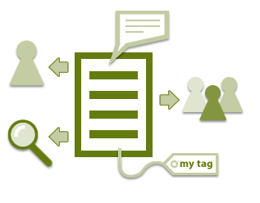

Slide 7
What We’ll Cover
We will learn how to:
Sign up for an individual RefWorks account
Add citations to RefWorks from databases
Organize citations within RefWorks
Sharing references with RefShare
Create a bibliography from saved citations
Add citations from RefWorks to a paper
Format citations in a paper (create a bibliography with Write-N-Cite)
Cite webpages using RefGrab-It bookmarklet
Notes:
OK. That’s the nutshell overview of our session today.
In our class we will learn how to:
Get help via Library Citation Support pages
Sign up for an individual RefWorks account
Add citations to RefWorks from databases
Organize citations within RefWorks
Add citations from RefWorks to a paper
Format citations in a paper (create a bibliography with Write-N-Cite)
Cite webpages using RefGrab-It bookmarklet
Any questions before we begin?

Slide 8
RefWorks Library Guide
Accessible from “Research Guides” tab of library website
http://resources.library.lemoyne.edu/pubserv-refworks

Slide 9
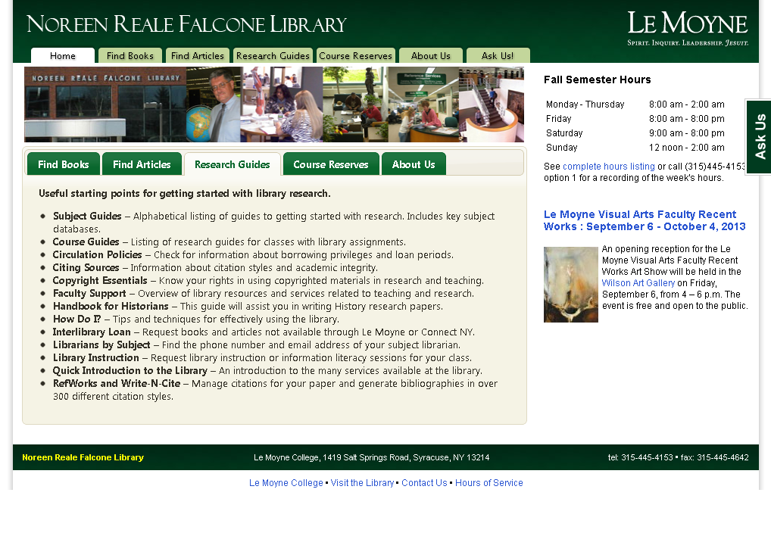
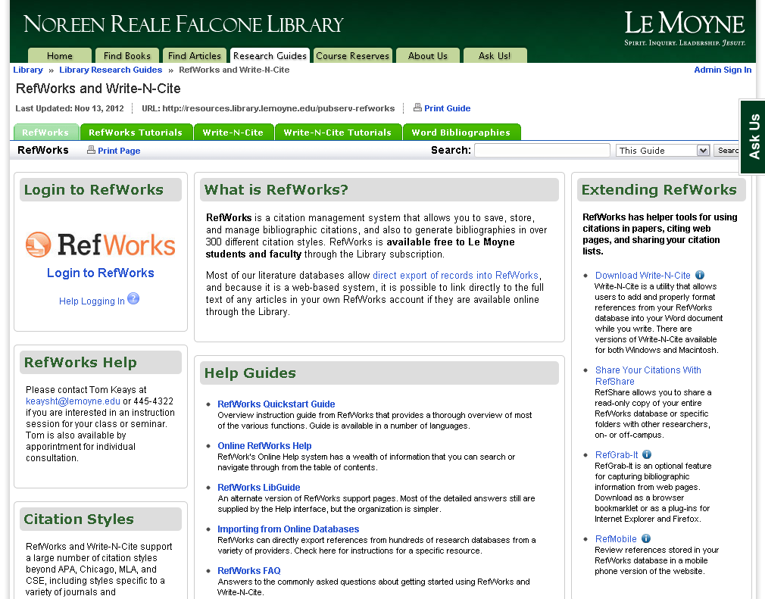
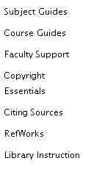

Slide 10
Create an account
Not tied to your campus login
Be secure! Don’t use your campus login!
Can have multiple accounts
Group Code will be emailed to you
Group Code = LeMoyne
you may need code to use RefWorks off-campus

Slide 11
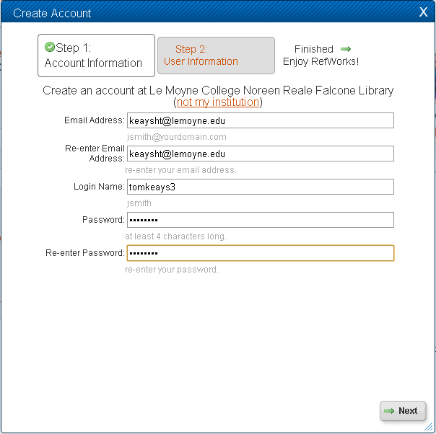
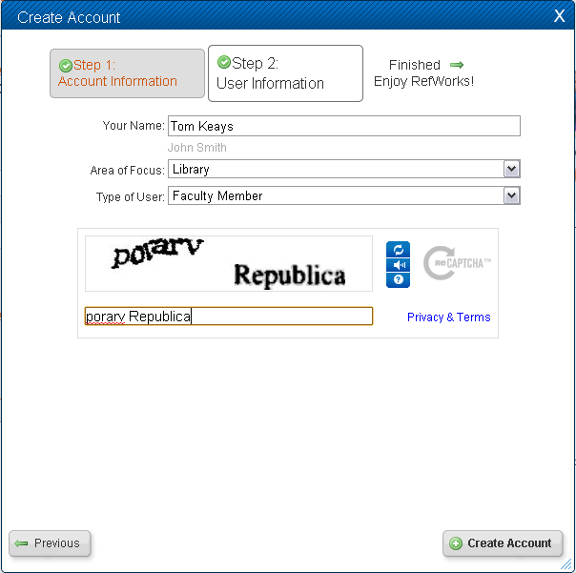
Notes:
When you click the RefWorks login link from the Citation Support pages, you will be presented with a log in form.
Note, it says RefWorks User Login for Syracuse University Library. If this login screen says anything else or asks for a Group Code, then you need to check that you have are using the proxied url -- this sort of error comes up when you bookmark the RefWorks url on-campus and then find it isn’t working when you are off-campus.
If you don’t have an account or want to create another account -- you can create as many accounts as you need at anytime -- click the “Sign up for an Individual Account” link.

Slide 12
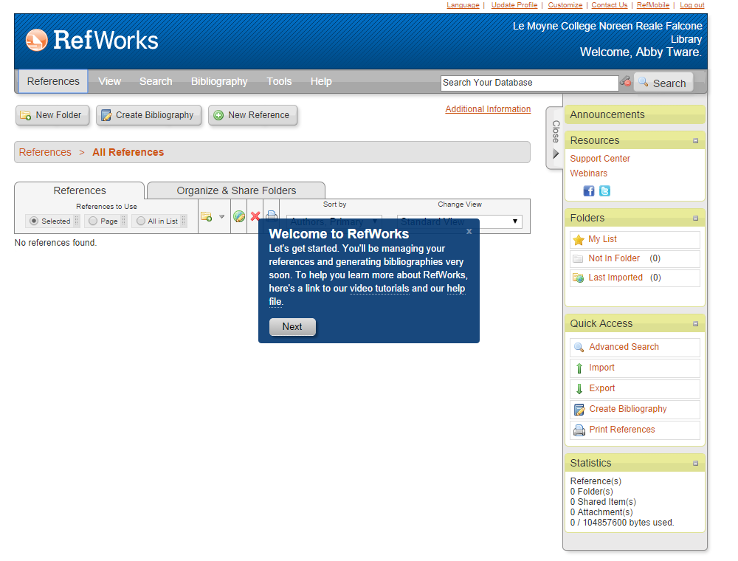

Slide 14
Notes:
Next, if you are a using a newly created account (or at least one that has no citations stored in it), you will see a “Getting Started” welcome screen.

Slide 15
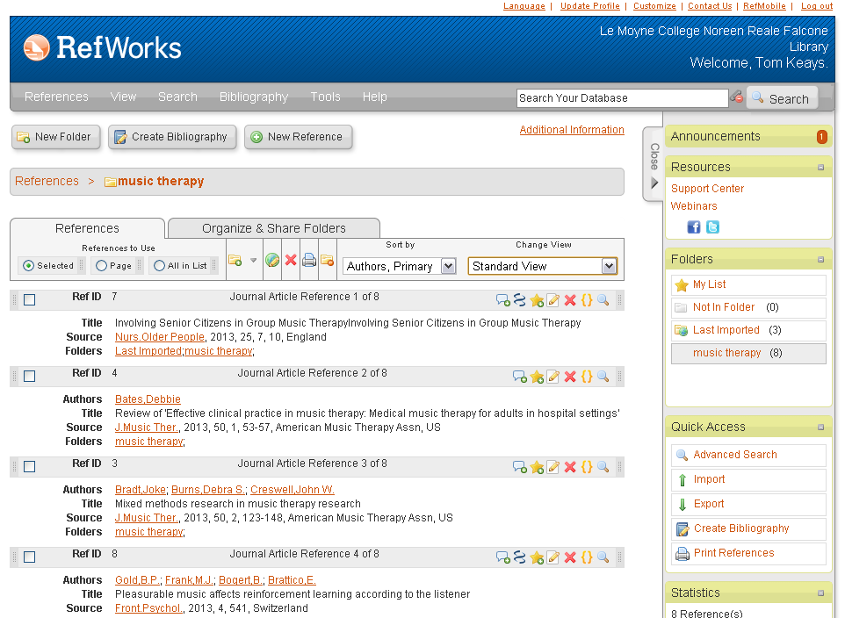
Notes:
Now we’re in the “Last Imported” folder.
We’ll explore folders a bit later, including how to create new folders of your own, but for now, just keep in mind that the “Last Imported” folder is one of the system structures that RefWorks itself provides. Specfically, this folder is a staging area that almost every citation, except those entered manually, passes through. As new citations enter the “Last Imported” folder, previous citations are bumped out.

Slide 16
Adding citations to RefWorks
Manually enter citations
Notes:
The first method we’ll look at is typing in citations by hand.

Slide 17
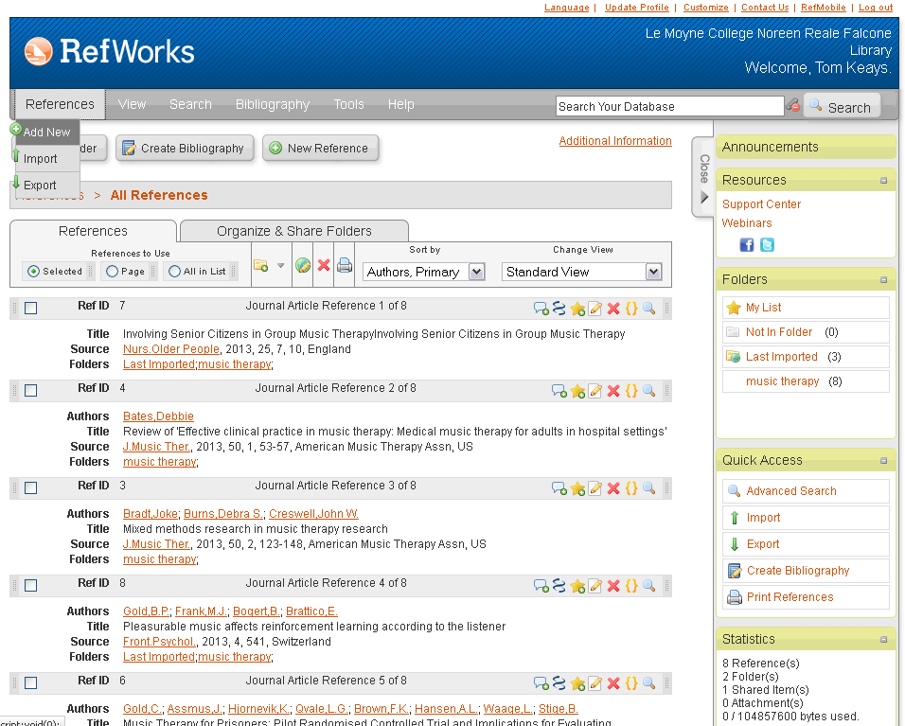
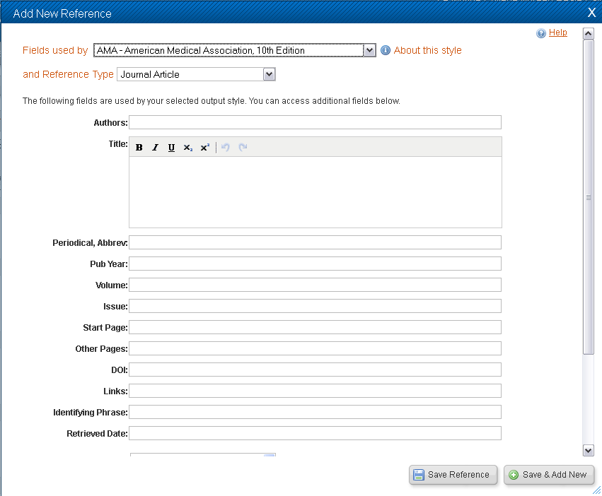
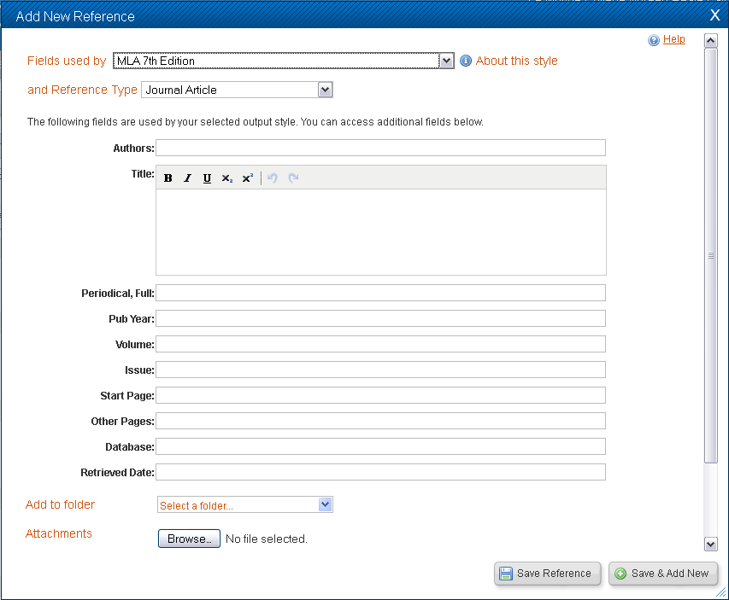
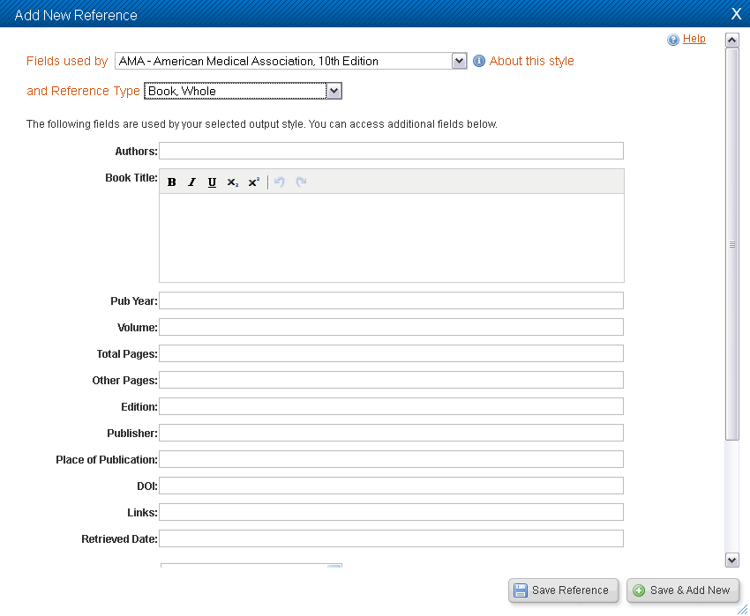
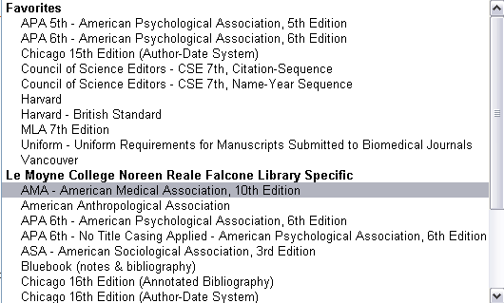
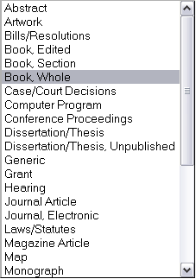

Slide 18
Adding citations to RefWorks
Manually enter citations
Manually Import citations from a text file or by copying and pasting
Library Catalog
AccessMedicine
Notes:
[See note in slide 12 to mention the “Import EndNote V8+ Database” option in the “References” menu. The instructor may want to mention this before presenting the material on this slide.]
While we’re still looking at the “References” menu, we’ll next examine how to import references from a text file.
Note that most of the options in the “References” menu area pertain to bringing in references into RefWorks that you have generally already identified and captured.

Slide 19
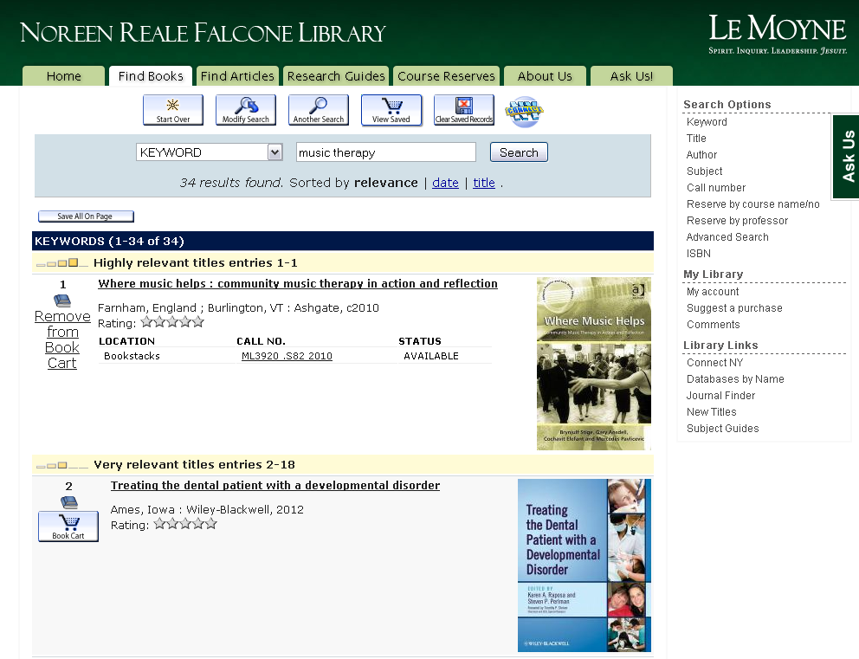
Notes:
Select “Import” from the “References” menu.
In our example, we will be using the library catalog, SUMMIT <summit.syr.edu> as our bibliographic database source. In the case of importing citations from a text file, it is important to choose settings that match the database you using. Chose“Syracuse University Library” as the Import filter option and “SUMMIT Catalog (Endeavor)” as the database.

Slide 20
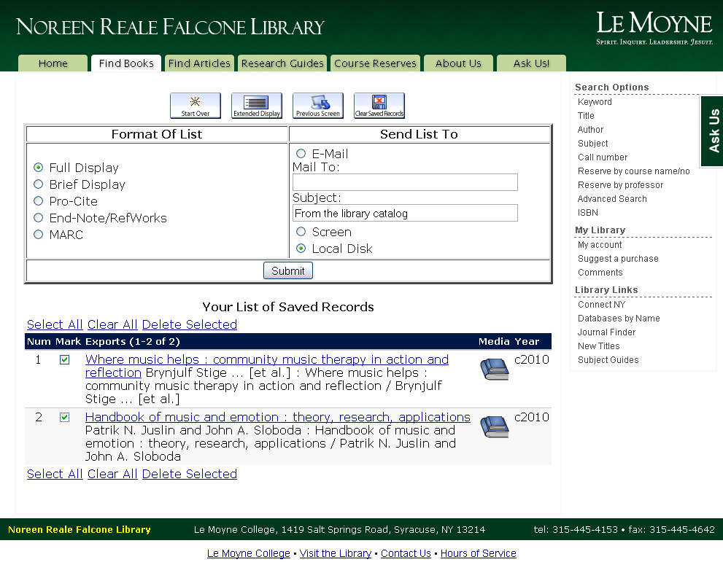
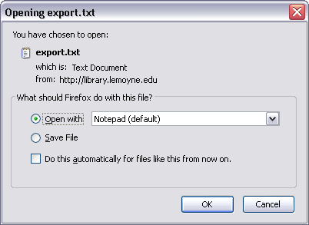
Notes:
Now open SUMMIT in a new window or tab and do a search. [In the example, I’ve done a keyword search on “frbr”.]
Select two of the title options by check-marking the boxes in the left column of the results.
Then, scrolling to the bottom of the page, make sure that the “Selected on Page” radio button is selected and that the “Download Format” is set as “Full Record”.
Click the “Format for Print/Save” button.

Slide 21
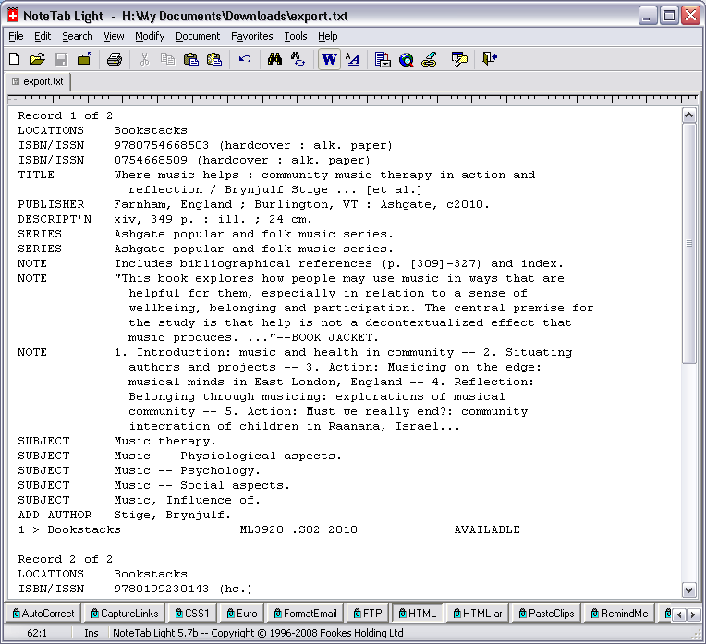
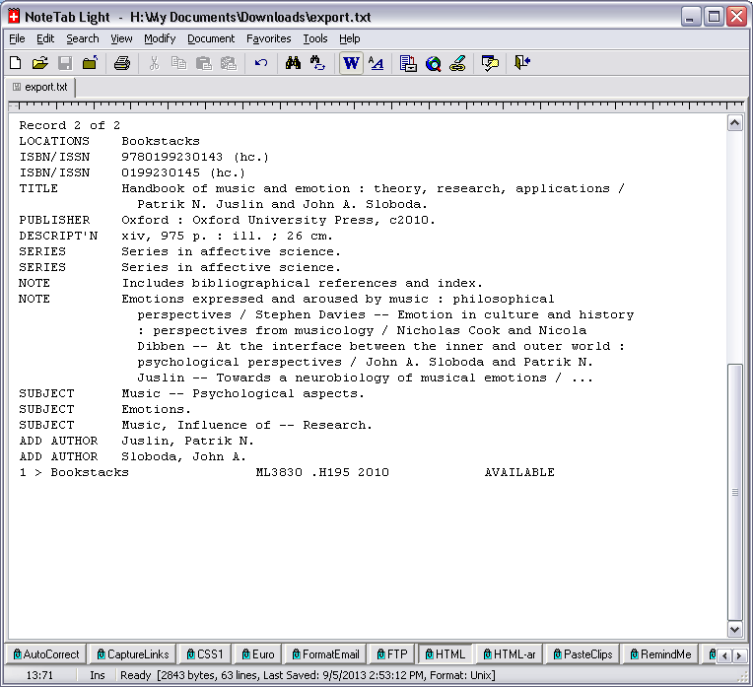
Notes:
Clicking the “Format for Print/Save” button brings up the formatted text version of the SUMMIT records for the citations that you check-marked on the results screen.
Note that each field has a clearly delineated field label -- e.g., “Title:”, “Author:”, “Published:”, “Subjects”, etc. -- and that each field is separated by an empty line. In this way RefWorks, by using the corresponding filter for this data format, can parse each record and import them cleanly as bibliographic entries.
To deliver these citations to RefWorks, you need to either save the page as a text file or simply highlight and copy the text for pasting into RefWorks.
Because RefWorks requires meticulously formatted export formats and a corresponding filter to decode them, it cannot therefore parse citations stored in a given style as, say, a bibliography stored in a Word document. Some third-party tools are on the horizon that may address this problem but, for now, you may have to enter them into RefWorks manually.

Slide 22
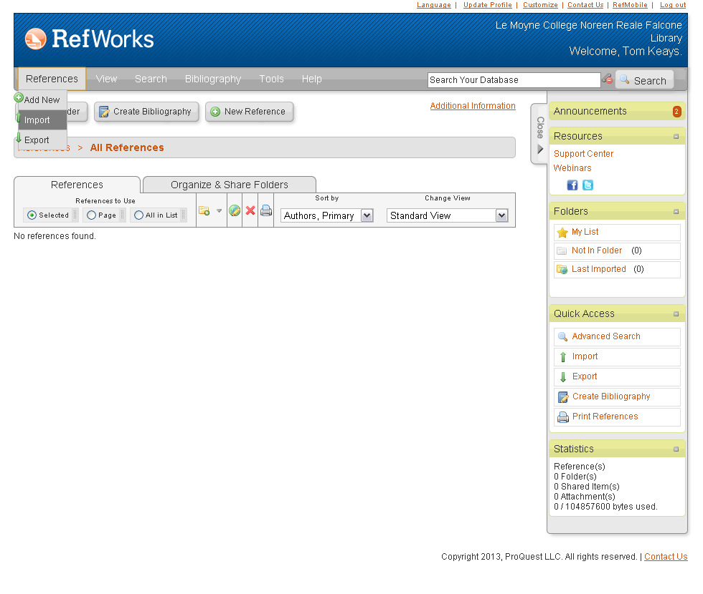
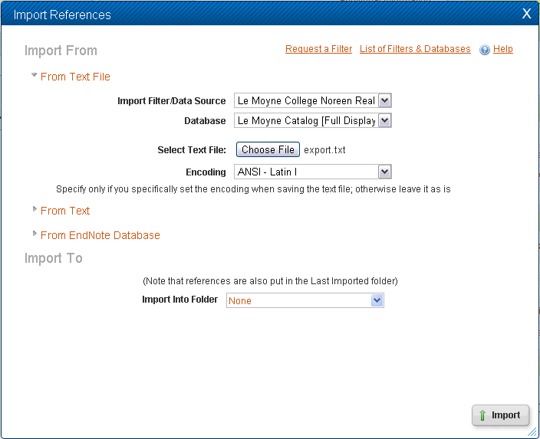
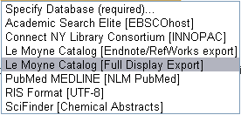
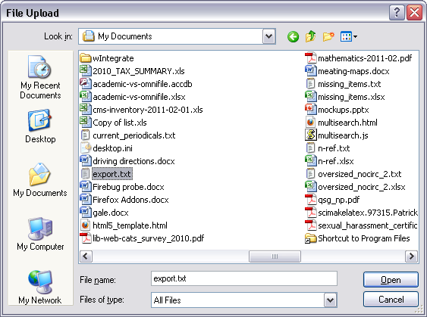

Slide 23
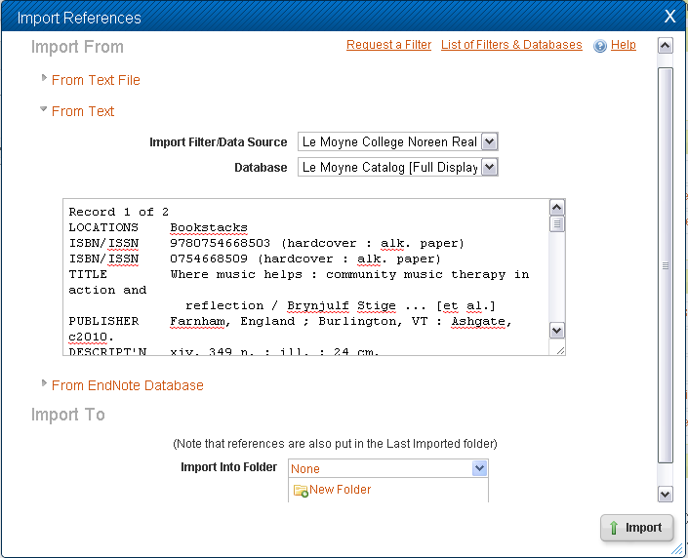

Slide 24
Notes:
As citations are imported into RefWorks, a progress message is displayed followed by a line of asterisks -- one for each citation you are importing -- and when the job is complete, a “View Last Imported Folder” button will display.
Click the “View Last Imported Folder” button.

Slide 25
Notes:
Now we’re in the “Last Imported” folder.
We’ll explore folders a bit later, including how to create new folders of your own, but for now, just keep in mind that the “Last Imported” folder is one of the system structures that RefWorks itself provides. Specfically, this folder is a staging area that almost every citation, except those entered manually, passes through. As new citations enter the “Last Imported” folder, previous citations are bumped out.

Slide 26
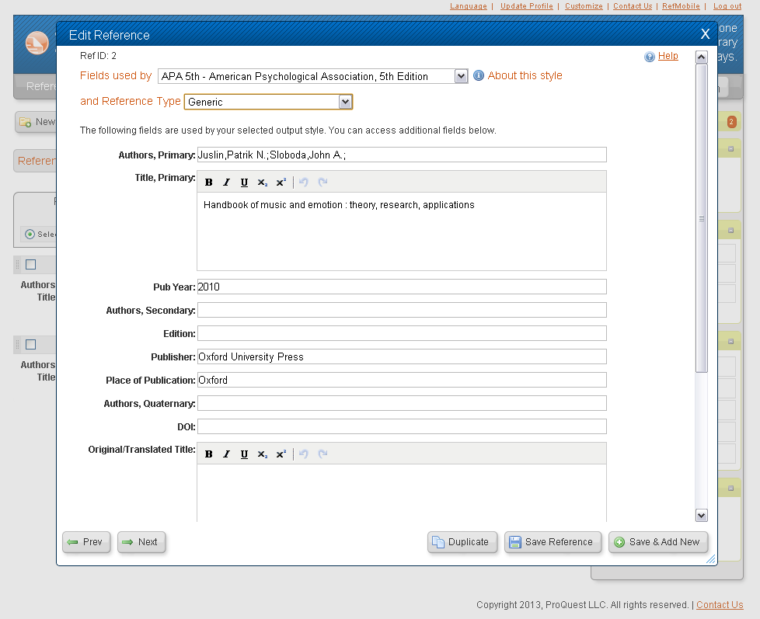
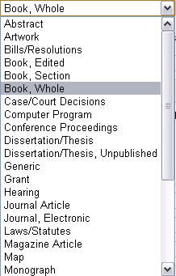

Slide 27
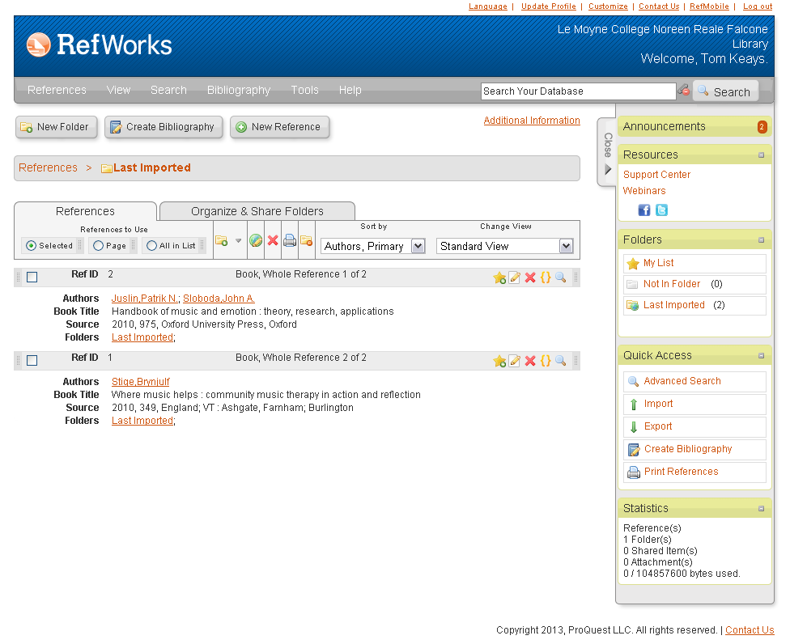
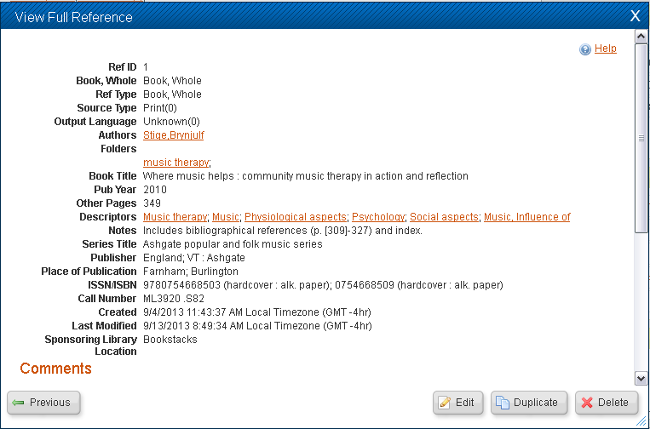

Slide 28
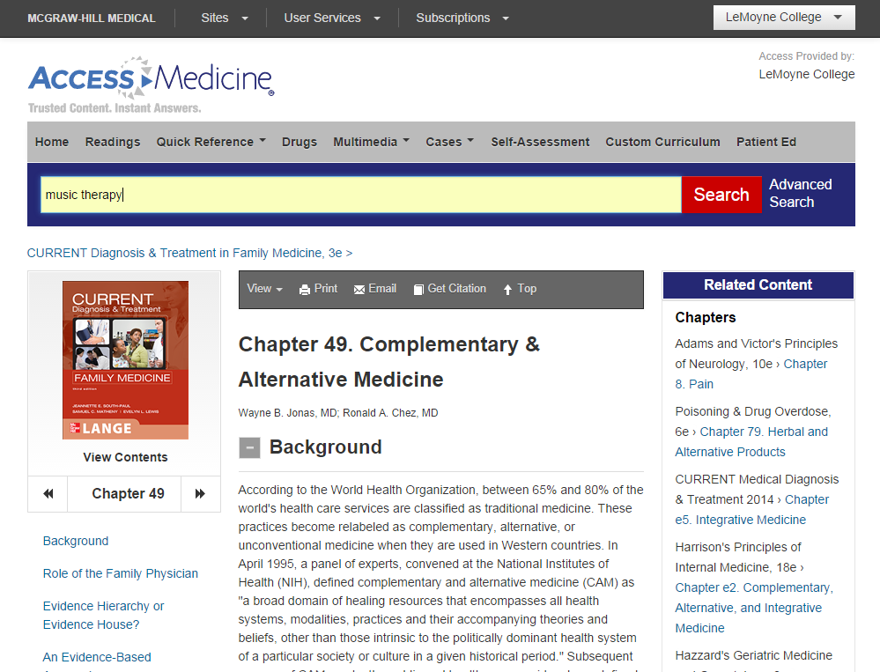

Slide 29
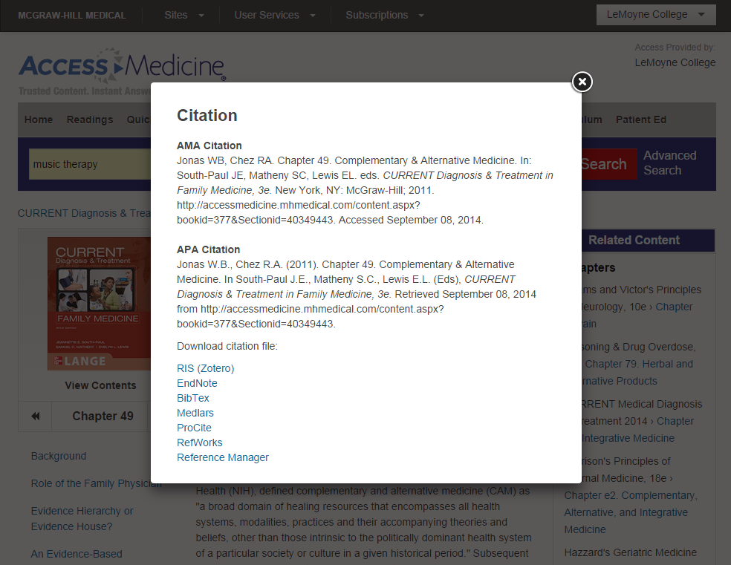

Slide 30
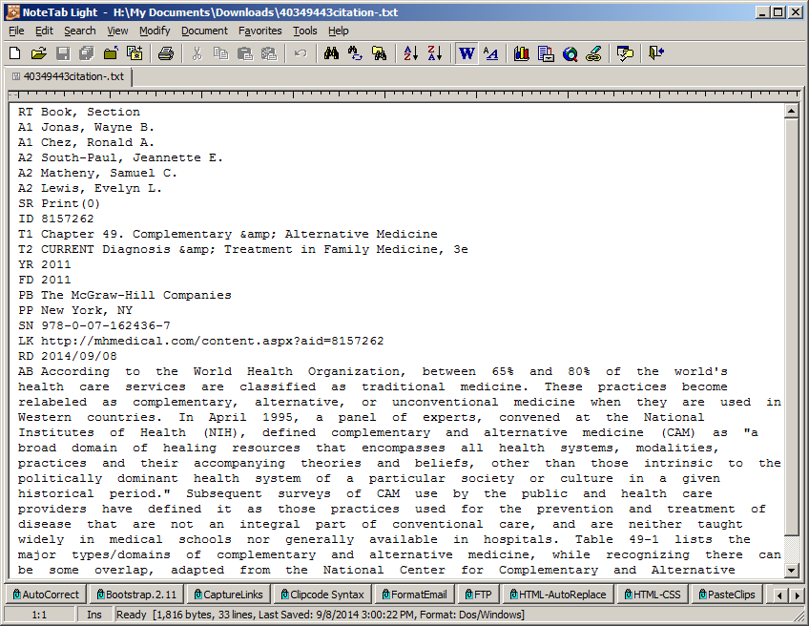

Slide 31
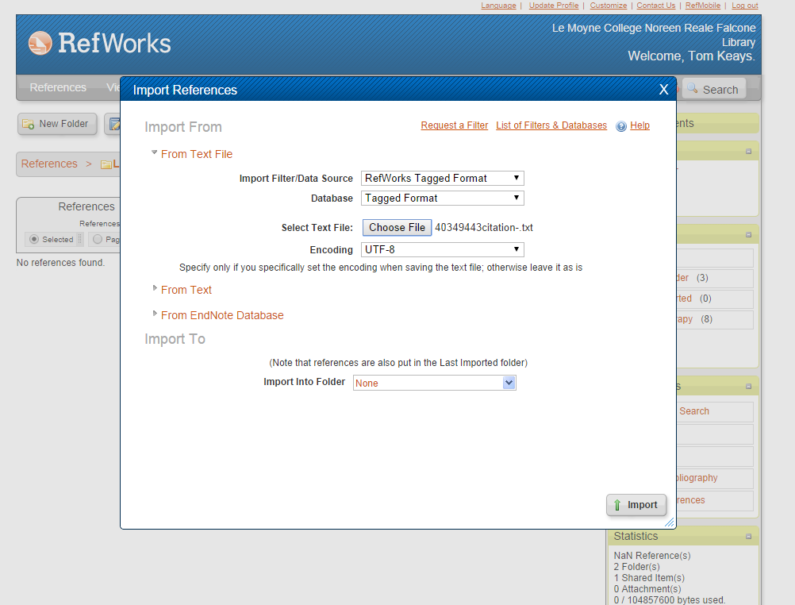

Slide 32
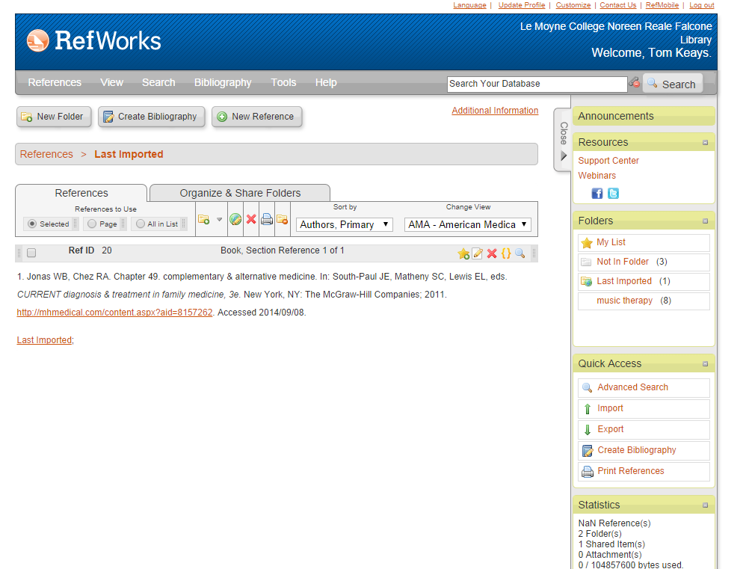

Slide 33
Adding citations to RefWorks
Manually enter citations
Manually Import citations from a text file or by copying and pasting
Direct Export citations from a database (if that feature is supported)
Notes:
Exporting citations via direct export from a research database Is the most common ways that you get references into RefWorks.
Note that we’ll need to leave the “References” menu of RefWorks to do this. In fact, we’ll leave RefWorks entirely and initiate the export process from outside -- e.g., a research database such as “LISA”.

Slide 34
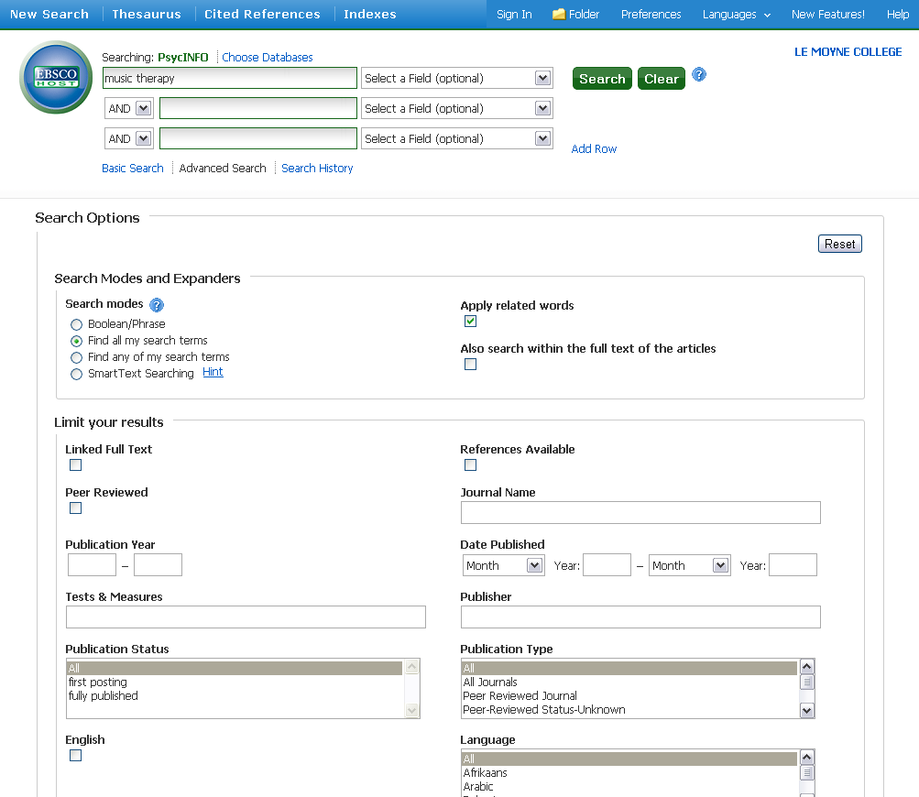

Slide 35
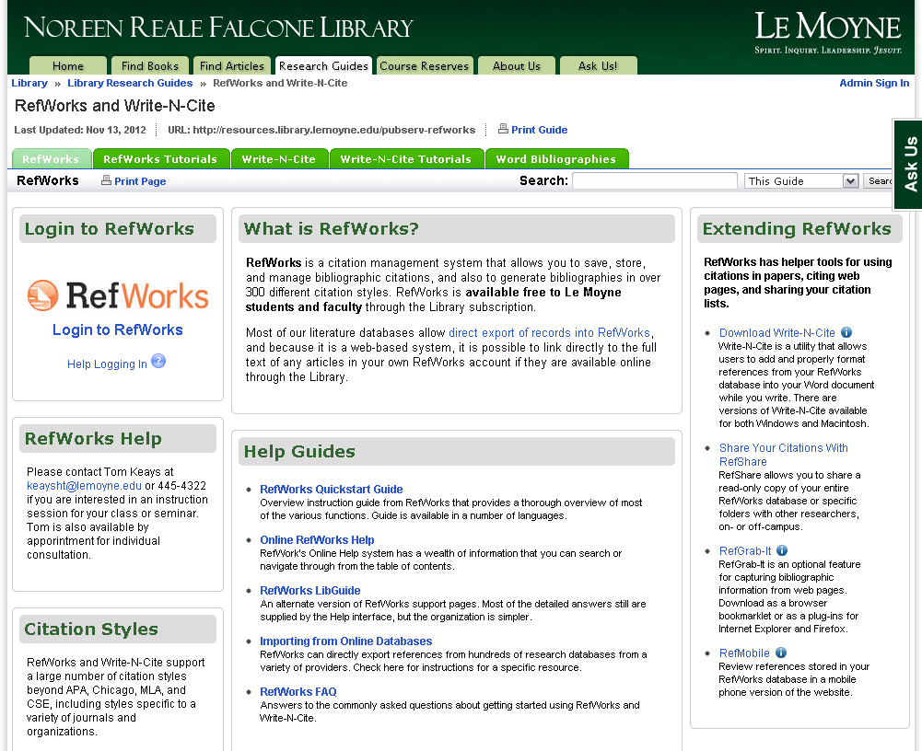

Slide 36
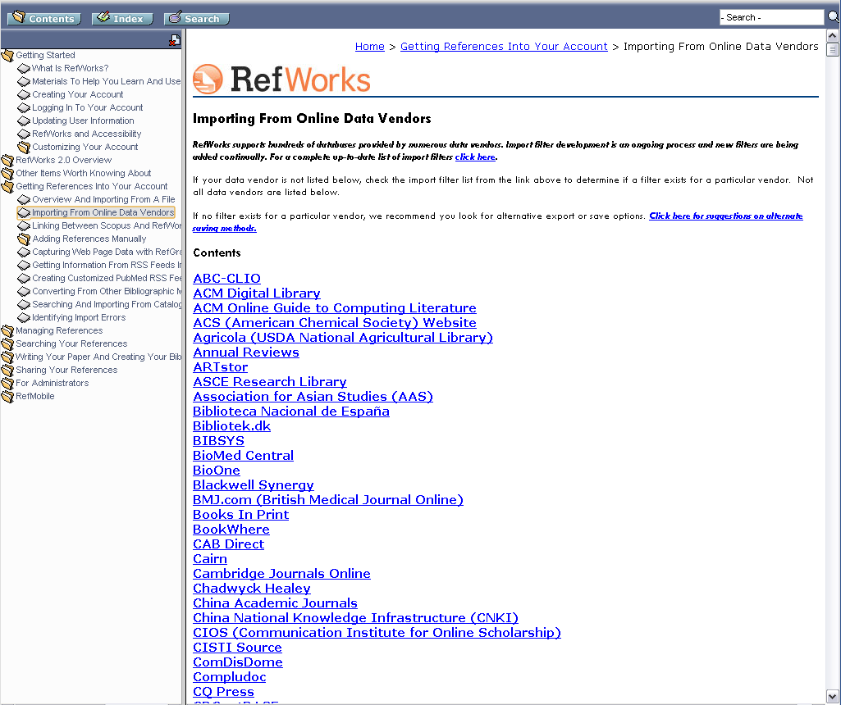

Slide 37
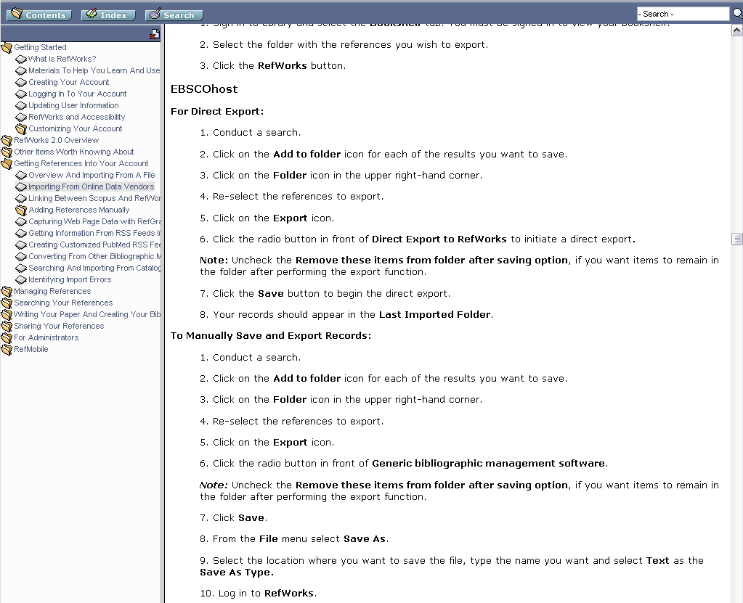

Slide 38
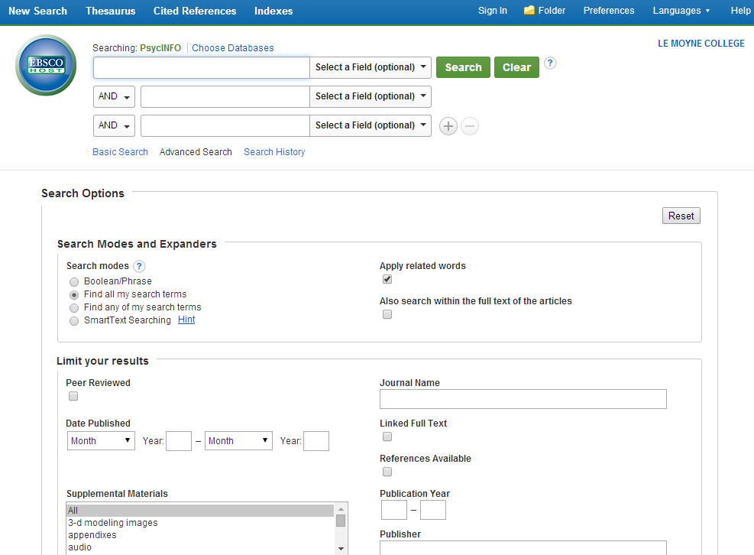

Slide 39
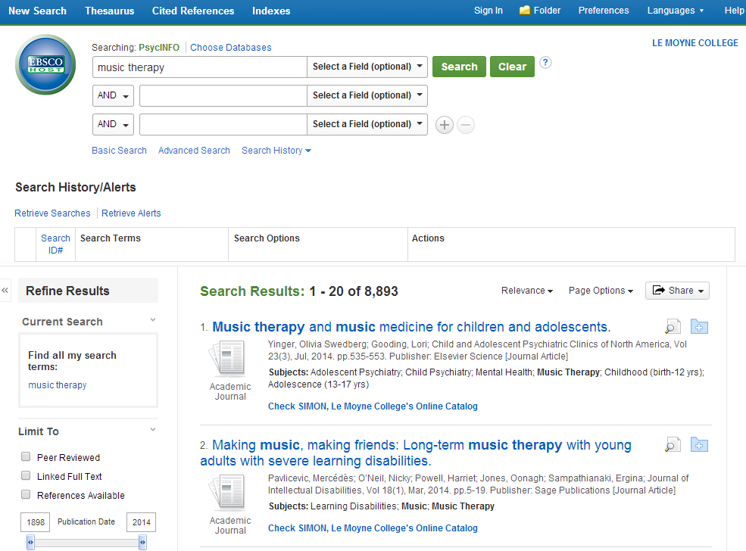

Slide 45
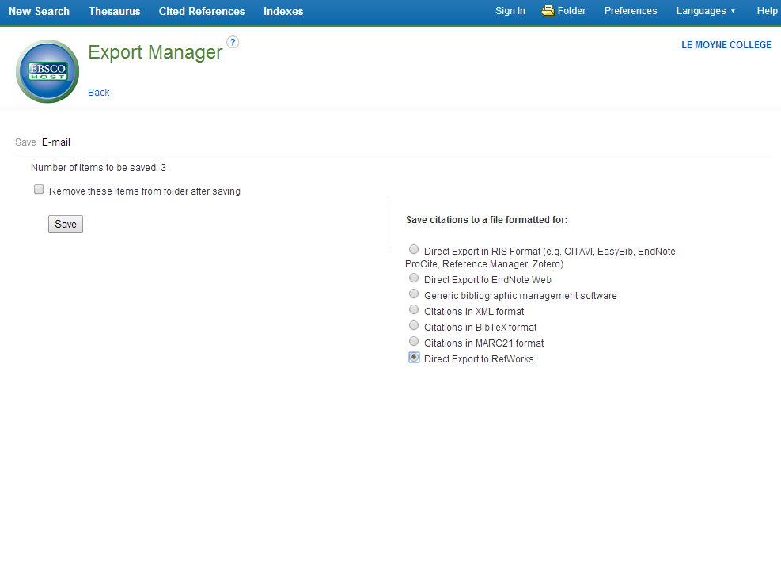

Slide 46
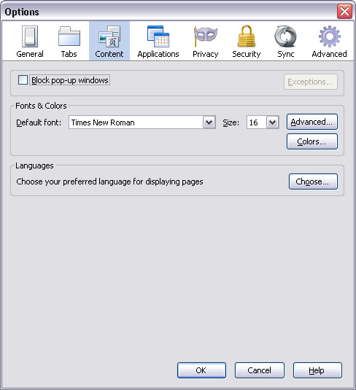
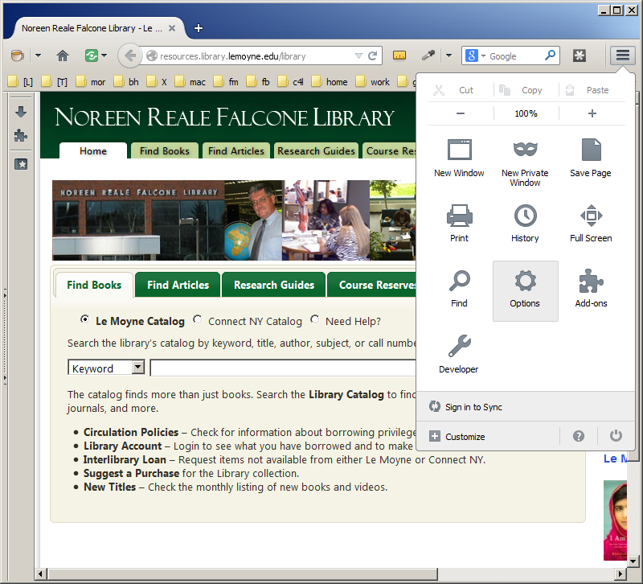
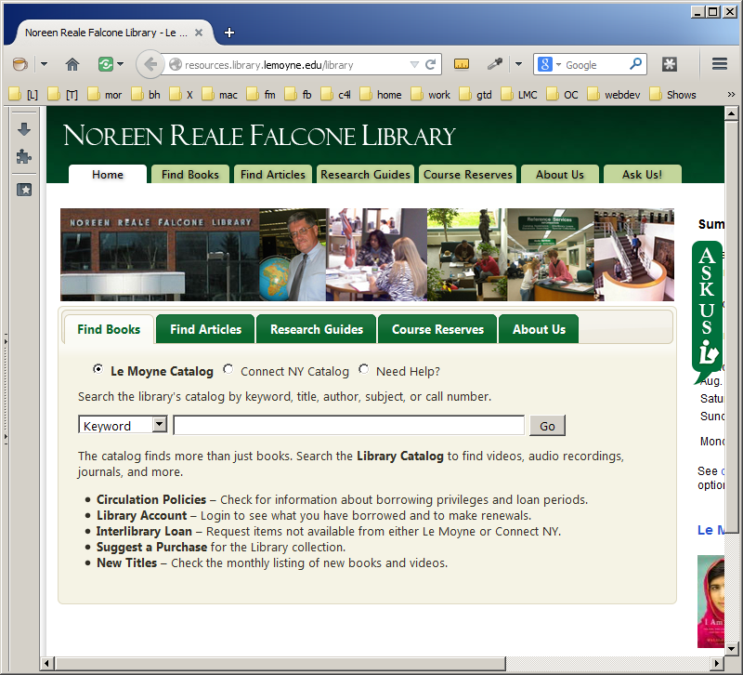
Turn off pop-up blockers
Firefox (Mozilla)
Notes:
This will open an “Options” window.
Select the “Content” tab and uncheck the box next to “Block pop-up windows” and click “OK”.

Slide 47
Turn off pop-up blockers
Internet Explorer
Notes:
Caveat: Exporting won’t work if your browser is set to block pop-up windows. Since the export windows generally are opened using JavaScript, your browser will interpret these as pop-ups, even if you initiated them by clicking.
In IE, just “Turn Off Pop-up Blocker” from the “Pop-up Block” option of the “Tools” menu.

Slide 48
Turn off pop-up blockers
Google Chrome

Slide 50
Notes:
When you click the “Export to RefWorks” button, a new RefWorks window or tab opens in your browser (even if RefWorks is already open in another window or tab). The overuse of multiple windows is one of the annoying and confusing things about RefWorks.
The progress bar will track citations as they are imported into RefWorks. When it is done, a final tally displays.
Click the “View Last Imported Folder” button.

Slide 51
Notes:
The “Last Imported” folder now shows the references we marked and exported from the “PsycINFO” database.
This is a good time, while your database search results are still available for comparison, to examine your imported results and make sure that RefWorks hasn’t messed anything up.

Slide 52
Organize citations within Refworks
Creating and naming folders
Moving references into folders
Notes:
Once you have a set of references in your RefWorks database, you may eventually want to start putting them in folders by topic. This is not necessary, but is an expedient for browsing large databases.
Next we’ll see how to create new folders and how to put citations into folders.

Slide 53
Notes:
[Instructor’s note: Explore the “View” and “Folders” menus. Show the options that are shared by both (redundant) and those that are unique.]
Choose “Create New Folder” from the “New Folders” button.

Slide 56
Notes:
Select a few references or click the “Page” or “All in List” radio buttons.
Choose the appropriate folder from the “Put in Folder…” select menu.
Note that your folders will display in red and system folders display in black.

Slide 63
Adding citations to RefWorks
Manually enter citations
Manually Import citations from a text file or by copying and pasting
Direct Export citations from a database (if that feature is supported)
Search > Online Catalog or Database
Notes:
The last method is really only truly useful for researchers who regularly search the PubMed biomedical database. In the case of PubMed, there is no direct export option and the export via text file option is somewhat non-intuitive.

Slide 65
Notes:
Select “Search” > “Online Catalog or Database”.

Slide 68
Notes:
Check-mark some records from the results page -- an external single-purpose RefWorks results window.

Slide 69
Notes:
Choose a folder to put references into.
Click “Import”.

Slide 71
Notes:
View the “Last Imported” folder as usual to see the results.
Assign to folders if you haven’t already.

Slide 75
Sharing References
RefShare

Slide 85
Sharing References
RefShare
Read-only password

Slide 88
Sharing References
RefShare
Read-only password
Create account for your group project

Slide 90
Bibliography
For creating bibliographies of references

Slide 94
Customizing RefWorks
Number of references displayed per screen
Citation preview settings
Set default folder

Slide 99
RefWorks Help
See the library guide http://resources.library.lemoyne.edu/ pubserv-refworks

Slide 102
RefWorks Help
See the library guide http://resources.library.lemoyne.edu/ pubserv-refworks
Built-in help in RefWorks

Slide 107
Introduction to RefWorks
Questions?
Notes:
That’s all folks!
What else should I go over that you wished I had?
Thanks for inviting me here today. I hope the session was worth your while.
Contact us via the Citation Support pages or the AskUs icon if you have questions later.

