Slide 2
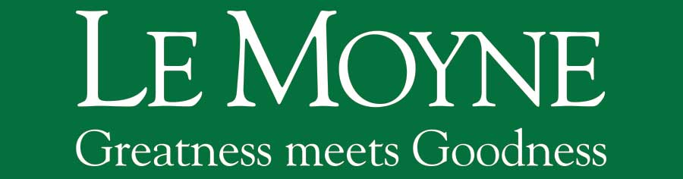
Open Educational Resources
Tom Keays, Falcone Library
#OPEN
Notes:
Introduction…

Slide 3
#OpenLeMoyne
Open source.
Open access.
Open society.
Open education.
Open data.
Open government.
Pomerantz, Jeffrey; Peek, Robin. Fifty shades of open.
First Monday, Vol.21, No.5, Apr. 2016. ISSN 1396-0466. <http://firstmonday.org/ojs/index.php/fm/article/view/6360>. doi:10.5210/fm.v21i5.6360.
#OPEN
Notes:
The term “Open Source” was coined in 1998 as a way to communicate “the pragmatic, business-case grounds” for free software. (Bruce Perens and Eric Raymond, Open Source Initiative). The Free Software Definition (1985) defines the “free” in free software as being about liberty, not price: it is consistent with the principles of free software to sell copies. What makes software “nonfree” (proprietary) is if it restricts any of the four essential freedoms, thereby exerting control over the user. As Stallman writes, “you should think of ‘free’ as in ‘free speech,’ not as in ‘free beer’.”
“Open Access” is defined most commonly in terms of scholarly literature and has to do (usually) with free online access to written works. Like “open source” before, one way it can accomplish this is through licensing.
The term “Open Society” was coined prior to World War I, to indicate a society tolerant of religious diversity. A more recent spin is the Open Society Foundations, a philanthropic organization headed by George Soros, to advancing justice, education, public health and independent media by creating open societies in place of authoritarian forms of government.
“Open Education” -- “sharing is probably the most basic characteristic of education: education is sharing knowledge, insights and information with others, upon which new knowledge, skills, ideas and understanding can be built” (Open Education Consortium, n.d.). MIT Open Courseware. MOOC (Massive Open Online Courses) s.a. Coursera, Udacity, MITx, etc., OER (Open Educational Resources).

Slide 4
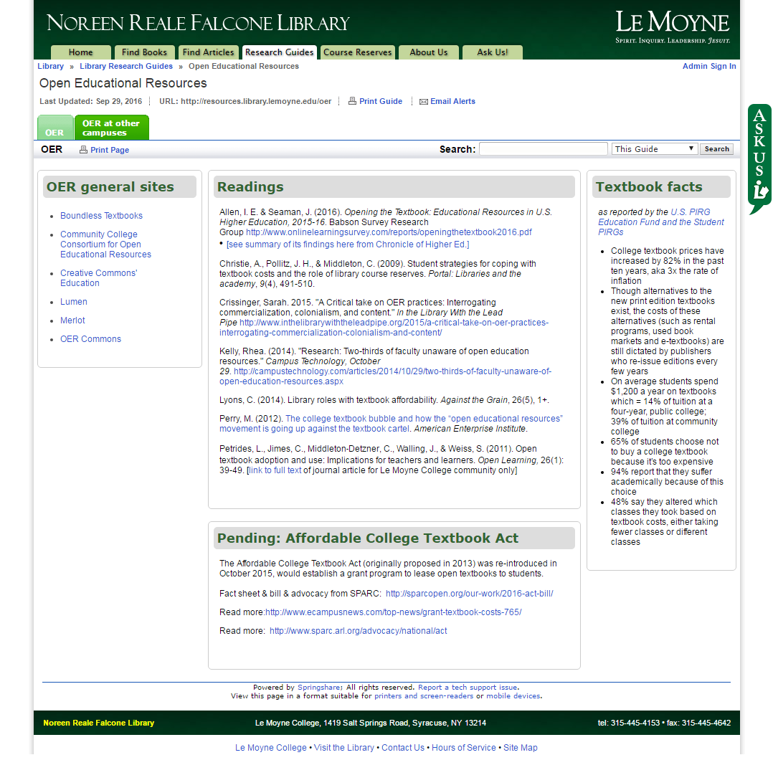
#OPEN
http://resources.library.lemoyne.edu/oer
Notes:
I’ll refer to the Open Educational Resources library guide in lieu of a handout.
It has a short bibliography of articles about OER as well as a number of useful links.
Open Educational Resources depend on Open Access.
But to understand Open Access, you need to understand the basics of Copyright.

Slide 5
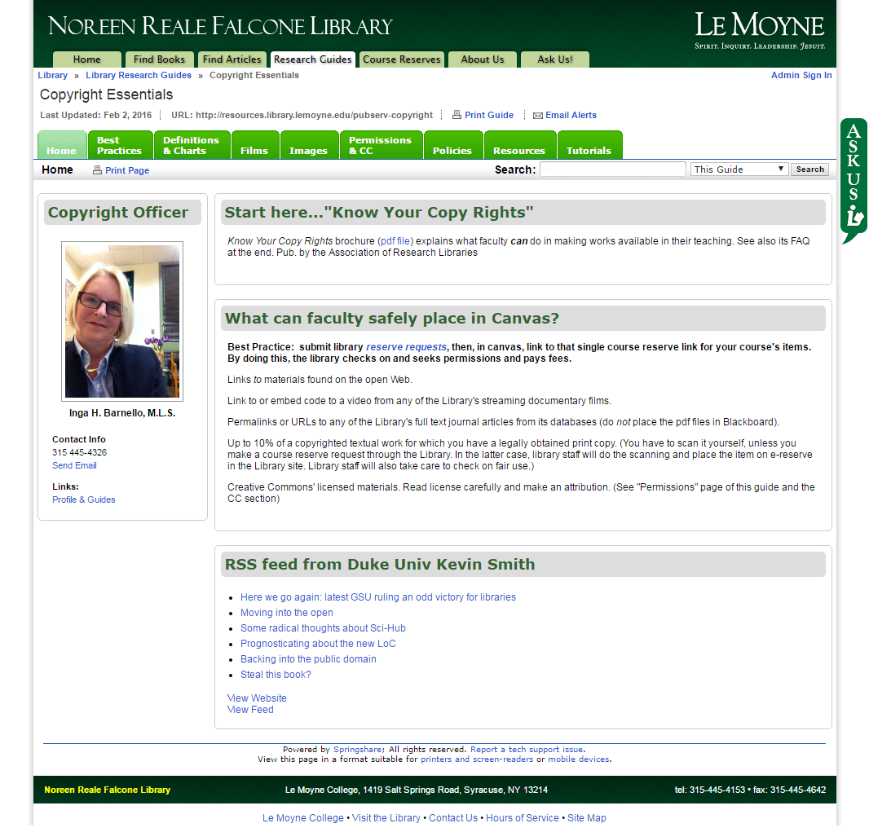
#OPEN
http://resources.library.lemoyne.edu/pubserv-copyright
Notes:
Inga Barnello is the Copyright Officer for the College. She maintains a series of pages designed to help faculty with questions regarding the use of intellectual property in teaching and research. I’m showing the Copyright Essentials library help guide, http://resources.library.lemoyne.edu/pubserv-copyright, but she has many others that you might wish to consult.
Both Inga, myself, and all of the librarians can be found in the Noreen Reale Falcone Library and are available for consultation.

Slide 6
Copyright Management
The Library is available to assist faculty, students, and staff who own the copyright to work produced at the College to:
Understand what U.S. copyright law protects.
Understand their exclusive rights under the law, and the legal exceptions and limitations on their exclusive rights.
Manage their copyrights effectively.
#OPEN
Notes:
So first principles, you can’t talk about open resources without first understanding copyright. And specifically, understanding your role in managing copyright for the works that you create. It all starts with copyright.
Also, by understanding how copyright applies to your work, it will help you better understand how you can use other author’s work in your teaching and research.
The Copyright Management section is derived from Carnegie Mellon Library’s “Guidelines on Author Rights and Preservation”
https://libwebspace.library.cmu.edu/libraries-and-collections/Services/Copyright/CMU_AuthorRights_Preservation_Guidelines_May2013.pdf

Slide 7
Copyright Management
In the United States, copyright protects
“original works of authorship fixed in any tangible medium of expression, now known or later developed, from which they can be perceived, reproduced, or otherwise communicated, either directly or with the aid of a machine or device.”
Copyright does not protect facts, ideas, procedures, processes, systems, methods, concepts, principles, or discoveries, “regardless of the form in which these are described, explained, illustrated, or embodied” in a copyrighted work (U.S.C. 17 §102). http://www.copyright.gov/title17/92chap1.html#102
#OPEN
Notes:
Copyright owners should understand what the U.S. Copyright Act protects. Basically, if you create it, you automatically own the copyright.
Copyright does not protect mathematical or physical observations, including formulas or data derived from observations or calculations. It means that charts of such data in published works might not themselves be protected by the copyright that covers the rest of your book or article.
Commercial publishers, of course, will be glad to resell your work and, in fact, make a good business licensing works that are probably public domain.

Slide 8
Copyright Management
Copyright owners have the exclusive rights to copy and distribute their work, to perform or display it publicly, and to make derivative works.
If someone else wants to use the work, the copyright owner’s permission is required…
unless the use is granted by a licensing agreement or an exception or limitation in the Copyright Act – e.g., “fair use”, TEACH Act, or other exceptions.
(U.S.C. 17 §106). http://www.copyright.gov/title17/92chap1.html#106
#OPEN
Notes:
Copyright owners should understand their exclusive rights under the law, and the legal exceptions and limitations on their exclusive rights.
In scholarly works, the right that matters most is attribution – you don’t want somebody else appropriating your work as their own.
Fair use is the common exception in teaching – you can put a physical book on reserve You can also place a scan of an article or scan of a chapter from a book on reserve.
The TEACH (Technology, Education and Copyright Harmonization) Act of 2002 expands the scope of educators' rights to perform and display works and to make the copies integral to such performances and displays for digital distance education, making the rights closer to those we have in face-to-face teaching. Section 110(1) of the Copyright Act already provides educators with a separate set of rights in addition to fair use, to display (show) and perform (show or play) others' works in the classroom. These rights are in Section 110(1) of the Copyright Act and apply to any work, regardless of the medium. https://copyright.lib.utexas.edu/teachact.htmlLicensing can extend your rights: You can LINK to entire books from Books24x7 or ProQuest Academic Complete since the library pays for a commercial license that allows just that. You can link to articles in our e-journal and full-text database collections because our licenses allow that. You can’t download that book or article and put it in Canvas or email it a colleague.

Slide 9
Copyright Management
Copyright owners can legally transfer their exclusive rights, individually or grouped, to someone else.
The transfer can be exclusive or non-exclusive.
With an exclusive transfer of a right, the author loses that right and cannot transfer or license that right to others.
With a non-exclusive transfer, the author still retains the transferred right and can transfer or license that right to others.
#OPEN
Notes:
Scholarship has always been an open process; the idea of open science dates back to the very origin of modern science. One of the foundations of the scientific method is that all work must be reproducible, and the only way for that to happen is if all processes are performed openly.
The legal scholar Lawrence Lessig has documented the expansion of copyright under U.S. law over the past 40 years. Lessig argues that this expansion, far from promoting “the Progress of Science and useful Arts” (as specified in the U.S. Constitution, Article I, Section 8), actively inhibits it, and that the modern U.S. is becoming a “permissions culture” rather than a “free culture”: in other words, that the default legal position is that one must gain permission to make use of a creative work, rather than the default being that one is free to do so.
The culture of scholarly publication has been to assign copyright exclusively to publishers.
Open Access wants to overturn this so non-exclusive rights transfers become the new norm.

Slide 10
Copyright Management
Manage your copyright effectively.
With rare exception, the interests of authors, academic disciplines, funding agencies, and the College are best served by open access and open licensing.
  Le Moyne Library encourages authors to be wary of exclusive transfer of their copyrights, particularly to commercial publishers.
#OPEN
Notes:
Exclusive transfer of all copyrights to a publisher can yield odd outcomes, for example, authors having to request permission or pay to use their own work.

Slide 11
What is “Open Access”?
Minimum: content is freely available online
#OPEN
Notes:
Firstly, OA materials have to be published in electronic format – PDF, Word, LaTeX, etc.
Secondly, they have to be placed on a networked server – i.e., on the world-wide web, on an FTP server, or some other internet server – accessible without restrictions – without passwords or other DRM – to anyone who wants it.

Slide 12
What is “Open Access”?
Minimum: content is freely available online
Best: content freely available online
+
non-exclusive usage rights granted by owner of the work.
  Author defines a license for use.
  Removes two barriers to access:
  price and permission.
#OPEN
Notes:
Peter Suber, Director of the Harvard Office for Scholarly Communication and Director of the Harvard Open Access Project, suggests that OA removes two types of barriers: price and permission.
In 2002 the Budapest Open Access Initiative issued the first formal declaration on Open Access: referring specifically to scholarly literature, OA is defined as “its free availability on the public internet, permitting any users to read, download, copy, distribute, print, search, or link to the full texts of these articles, crawl them for indexing, pass them as data to software, or use them for any other lawful purpose, without financial, legal, or technical barriers other than those inseparable from gaining access to the internet itself” (Budapest Open Access Initiative, 2002).
The Bethesda Statement on Open Access Publishing (2003) promotes OA for scientific literature, though with a narrower focus on biomedical research specifically.
The Berlin Declaration on Open Access to Knowledge in the Sciences and Humanities (2003) was written to promote OA for scientific knowledge and cultural heritage broadly, and so includes not only scholarly literature, but also data, metadata, source materials, and multimedia material.

Slide 13

Creative Commons
Rights granted by
  Attribution: All distributions of a work, and derivative works based upon it, must be credited to the creator of the work.
  No Derivatives: A work may be redistributed, but only “unchanged and in whole;” no derivative works may be made based on it.
  Non-commercial: Derivative work can not be for commercial use.
  Share-alike: Derivative work must be licensed under terms identical to those of the original work.
#OPEN
https://creativecommons.org/
Notes:
The idea of Creative Commons licensing is derived from Open Source licenses. MIT, GNU, etc.
Attribution and No Derivatives are straight out of the U.S. Code. Importantly, of all the rights articulated in the U.S. Code, these are the only ones that may be reserved under a CC license.
The other two rights articulated by CC licenses (Non-commercial and Share-alike) are restrictions to the first two rights, articulating what the user can or cannot do with derivative works. Share-alike is essentially the same as the concept of “Copyleft;” both restrict the future rights of others.

Slide 14
Creative Commons
Rights granted by
https://licensebuttons.net/
#OPEN
Notes:
Mix and match rights

Slide 15
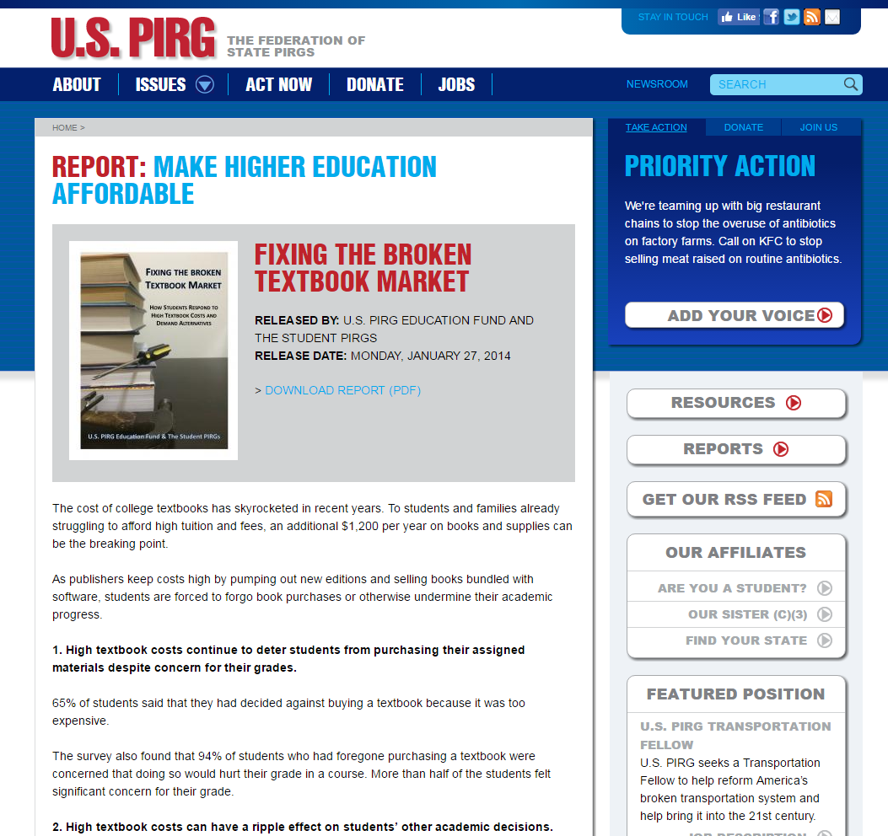
#OPEN
http://www.uspirg.org/reports/usp/fixing-broken-textbook-market

Slide 16
Fixing the Broken
Textbook Market
College textbook prices have increased by 82% in the past ten years – 3x the rate of inflation
Though alternatives to the new print edition textbooks exist, the costs of these alternatives (such as rental programs, used book markets and e-textbooks) are still dictated by publishers who re-issue editions every few years
On average students spend $1,200 a year on textbooks which = 14% of tuition at a four-year, public college; 39% of tuition at community college
65% of students choose not to buy a college textbook because it’s too expensive
94% report that they suffer academically because of this choice
48% say they altered which classes they took based on textbook costs, either taking fewer classes or different classes
#OPEN
http://www.uspirg.org/reports/usp/fixing-broken-textbook-market

Slide 17
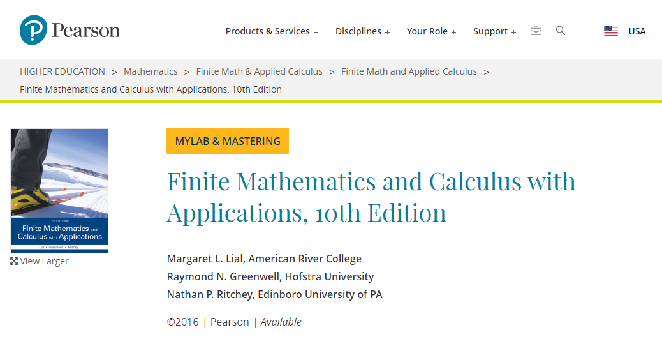
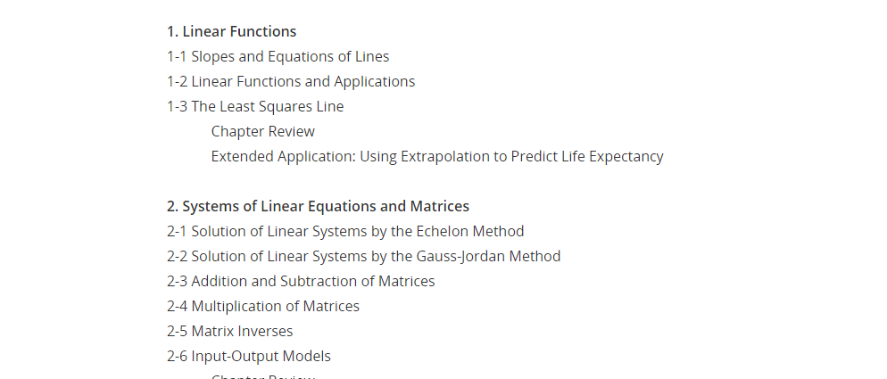
$238.40 List
$219.60 Textbooks.com
$202.63 Amazon
$142.99 rent, no expire
$97.99 rent 180 days
$56.38 rent Amazon
(semester)
$166.35 Amazon (used)
$91.31 B&N (used)
$52.73 AbeBooks (used)
$103.95 MyMathLab
#OPEN

Slide 18
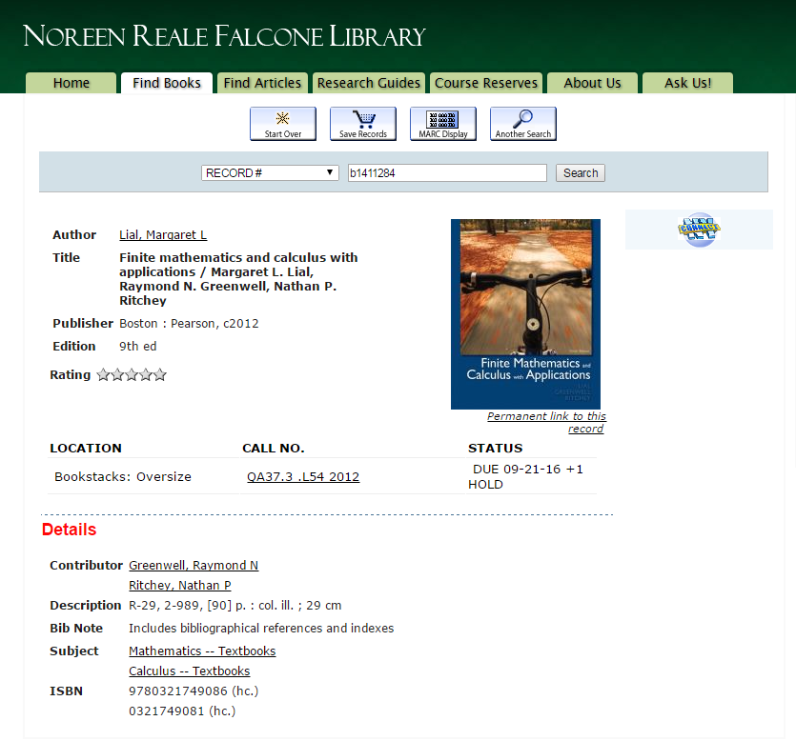
#OPEN

Slide 19
OER
Open Educational Resources
  Educause OER resources (2016) http://tinyurl.com/educause-oer-2016
  Open Textbooks – textbooks released with some sort of CC or PD license.
  "Opening the Textbook: Educational Resources in U.S. Higher Education, 2015-16" (Babson Survey Research Group, 2016) http://www.onlinelearningsurvey.com/
#OPEN
Notes:
Survey of 3,000 full-time and part-time professors
Awareness of free or openly licensed educational resources, including textbooks and other teaching materials, has increased slightly over the past year, but still only 6.6 percent of faculty members are "very aware" of them.
87 percent [of faculty surveyed] said the cost to the students had been important or very important to them. But the survey also found that only about 5 percent of those professors had assigned a free or openly licensed textbook.
professors who teach large-enrollment introductory courses were adopting openly licensed materials at twice the rate of the general faculty population
perceived barriers to using the materials: 49 percent said "there are not enough resources for my subject"; 48 percent said it is "too hard to find what I need"; and 45 percent said "there is no comprehensive catalog of resources."
Source: Blumenstyk, Goldie . More Professors Know About Free Textbook Options, but Adoption Remains Low. Chronicle of Higher Education, July 26, 2016. http://chronicle.com/article/More-Professors-Know-About/237252

Slide 20
Opening the
Textbook
Survey of 3,000 full-time and part-time professors
Increased awareness in past year, but only 6.6% of faculty are “very aware” of OER textbooks.
87% said cost to student very important, but only 5% of them had assigned an open textbook.
Large enrollment classes adopting twice the rate of general faculty population.
Perceived barriers:
  Not enough resources for my subject (49%)
  Too hard to find what I need (48%)
  No comprehensive catalog of resources (45%)
#OPEN
  http://www.onlinelearningsurvey.com/
Notes:
Survey of 3,000 full-time and part-time professors
Awareness of free or openly licensed educational resources, including textbooks and other teaching materials, has increased slightly over the past year, but still only 6.6 percent of faculty members are "very aware" of them.
87 percent [of faculty surveyed] said the cost to the students had been important or very important to them. But the survey also found that only about 5 percent of those professors had assigned a free or openly licensed textbook.
professors who teach large-enrollment introductory courses were adopting openly licensed materials at twice the rate of the general faculty population
perceived barriers to using the materials: 49 percent said "there are not enough resources for my subject"; 48 percent said it is "too hard to find what I need"; and 45 percent said "there is no comprehensive catalog of resources."
Source: Blumenstyk, Goldie . More Professors Know About Free Textbook Options, but Adoption Remains Low. Chronicle of Higher Education, July 26, 2016. http://chronicle.com/article/More-Professors-Know-About/237252

Slide 21
#OPEN
http://resources.library.lemoyne.edu/oer
Notes:
There may not yet be an answer to the supposition that there are “not enough resources for my subject” but there are ways to find out what exists.

Slide 22

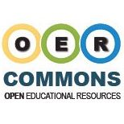



Open Textbooks
https://oerconsortium.org/find-oer/
https://www.oercommons.org/
http://collegeopentextbooks.org/
http://textbooks.opensuny.org/
https://openstax.org/
#OPEN
Notes:
Open Education Consortium – aimed at community colleges but useful for all. Lots of good finding aids. MIT is a sponsor. 300 higher education institutions and related organizations have freely shared many thousands of courses, open textbooks and other resources, and collaborated to foster widespread adoption of OERs.
College Open Textbooks – partnership with Open Education Consortium . 750+ open textbooks with 150+ content or accessibility reviews.
OpenSUNY -- leverages the expertise of the SUNY campuses that are successfully using OER. 17 textbooks, but growing.
Open Stax – a nonprofit based at Rice University, with mission to improve student access to education. 20+ books K-12 and college.
WikiBooks – “open-content textbooks collection that anyone can edit.”

Slide 23
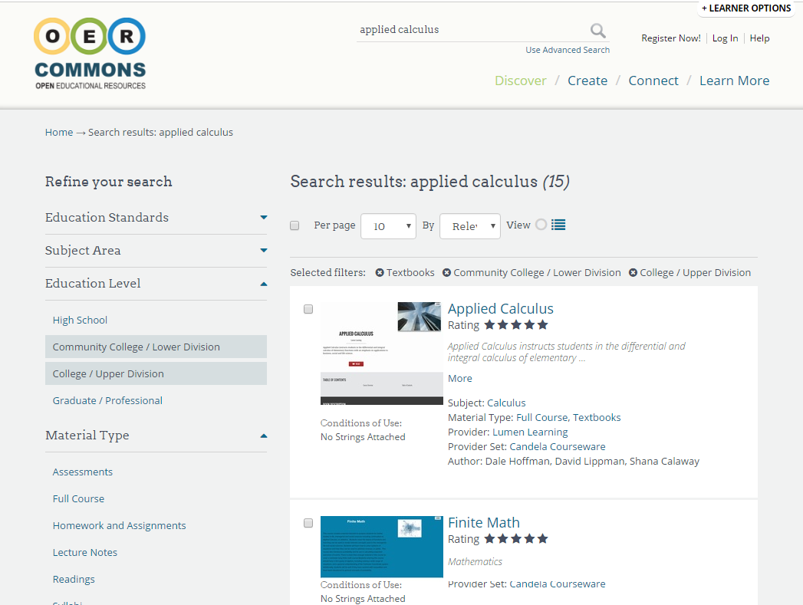
#OPEN

Slide 24
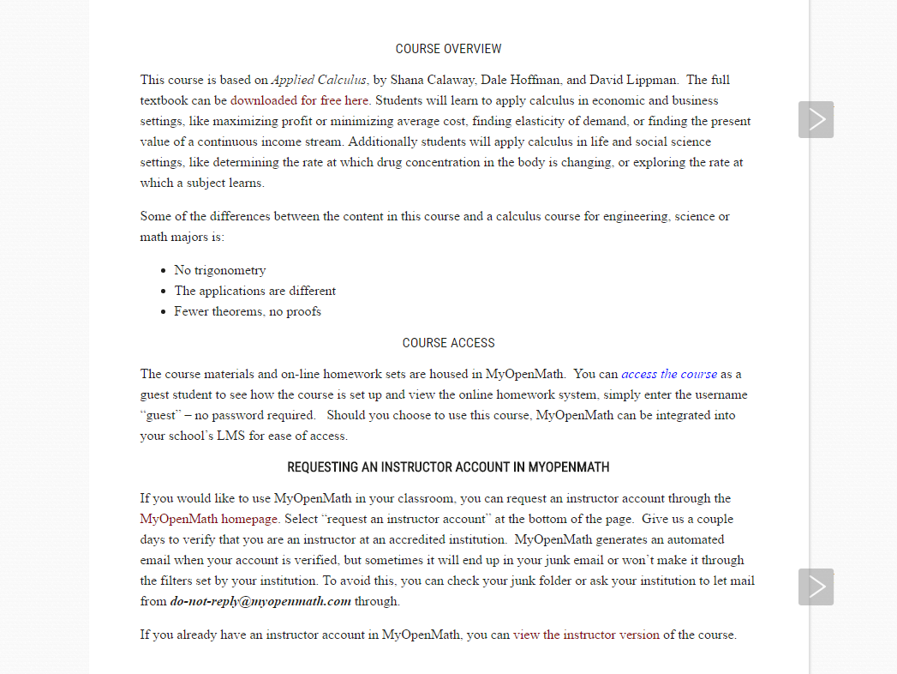
#OPEN

Slide 25
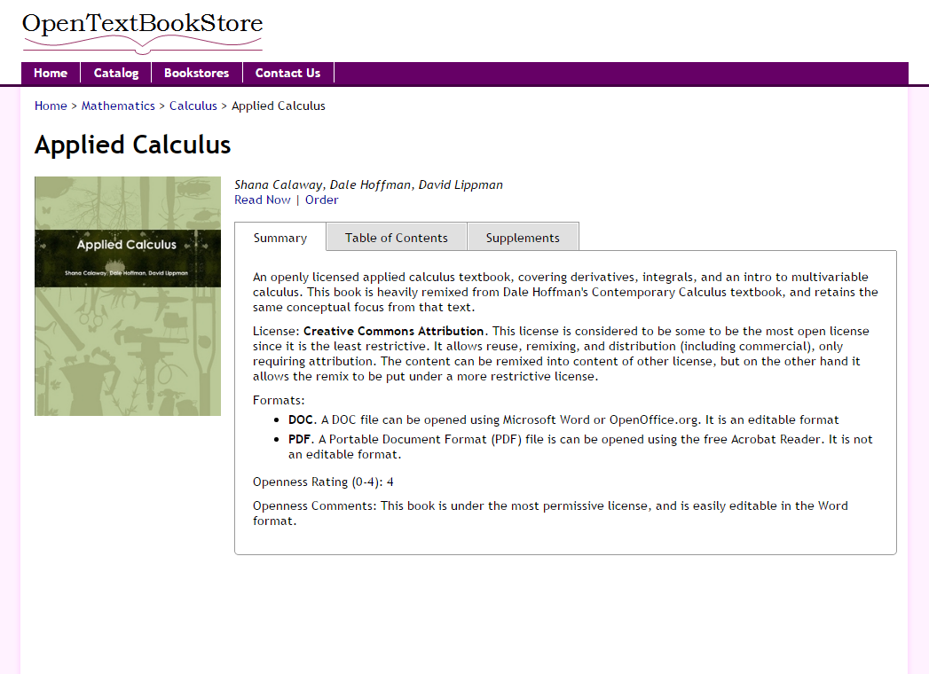
#OPEN

Slide 26
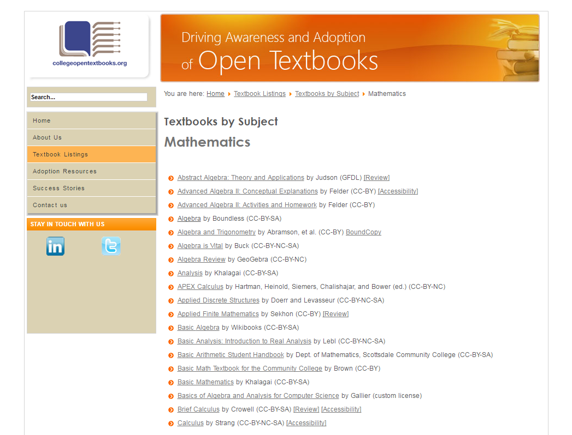
#OPEN

Slide 27
#OPEN

Slide 28
Open Courseware
Activities and Labs
Assessments
Audio Lectures
Case Study
Data
Full Course
Games
Homework and Assignments
Images and Illustrations
Instructional Material
Interactive
Lecture Notes
Lesson Plans
Module
Primary Source
Readings
Reference
Resource Review
Simulations
Student Guide
Syllabi
Teaching and Learning Strategies
Textbooks
Unit of Study
Video Lectures
#OPEN
Notes:
Although the conversation lately has centered on open textbooks, OER has a deeper heritage than that.
Open Courseware was the original conversation starter, and includes many more educational components than just textbooks.

Slide 29
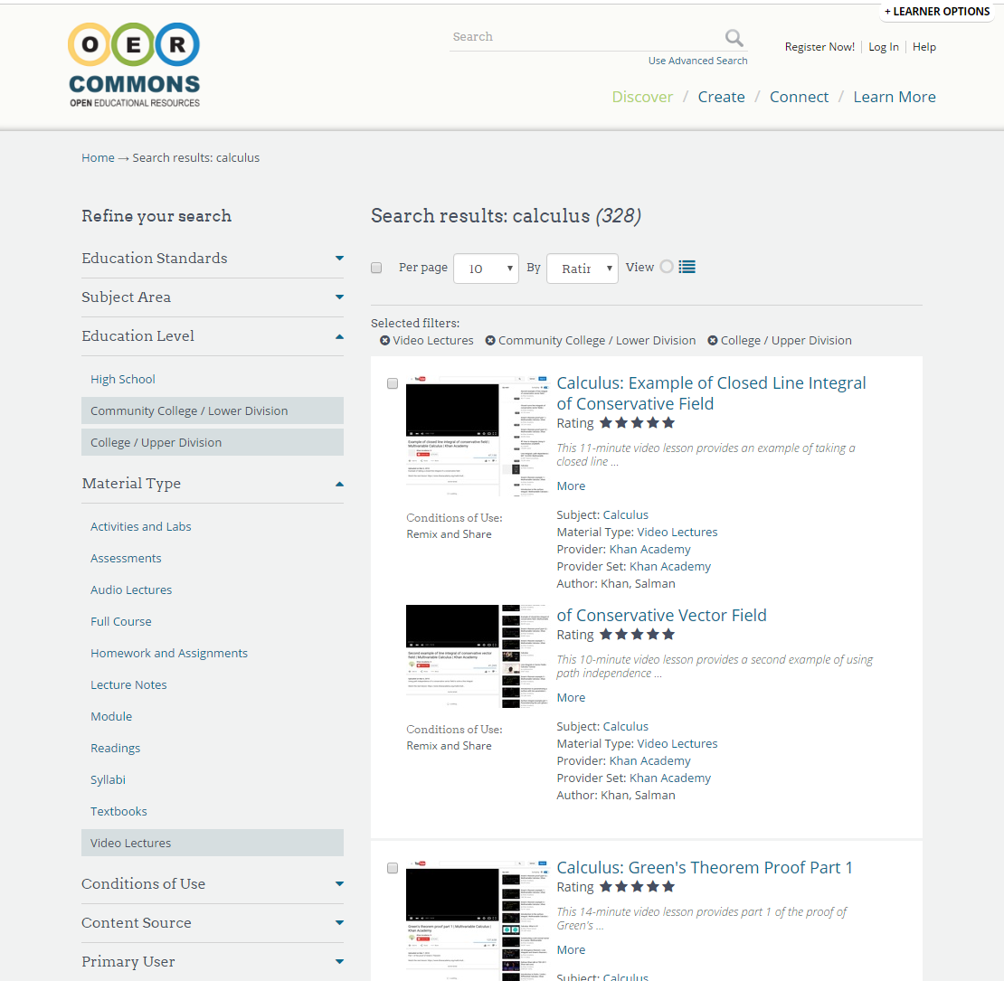
Open Courseware
#OPEN
Notes:
Although the conversation lately has centered on open textbooks, OER has a deeper heritage than that.
Open Courseware was the original conversation starter, and includes many more educational components than just textbooks.

Slide 30
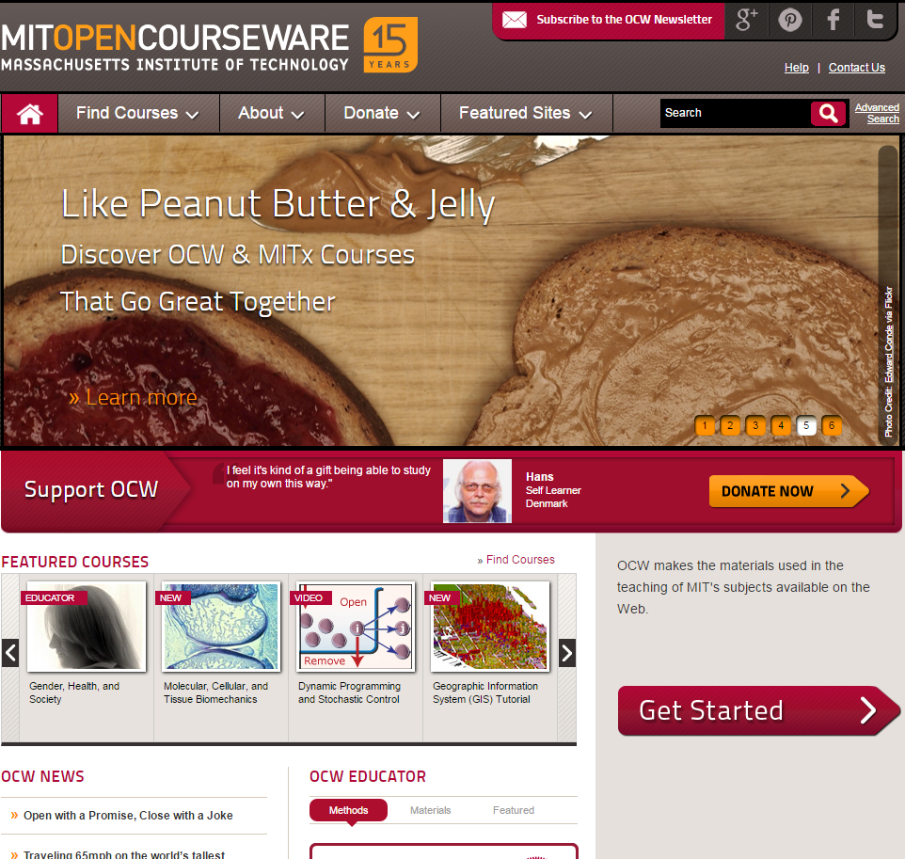
#OPEN
http://ocw.mit.edu/
Notes:
MIT OCW http://ocw.mit.edu/
2340 courses, all 5 schools, 33 academic units. 120 new courses a year.
Textbooks, syllabus, class notes, full online classes including videos. MOOCs (MITx / EdX) that you can self-enroll in or pay to take for credit.
Source: http://news.mit.edu/2016/mit-opencourseware-celebrates-15-years-open-sharing-0404

Slide 31
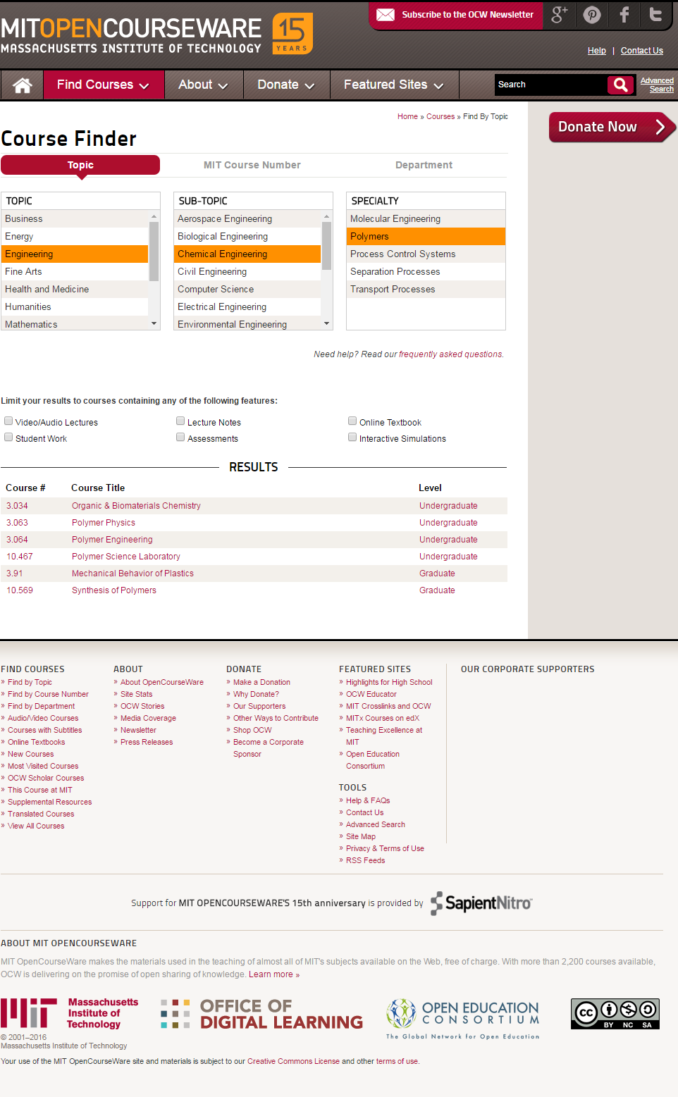
#OPEN
Notes:
MIT’s Course Finder lets you browse by topic, course number, and department.
Limit results by online lectures, lecture notes, online textbook, student work, assessments, interactive simulations.

Slide 32
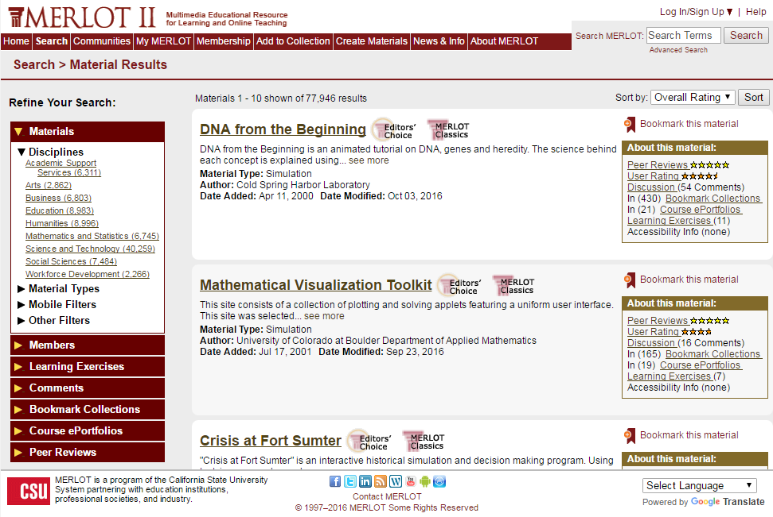
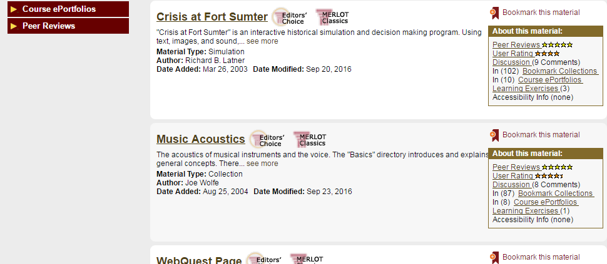
#OPEN
https://www.merlot.org/
Notes:
The MERLOT project began in 1997, when the California State University Center for Distributed Learning (CSU-CDL at www.cdl.edu) developed and provided free access to MERLOT (www.merlot.org).
Now has contributors from all over the world.

Slide 33
#OpenLeMoyne
Questions?
Tom Keays
x4322
keaysht@lemoyne.edu
#OPEN
Notes:
The Library is here to help you with your teaching and research.

Slide 34
#OPEN
Notes:
OA Policy – for instance, would give a better context for subsidizing Article Processing Costs (APC) and specifying the types of items that will be subsidized.

Slide 35
Missing Pieces
Two things that would increase the success of Open Access at LMC:
  Open Access Policy
    Mandate open access by LMC authors
    The Senate working with the Provost
    Subsidizing Article Processing Charges
  Institutional Repository
    Showcase for Le Moyne scholarship
    Provost Office and the Library
#OPEN
Notes:
OA Policy – for instance, would give a better context for subsidizing Article Processing Costs (APC) and specifying the types of items that will be subsidized.

